Slide 1
software Architecture and AgilE Development
ALAN MESSINGER
SOURCE ARTICLE :
Agility and Architecture:Can They Coexist?
Pekka Abrahamsson, University of Helsinki
Muhammad Ali Babar, IT University of Copenhagen
Philippe Kruchten, University of British Columbia

Slide 2
WHAT IS AGILE?
http://www.agilemanifesto.org/

Slide 3
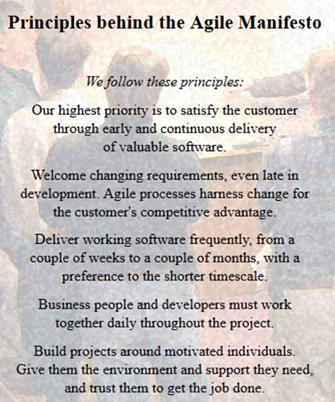
WHAT IS AGILE?
http://www.agilemanifesto.org/

Slide 4
Reasons why agile arose
Response to Waterfall and other traditional development methodologies.
Need for projects to respond better to change.
Created by developers in reaction to traditional top-down, management-heavy work environments. BUFD and YAGNI.

Slide 5
Benefits of agile
Flexibility: Changes to requirements, even late in the project life cycle can be handled with little disruption.
Increased Productivity?: Proponents of Agile claim improvements in project success.
Developer Friendly: Developers tend to prefer working in Agile environments.

Slide 6
Criticisms of agile
Not Scalable: Difficult to make Agile work across large geographically dispersed teams in complex enterprise level projects.
Not Proven: Agile is a collection of best practices based on opinion. Agile projects tend to collect few hard metrics. (working software is the primary gauge of progress)
Too Developer Friendly: Meets developer needs, not necessarily business goals. Agile is often perceived as lacking rigor or structure.

Slide 7
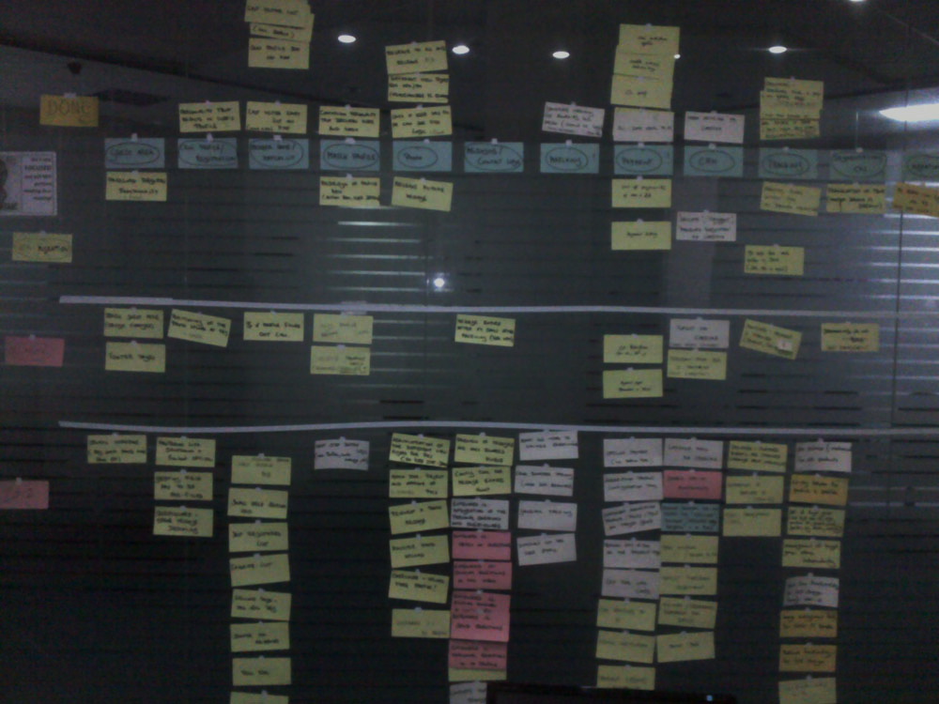
“Agile Software Development is often considered a software development process, but is actually a marketing technique developed by 3M to sell more post-it notes.”
Uncyclopedia, The Content-Free Encyclopedia

Slide 8
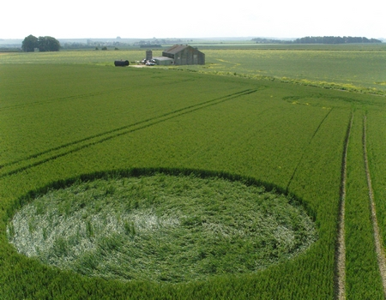
“Just as a crop circle is hard to see when you’re standing in the middle of it, we believe that much of frameworks’ accidental complexity comes from their bottom-up creation intended to give programmers, not architects, more powerful, expressive forms.”
Paul Clements & Mary Shaw
“The Golden Age of Software Architecture” Revisited

Slide 9
A closer look: COMMON Agile characteristics
Iterative and incremental life cycles,
Focus on small releases,
Collocated teams, and
A planning strategy based on a release plan driven by a feature or product backlog and an iteration plan handling a task backlog.
Source: Sanjiv Augustine, Managing Agile Projects

Slide 10
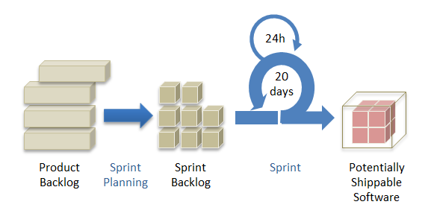
Example of an agile cycle: Scrum
Source: G3 Global

Slide 11
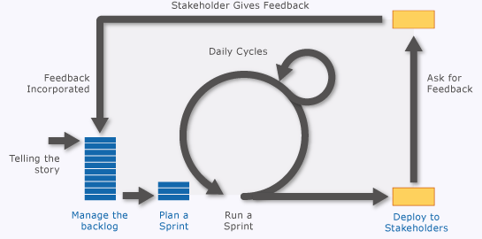
Scrum – a different look
Source: msdn

Slide 12
Ways Agile needs architecture
Communication: SCRUM meetings and Stakeholder feedback. High level communication can be aided by Architecture.
Decomposition/Sprint Planning: How to divide a project up into sprint sized blocks in an inherently architectural problem.
Non Functional Requirements: User stories tend to focus on functionality. You cannot handle security in a 2 week sprint.

Slide 13
What architecture can learn from agile
Flexibility: It is important for architectures to evolve over the lifecycle of the project. Project control comes from the ability to respond to change
Team structure: The perception of “the ivory tower” is damaging to team morale and productivity. Architects should be part of the development team.

Slide 14
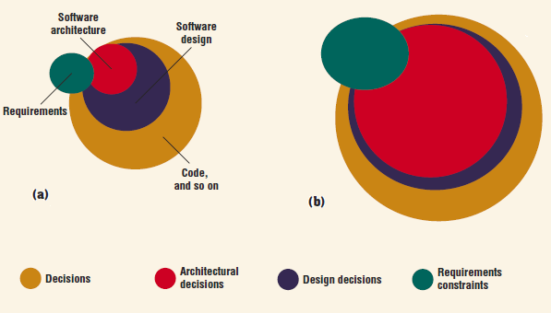
Reality vs. Perception

Slide 15
Different approaches and Relative strengths
SOFTWARE ARCHITECTURE | AGILE DEVELOPMENT
ANTICIPATION: Make important decisions early. | ADAPTATION: Leave decisions as late as possible.
QUALITY ATTRIBUTES: Architectural concerns often relate to non-functional requirements. | FUNCTIONALITY: User stories relate primarily to functional requirements.
MACRO PERSPECTIVE: Big picture, high level viewpoint of the project. | MICRO PERSPECTIVE: Focus on small chunks, two week sprints.
BUSINESS CONCERNS: Balance conflicting requirements and concerns upfront. | DEVELOPER FRIENDLY: Improves team morale
COMPLEXITY: The more complex a project the more of a need for architectural planning | SIMPLICITY: Divide and conquer. Known domains. Reusing a basic architecture.

