Slide 1
The Role of the Architect
Kevin Bao Le
Comp 684

Slide 2
Outline
What is architecture?
What does an architect do?
Implications for the Architect
Architect Competency Framework
Domains of Competency
Conclusion
References
Questions?

Slide 3
What is software architecture?
“architecture is the structure of the system, comprised of
components or building blocks
the externally visible properties of those components, and
the relationships among them”
The people who do this are called architects.

Slide 4
What does an architect do?
A software architect is an information technology professional.
He is responsible for dictating design choices to software developers, including but not limited to: platforms, coding and technical levels.
His goal is to gain a complete understanding of his clients’ needs and effectively communicate them to the software design team.

Slide 5
System Perspective Implications for the Architect
An architect needs to be good at:
seeing the big-picture,
dealing with ambiguity
setting priorities
dealing with conflicting priorities, making compromises
analyzing tradeoffs
working across disciplines
leading, following and getting out of the way
persuading others
mediating conflicts

Slide 6
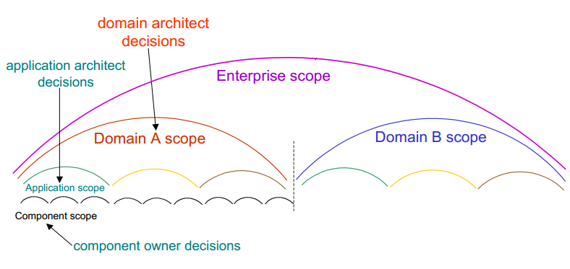
Architectural Decisions A matter of scope

Slide 7
Implications for the Architect
An architect also needs to
be credible and knowledgeable about areas within decision scope.
Build consensus of opinions.

Slide 8
Architectural Decisions Implications for the Architect
Architect needs to
work at a high level of abstraction, yet go into detail where necessary.
be good at modeling, rigorous in documenting decisions, and good at communicating them to various audiences.
use different views to show how the architecture addresses various stakeholders’ concerns.

Slide 9
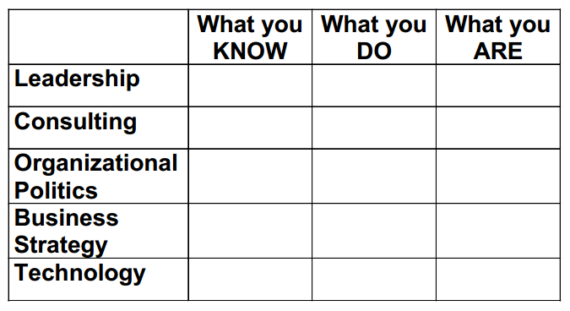
Architect Competency Framework
This framework helps architects assess areas for their own personal development, and managers in identifying who is a good fit for the architect role.

Slide 10
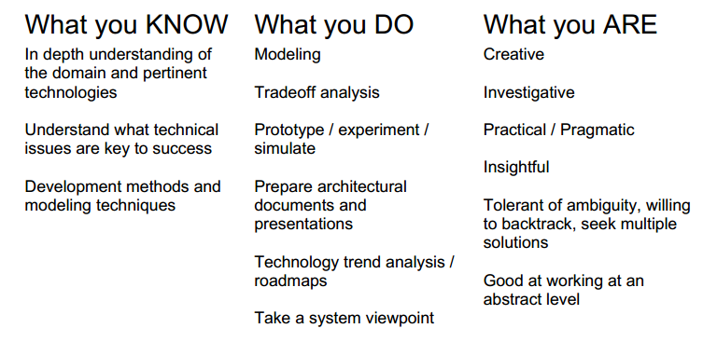
Domains of Competency Technology

Slide 11
Domains of Competency Business Strategy

Slide 12
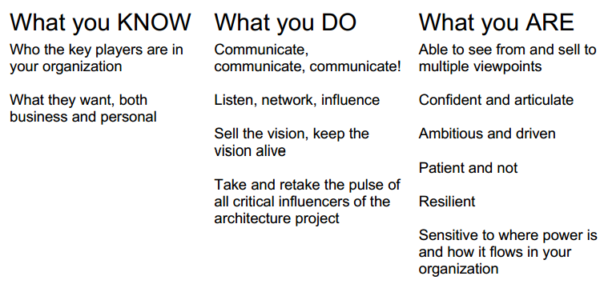
Domains of Competency Organizational Politics

Slide 13
Domains of Competency Consulting

Slide 14
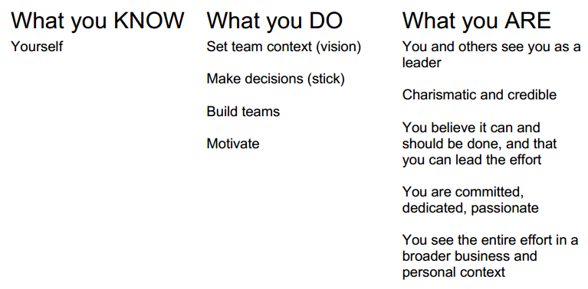
Domains of Competency Leadership

Slide 15
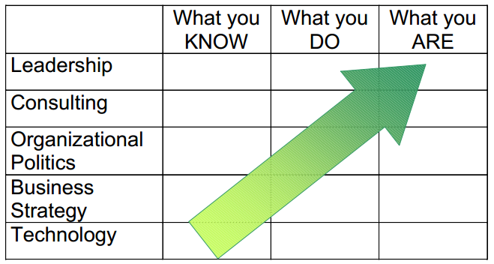
Conclusion
As you become more senior in architect role, it is less about what you know and more and more about who you are -- your personal characteristics.

Slide 16
Risks/Rewards of the Role
• Risks
you don’t enjoy the nontechnical work
more responsibility / less control
insufficient drive to overcome resistance
poor odds of success
everyone has a better idea
• Rewards
more interesting and complex problems
career advancement and recognition
greater scope of activities, influence, contribution

Slide 17
References Books
Bass, Clements and Kazman, Software Architecture in Practice, Addison-Wesley, 1998.
Lewis, R. Architect? A Candid Guide to the Profession. MIT Press, 1998.
Rechtin, E. Systems Architecting: Creating and Building Complex Systems. Prentice-Hall, 1991.
World-wide Institute of Software Architects (WWISA) web site: www.wwisa.org
SEI web site: www.sei.cmu.edu/technology/architecture

Slide 18
References Papers
Bredemeyer, Dana and Ruth Malan, “Role of the Software Architect”, 1999. http://www.bredemeyer.com/pdf_files/ArchitectRole.PDF
Bredemeyer, Dana, “James Madison and the Role of the Architect”, June 1999. http://www.bredemeyer.com/pdf_files/madison.pdf
Kruchten, Philippe, “The Architects--The Software Architecture Team”, Software Architecture, Patrick Donohoe (ed.), 1999.
Kruchten, Philippe, “Common Misconceptions about Software Architecture”, The Rational Edge, April 2001.
Muller, Gerrit, “The Role and Task of the System Architect”, http://www.extra.research.philips.com/natlab/sysarch/RoleSystemArchitectPaper.pdf
Malan, Ruth and Dana Bredemeyer, “Architecture Teams”, 2001 http://www.bredemeyer.com/pdf_files/ArchitectureTeams.PDF

Slide 19
References Web Sites
Enterprise-wide IT Architecture (EWITA) site: http://www.ewita.com
Resources for Software Architects site: http://www.bredemeyer.com
SEI web site: http://www.sei.cmu.edu/technology/architecture
Philips Gaudi project site: http://www.extra.research.philips.com/natlab/sysarch/index.html

Slide 20
Thank you!
Questions ???

