Slide 1
Agile Architecture
Prabhu Venkatesan for COMP-684

Slide 2
Agile and Architecture :
Do they get along ?
Oxymoron
Compatible ?

Slide 3
Architecture
In the beginning …
1970’s thro 2000
“The software architecture of a program or computing system is the structure or structures of the system, which comprise software elements, the externally visible properties of those elements, and the relationships among them.“
Software architecture is not only concerned with structure and behavior, but also with usage, functionality, performance, resilience, reuse, comprehensibility, economic and technological constraints and tradeoffs, and aesthetics.
… There was Architecture.

Slide 4
Architecture Process
start with a business goal
work out what needs to change (people, process, technology, application, data …)
Spell what the changed scenario will look like.
followed by an implementation plan
execution of the plan with proper governance.
The approach is top-down, structured and planned.

Slide 5
Agile
In February 2001, 17 software developers met at the Snowbird, Utah resort, to discuss lightweight development methods.
and was born … Agile Manifesto:
“We are uncovering better ways of developing software by doing it and helping others do it. Through this work we have come to value:
Individuals and interactions over processes and tools
Working software over comprehensive documentation
Customer collaboration over contract negotiation
Responding to change over following a plan
That is, while there is value in the items on the right, we value the items on the left more.”

Slide 6
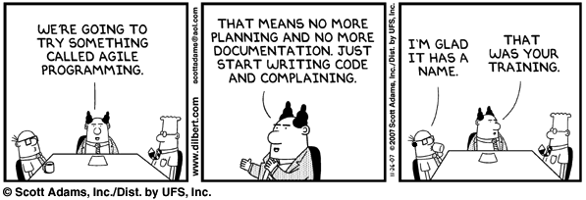
Agile Process
Customer satisfaction by rapid delivery of useful software
Working software is delivered frequently (weeks rather than months)
Close, daily co-operation between business people and developers
Self-organizing teams
Regular adaptation to changing circumstances
Welcome changing requirements, even late in development

Slide 7
Anticipation vs. Adaptation
“…the mission, scope, tools, mentality, culture, and personality types of enterprise architects and agilists are so radically different …. not only is the nature of their work different, but the management styles, employment incentives, and career path options that work with one group don’t work with the other …”
Architecture = Big Up-Front Design - BUFD
Architecture = massive documentation, YAGNI – You ain’t gonna need it
Role of architect(s)
Low perceived or visible value of architecture
Agile lacks any scientifically-based evidence to support its proponents
agile methodologies are too extreme

Slide 8
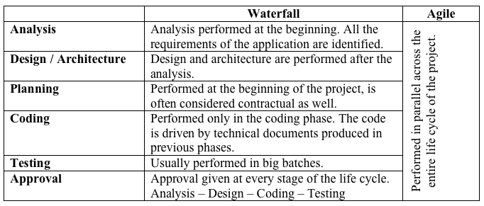
To Summarize

Slide 9
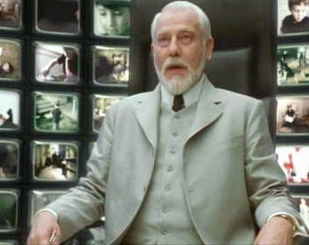
Is the a middle path
What would be a model that combines the benefits of Agile methodology with the predictability offered by conventional architecture ?
Can it be applied to projects of various sizes ?
Does it involve an architect ?
What is the role of the architect ?

Slide 10
Agile Architecture - Objectives
Deliver working solutions
Maximize stakeholder value
Find solutions which meet the goals of all stakeholders
Enable the next effort
Manage change and complexity

Slide 11
Agile Architecture - Principles
Value people
Communicate
Less is More – Don’t overbuild
Embrace Change – Plan it, Manage it
Choose right solution for enterprise
Deliver Quality
Model and document in a agile fashion

Slide 12
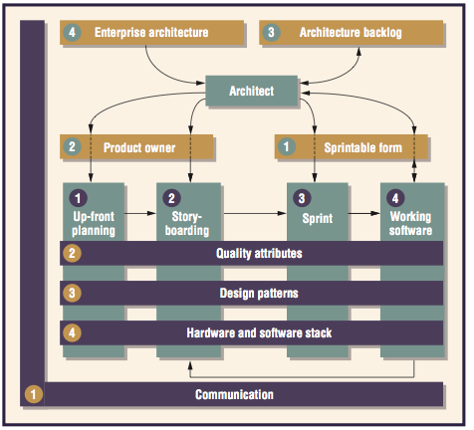
Agile Architecture - Lifecycle

Slide 13
Agile Architecture – Interactions – Upfront Planning
Understand business objectives.
Get input from the technical team.
Communicate the general direction to everyone.
Set approximate target ranges for attributes and trade-offs
Choose important design patterns.
Outline general interactions among significant patterns.
Reuse the corporate stack.
Prototype early to verify assumptions.
hardware and software changes are inherently non agile.

Slide 14
Agile Architecture – Interactions – Storyboard
Actively facilitate story- boarding sessions.
Work architectural user stories into the backlog
Add stories to improve specific attributes, refactoring.
Add stories to build design patterns
Add stories designed to validate hardware and software

Slide 15
Agile Architecture – Interactions – Sprint
Attend daily stand-ups.
Build functionality as a means of gaining understanding.
Mentor and assist as expertise allows.
Build attributes into code, explicitly
Assist in designing to build/improve attributes.
Solve for detailed design patterns.
Assist in building the most critical design patterns
Validate hardware and software selection in early sprints.
Change early and quickly if stack needs adjusting.

Slide 16
Agile Architecture – Interactions – Sprint
Attend the sprint review.
Review documentation.
Advocate refactoring for architectural value with team/owner.
Verify that the delivered solution meets target ranges.
Adjust target ranges if build indicates a need for adjustment.
Verify that the delivered design patterns are valid.
Adjust design patterns as build work indicates.
Verify hardware / software by continually through code release
Deploy to other environments

Slide 17
Agile Architect– Skills
Decomposition of Stories.
Business Centric vs. Architecture Centric decomposition
Product Owner Buy in. Quality Attribute trade-off
Architecture Backlog – Out-of-scope, wishlist
Incremental Architecture
- Hardware / Software stack
- Design Patterns
- Quality Attributes
- Communication

Slide 18
Conclusion
… a triumph equaled only by its monumental failure
… I have since come to understand that the answer eluded me because it required a lesser mind, or perhaps a mind less bound by the parameters of perfection.

Slide 19
Questions ?

