Slide 1
4+1 View Model of Software Architecture
Presented By: Reham Alhejaili
May, 1st

Slide 2
Outline
What is the architecture view?
What is the relevance to Comp 684course?
About author.
The problem that discussed in the article.
Suggested Solution
4+1 view model
Logical view
Process view
Development view
Physical view
Scenarios
The Iterative process
Annotation

Slide 3
What is the architecture view?
The author's of our book had mentioned the view in chapter 9.
The author’s defined the view as a representation of a coherent set of architectural elements , as written by and read by system stakeholders.

Slide 4
What is the relevance to Comp 684course?
The basic principle of documenting software architecture:
“Documenting an architecture is a matter of documenting the relevant views and then adding a documentation that applies to more than one view.”( Bass, Clements and Kazman)

Slide 5
Overview about the article's author:
Philippe Kruchten has more than 16 years of experience as a leader of the development team in Rational corporation.
He had a good experiences in industry (Telecom, Air traffic control system) which he used to justify his model.

Slide 6
Problems:
Architecture documents do not address the concerns of all stakeholders .
Deferent Stakeholders : end-user, system engineers, developers and project managers.
Architecture documents contained complex diagrams some times they are hard to be represented on the documentation.

Slide 7
Solution
Using different notations for several Views each one addressing one specific set for concerns.
Use“4+1” view model.

Slide 8
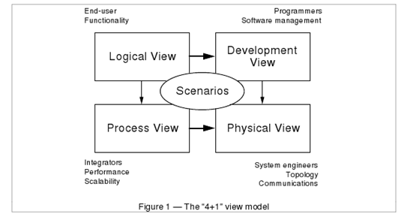
4+1 View Model of Architecture
Philippe Kruchten
Rational Software Corp.

Slide 9
Logical View
• The logical view, which is the object model of the design (when an object-oriented design method is used)
Viewer: End-user
considers: Functional requirements- What are the services must be provided by the system to the users.
Notation: The Booch notation .
Tool: Rational Rose

Slide 10
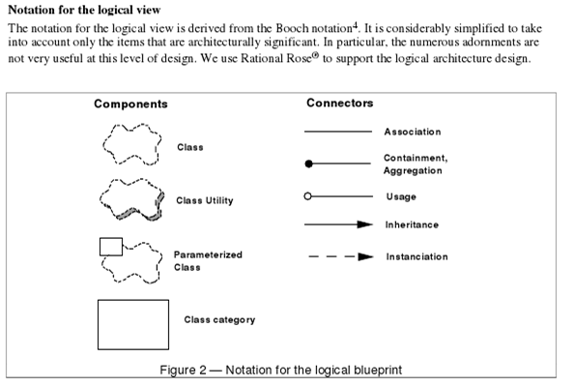
By Philippe Kruchten
Rational Software Corp.

Slide 11
Logical view Example
Philippe Kruchten
Rational Software Corp.

Slide 12
Process View
The process view, which captures the concurrency and synchronization aspects of the design(The process decomposition).
viewer: Integrators
considers: Non - functional requirements (scalability, concurrency, and performance)
style: Garlan and Shaw ‘s Architecture styles.

Slide 13
Process view (cont.)
Uses multiple levels of abstractions.
A process is a grouping of tasks that form an executable unit:
Major Tasks: Architecture relevant tasks.
Minor or helper Tasks: (Buffering)

Slide 14
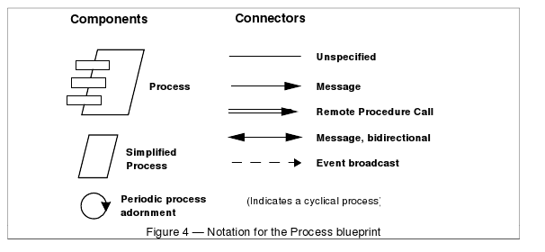
Notation
By Philippe Kruchten
Rational Software Corp.

Slide 15
Process View example
Philippe Kruchten
Rational Software Corp.

Slide 16
Development View
The development view, which describes the static organization of the software in its development environment.
Viewer: Programmers and Software Managers
considers: software module organization. (Hierarchy of layers, software management, reuse, constraints of tools).
Notation: the Booch notation.
Style: layered style

Slide 17
Notation
By Philippe Kruchten
Rational Software Corp.

Slide 18
Physical View
the physical view, which describes the mapping(s) of the software onto the hardware and reflects its distributed aspect.
Viewer: System Engineers
Considers: Non-functional requirement (reliability, availability and performance). regarding to underlying hardware.
There may be two architecture:
Test and development
deployment

Slide 19
Physical view example
By Philippe Kruchten
Rational Software Corp.

Slide 20
Scenarios
(Putting all “4 views” together)
Viewer: All users and Evaluators.
Considers: System consistency and validity
Notation: Similar to logical view

Slide 21
Scenario example
By Philippe Kruchten
Rational Software Corp.

Slide 22
Correspondence between the views
The views are interconnected.
Start with Logical view and Move to Development / Process view and then finally go to Physical view.

Slide 23
From logical to Process view
Two strategies :
Inside-out: starting from Logical structure
Outside-in: starting from physical structure

Slide 24
From Logical to development
They are very close, but the larger the project, the greater the distance between these views.
Grouping to subsystems depending on:
The team organization.
The class categories which includes the packages.
The Line of codes.

Slide 25
Iterative process
Not all architectures need all views.
A scenario-driven approach to develop the system is used to handle the iterative.
Documenting the architecture:
Software architecture document: follows closely “4+1” views.
Software design guidelines: it captured the most important design decisions that must be respected to maintain the architectural integrity.

Slide 26
Annotation:
“4+1 views” methodology successfully used in the industry
Air Traffic Control
Telecom
This paper missing the tools to integrate these views which lead to an inconsistency problem.
The inconsistency problem is more tangible in the maintenance of the architecture.

Slide 27
Thank you for your lasting

Slide 28
Is there any question?

