Slide 1
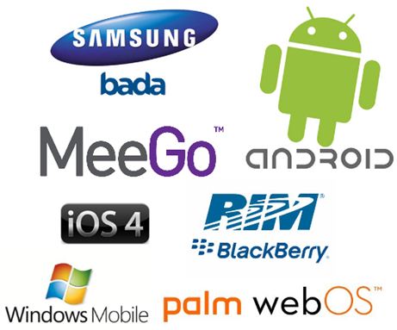
Mobile Software Systems
Kevin Bao
Peter Chyla
Prabhu Venkatesan
Notes:
We are all using mobile phones
1973 first mobile, 10 hrs to charge, talk for 30 mins. Limited locomotion
1979 Nippon Telegraph 1G, multiple cell site, analog signals
1990’s 2G and 2.5G digital signals, sms, content download
Early 2000s 3G – circuit switching to packet switching for data faster data rates, streaming content.
4G LTE all IP or packet switching.

Slide 2
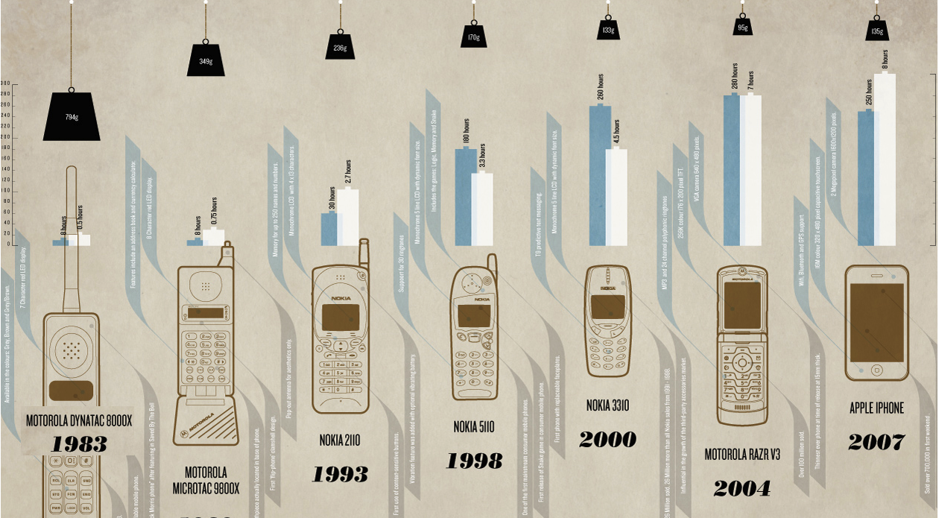
Evolution of Mobile Hardware
From “Brick” to “Slick”
Notes:
Evolution in terms of size, weight, form factor, internal memory capability, processor, graphics processor.
2005 – Phone as a computing device, Data Capabilities
Full fleged operating system, User is able to add on to the functionality

Slide 3
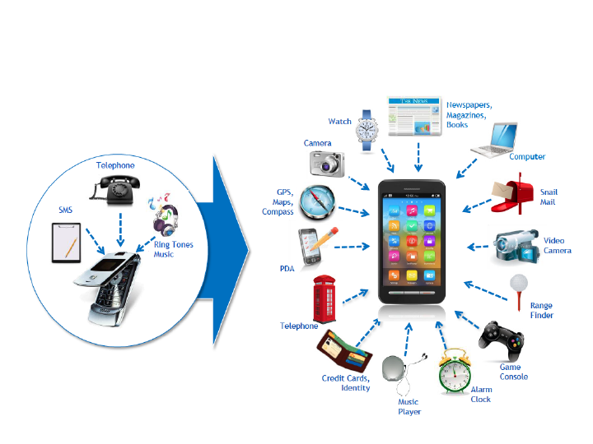
Evolution of Mobile Functionality/Software

Slide 4
Why is Mobile Interesting
Big
5.2bn mobile phone subscriptions
vs. 4.2bn people with toothbrush
On-hand
For 91% of the population the device is only an arm’s length away (24/7)
Users look at their mobile device 150x/day on average
Individual
60% of married people will not share their mobile with spouse
Relevant
11% of under-25 year-olds find it ok to read text messages whilst having sex !!
Sources:
Tomi Ahonen (2011), Gartner (2010), Morgan Stanley (2007), Wired Magazine (2006), Retrevo Gadgetology Report (2010) by way of Prof. Vince Mitchell (Cass University)

Slide 5
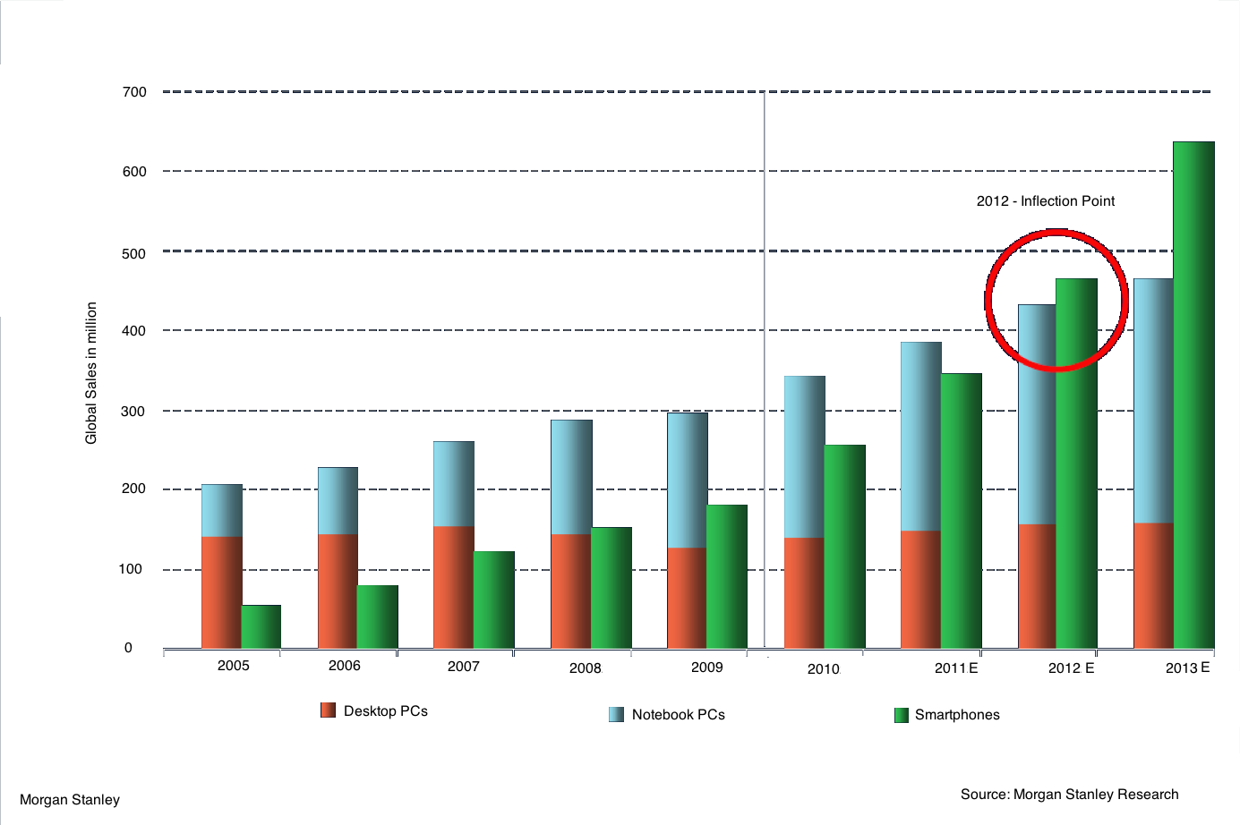

Slide 6
Why is Mobile Interesting
Gadget convergence
A study of smartphone users finds they're spending less time with:
Digital cameras
GPS units
Laptop/desktop computers
Video game systems
Camcorders
iPods
and car radios
Source: Jacobs Media and Arbitron Sept 27, 2010 (by way of T. Ahonen, 2011)
Notes:
Mobile negated the business case for GPS units

Slide 7
Statue of an angel holding a mobile phone at St. John's Cathedral in Den Bosch, Netherlands

Slide 8
How is Mobile Software Different
Desktop software is not suited for mobile
Higher heterogeneity
Desktop world for developers is quite homogeneous
Initially: problem of device fragmentation
“inability to develop an application against a reference operating context and achieve the intended behaviour in all operating contexts suitable for the application”
Recently: shift towards platform fragmentation
iOS, Android, bada, Blackberry, Win Phone 7, Symbian, J2ME/JavaFX, WebOS, Win Mobile, OpenMoko, LiMo
Homogeneity at least within platform

Slide 9
Characteristics
Different usage context
Limited attention time span: 4 seconds
Inherent context factors
Mobility (constant change of position)
Device capabilities (CPU, battery, screen size)
Operator plan and communication costs
Interaction possibilities
Sources:
A. Oulasvirta, S. Tamminen, V. Roto, and J. Kuorelahti. Interaction in 4-second bursts: the fragmented nature of attentional resources in mobile hci. In Proceedings of CHI 2005, pages 919–928, 2005.

Slide 10
Characteristics
Different market rules
Much shorter product lifecycles
With much shorter time-to-market
More difficult user attraction: a lost user is very difficult to win back
Different product distribution means
Mostly centralised application stores: The “Apple Model”
Different business models
Depending on platform → different ecosystem rules
Different price policies (Android: free apps)
Different revenue channels (ads)
Different payment methods (operator billing)

Slide 11
Characteristics
Different interaction possibilities / user experience
Conventional “desktop means” cannot be assumed
No mouse, keyboard, large screen
Instead
Multipoint-touch
Gestures and motion detection
Sensors (acceleration, tilt, GPS, compass)
Haptic feedback
STT/TTS
Camera (face detection/recognition)

Slide 12
What does an OS provide?
Hardware abstraction +
Application Framework

Slide 13
Some Requirements for successful Mobile OS
Easy and consistent for app developers
Responsive, fast and efficient
Secure
Run with limited RAM

Slide 14
Easy and consistent for app developers
Apps attract users and user attract apps
Inconsistent hardware
Small Screen, Large Screen, keyboard, touchscreen 1MP camera, 10MP camera, 600Mhz single core - 1GHZ quad core
Multiple OS versions

Slide 15
App development: iOS
Hardware is Apple, so developers know what to expect.
ARM only, so no need for virtual machine (code written and compiled)

Slide 16
App development: Android
Dalvik Virtual Machine and application framework to isolate apps from hardware variations
As long as an app only uses the application framework, Google claims that the app will work on future Android versions
Hardware support implemented in the Linux Kernel

Slide 17
App Development: Windows Phone
Common Language runtime provides further isolation from hardware.
Hardware isolation. Additionally, Microsoft specifies the hardware requirements, leaving little room for significant fragmentation

Slide 18
Responsive, fast and efficient
As opposed to desktop users, mobile phone users are accustomed to a responsive system.
Every single CPU cycle consumes battery power.
The more time the CPU can spend sleeping the longer the battery life will be.

Slide 19
Responsive, fast and efficient
Apple iOS:
Entire system along with applications written in C/C++ and Objective C
Pro: No inherent inefficiency Con: Very hard to port
Google Android:
Core of system written in C/C++.
Application framework and applications in Java, but interpreted with efficient Dalvik VM
Pro: Trivial to port Con: All of the instructions consumed interpreting JAVA are essentially wasted
Windows Phone 7:
Entire System in C/C++. Only applications are interpreted using JIT.
Pro: OK for efficiency and portability Con: Harder to port than Android

Slide 20
Secure
Lots of personal data on phones.
Location information, bank accounts, text messages, e-mail
Mobile is easy to lose or steal.
Corporate customers easily turned off by insecure system

Slide 21
Secure
"A Window Into Mobile Device Security" June 2011, Symantec

Slide 22
Secure: iOS
Good:
Uses HW encryption on all data.
All apps in app store are verified by Apple.
Permissions required for SMS, making calls, GPS and receiving notifications from internet.
All apps run in sandbox
Not so good:
All apps have unrestricted internet, calendar and media file access.
~200 vulnerabilities discovered since release.

Slide 23
Secure: Android
Good:
Sandbox
Permissions for everything during install
Bad:
No app verification (malware in app store)
User can easily compromise security by granting permissions to wrong app.
No HW encryption until 3.0
As of June 2011, 1 critical vulnerability has not been patched in Android 2.2

Slide 24
Secure: Windows Phone 7
Good:
Each app verified.
Sandbox
Permissions for everything
Looks very good on paper
Bad:
It's from the same company that brought us windows

Slide 25
Run With Limited RAM
Mobile devices have limited memory.
Adding more memory is not a solution.
The more memory available the more will be used.
Easy solution if only one app can run.
Desktop System Solution:
Virtual Memory

Slide 26
Run With Limited RAM
Android:
Activities (UI elements) do not run in the background
Must save state and prepare to be removed when switched from the running state.
Services (no UI) run in the background.
Service has no UI, so usually not much RAM required.
It is possible to write a wasteful service which will run down the battery.

Slide 27
Run With Limited RAM
iOS (no application multitasking until iOS 4.0)
Applications are limited on what they can do when in the background.
Must save state and free up as much RAM as possible when being moved to background
If consuming a lot of RAM, it is likely that your app will be killed when memory is low.
Apple verifies that apps conform to its requirements for "Being a Responsible Background App"

Slide 28
Run With Limited RAM
Windows Phone 7
Apps do not run in the background.
Apps save state and prepare to be removed from RAM.
May use background agent to perform background tasks.
Microsoft ensures that the background agents do not needlessly consume power.

Slide 29
Distribution
Typically users buy phones with the OS preinstalled.
Major updates are typically done using USB connection to PC.
Minor updates are done OTA.

Slide 30
How to Make money
Apple: Hardware Sales
Google: Adds
Microsoft: Royalties?

Slide 31
Mobile Application Development
Kevin Bao Le

Slide 32
What is Mobile Application Development ?
Mobile application development is the process by which application software is developed for small low-power handheld devices such as mobile phones.
These applications are either pre-installed on phones during manufacture, downloaded by customers from various mobile software distribution platforms, or web applications delivered over HTTP which use server-side (e.g. ASP.NET or C#) or client-side processing (e.g. JavaScript) to provide an "application-like" experience within a Web browser.

Slide 33
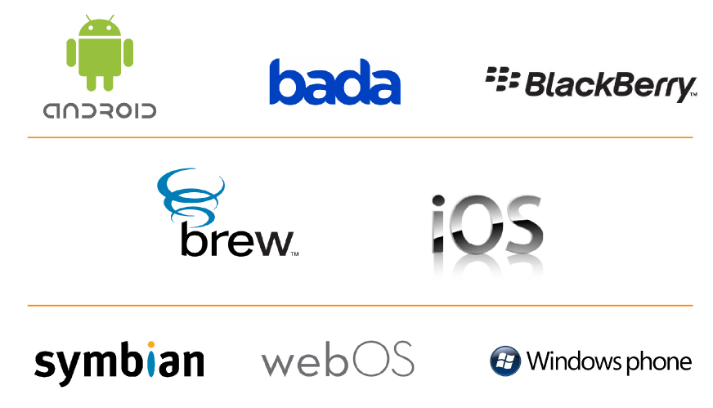
Execution environments
Windows Mobile, Android, HP webOS and iOS offer free SDKs and integrated development environments to developers.

Slide 34
Platform development environment
Each of the platforms for mobile applications also has an integrated development environment which provides tools to allow a developer to write, test and deploy applications into the target platform environment.
The following table summarizes the elements in each of the development environments.

Slide 35
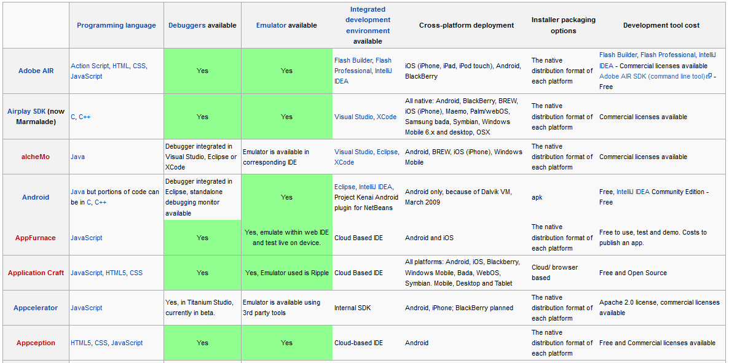

Slide 36
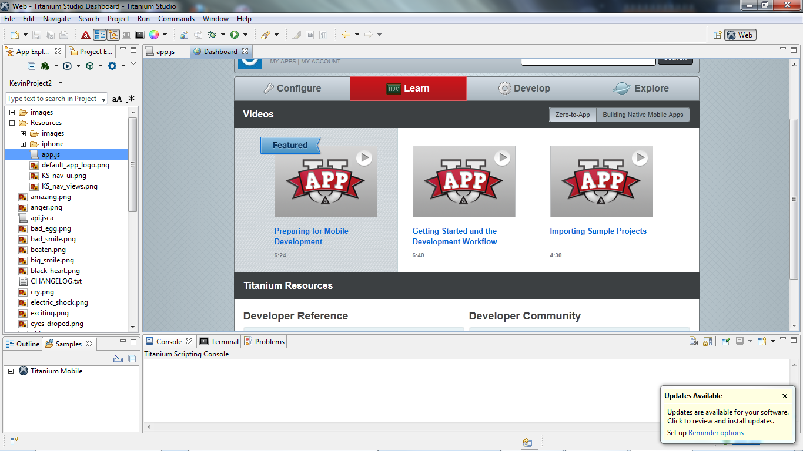

Slide 37
Mobile application testing
Mobile applications are first tested within the development environment using emulators and later subjected to field testing. Emulators provide an inexpensive way to test applications on mobile phones to which developers may not have physical access.
The following are examples of tools used for testing application across the most popular mobile operating systems.
Google Android Emulator: It is Android Emulator which is patched to run on a Windows PC as a standalone app without having to download and install the complete and complex .Android SDK, and can be even installed and Android compatible apps can be tested on it.
TestiPhone: It is a web browser based simulator for quickly testing iPhone web applications. This tool has been tested and works using Internet Explorer 7, Firefox 2 and Safari 3.
iPhoney: It gives a pixel-accurate web browsing environment and it is powered by Safari. It can be used while developing web sites for the iPhone. iPhoney will only run on Mac OS X 10.4.7 or later.
BlackBerry Simulator: There are a variety of official BlackBerry simulators available to emulate the functionality of actual BlackBerry products and test how the BlackBerry device software, screen, keyboard will work with application.

Slide 38
More tools…
elusivestars.com: This is a crowd sourced service for Android and iPhone applications, offering application testing by real users with real devices.
FoneMonkey: This is a free Mobile Application Testing tool for iPhone applications
Robotium: This is an automation tool for Android Mobile Application
Sikuli: This is a visual technology to automate and test graphical user interfaces (GUI) using images.
Deviceanywhere: This is an automation tool for Mobile Application across all platforms, all devices.
Monkey Runner: A Mobile application testing tool for Android.
ZAP-fiX: enhances test automation by allowing enterprise testing of mobile applications. It provides modular test coverage across multiple operating systems and supports testing on multiple devices simultaneously. Supported platforms are iPhone, iPad, Android, BlackBerry, webOS and Windows Mobile.

Slide 39
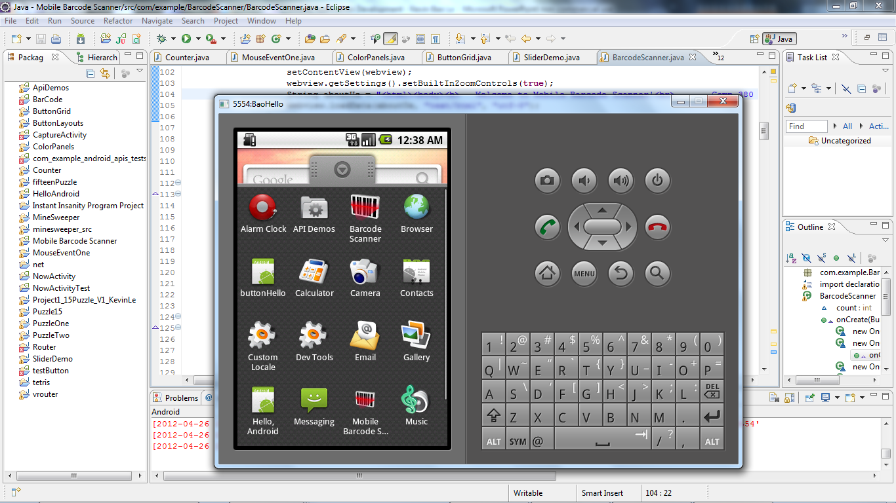
Android Emulators

Slide 40
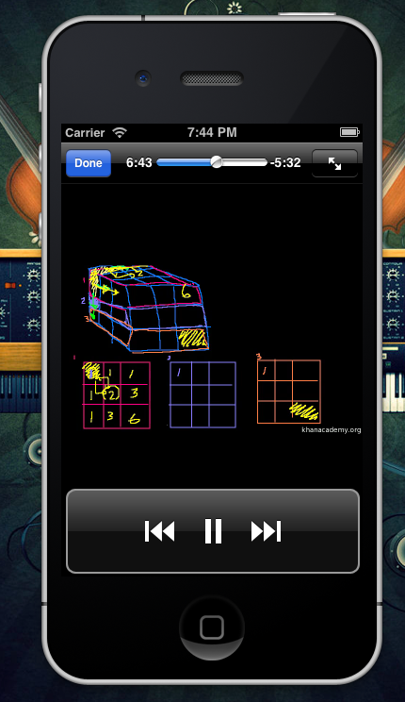
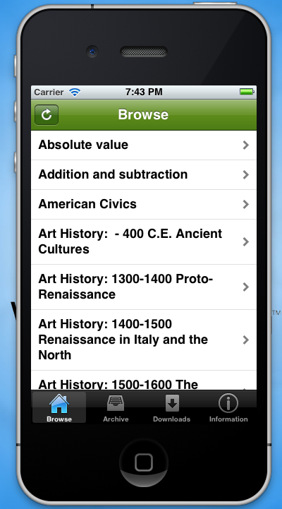
iPhone emulators

Slide 41
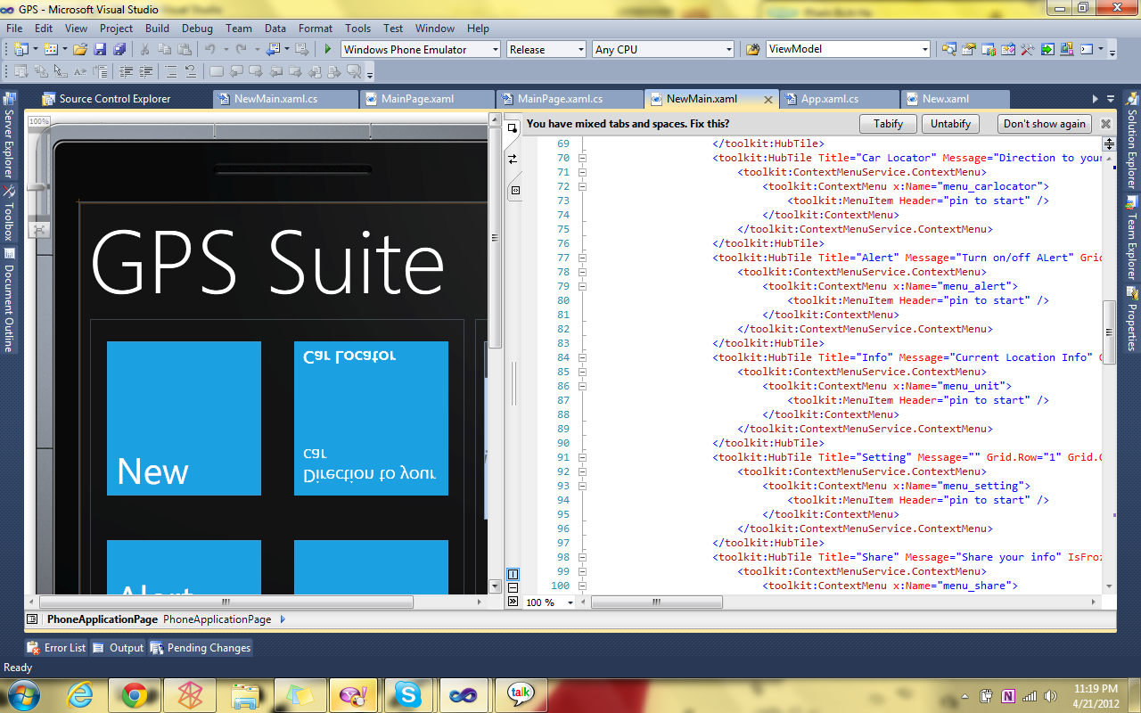
Windows Phone Emulators

Slide 42
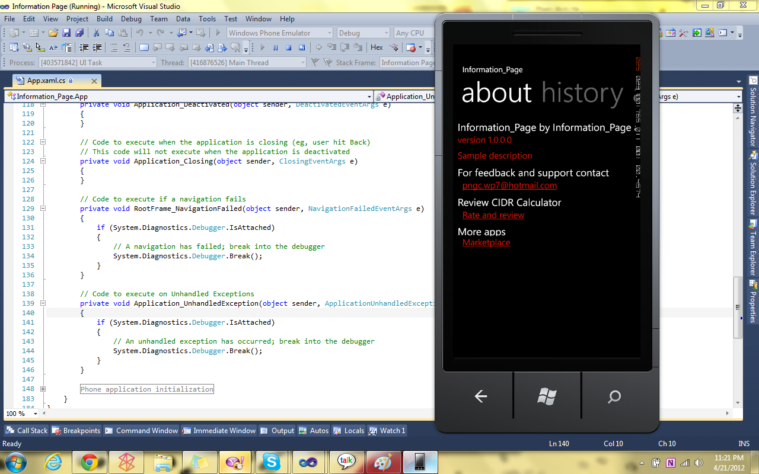

Slide 43
The triumph of iOS and Android
iOS and Android are winning not only by virtue of technological sophistication, but primarily by the strength of their application systems. These ecosystems comprise thousands of application developers and content providers.
As of October 2011, Apple’s App Store leads the way, with over 500,000 applications. Android Market is second, with over 300,000 applications.

Slide 44
Mobile App Development
True application platforms like iOS and Android attract huge financial investments. If a typical app costs an estimated $10,000 to $50,000 to develop, then the 500,000 iOS apps represent an average investment of $15B in iOS. Because of network effects, this investment on the part of developers, investors, and brands directly contributes to iOS’ value, in the eyes of both users and other developers, and Apple’s estimated $71B iOS-powered device sales for the year ending September 2011.

Slide 45
Mobile App Development
The next table demonstrates the effectiveness of Google, Apple and Microsoft in amassing ecosystems of “publishing developers” and the associated developer mindshare.

Slide 46
The importance of Mobile App
Applications play a important role in the success of a mobile platform. It is critically important that a platform provides developers with efficient tools for all stages of application development, from writing the code, to publishing the app.
Different platforms have varying degrees of success in this area, and their success is reflected in the health of their app ecosystems.
Moreover, developers need to master new tools every time they switch to a new platform.

Slide 47
Programming Language
There is generally no common programming language that can be used on all platforms:
iOS apps are written using Objective-C (a superset of C influenced by Smalltalk)
Android and BlackBerry use different dialects of Java as their main programming languages
Windows Phone apps are developed using C#, which is part of .NET framework
Symbian^3, Bada and BREW support commonly-used C and C++ languages
webOS uses JavaScript together with HTML/CSS as its primary development language.

Slide 48
Development Environment
There is generally no common development environment either:
iOS apps can only be developed using Apple XCode tools running on Mac OS computers
Windows Phone apps have to be developed with Microsoft Visual Studio tools using a Windows PC; Windows is the de facto platform for enterprise software developers.
Symbian^3 development uses the Qt environment.
WebOS apps are developed using the Ares browser-based development environment that is used in combination with Eclipse IDE.

Slide 49
Application stores
Several initiatives exist both from mobile vendor and mobile operators around the world.
Application developer can propose and publish their applications on the stores, being rewarded by a revenue sharing of the selling price.
Most famous is Apple's App Store, where only approved applications may be distributed and run on iOS devices (otherwise known as a walled garden).
With extraordinary speed Google's Android Market counting (at the moment) the 2nd largest number of apps and which are running on devices with Android OS.
HP / Palm, Inc have also created the Palm App Catalog where HP / Palm, Inc webOS device users can download applications directly from the device or send a link to the application via a unique web distribution method.
Additionally, mobile phone manufacturers such as Nokia has launched Ovi app store for Nokia smartphones.

Slide 50
Publishing Apps
The majority of developers use native platform application stores for distributing their apps. Each store has its own guidelines, policies and procedures.
The Apple App Store is known for its rigorous certification requirements, and unpredictable approval process. Applications can be rejected for unexpected reasons, and there is no way to predict how long it will take to pass the certification.
For developers designing apps for non-US or non-English markets, there is another hurdle: Apple testers sometimes misunderstand local aspects of the app or service, and reject it for the wrong reasons.

Slide 51
Publishing Apps
The process for publishing apps on Android Market is exactly the opposite.
Android application publishing is a self-service process foregoing any application testing or manual approval.
On one hand, this makes life easier for developers: the submitted app usually shows up in the store within minutes.
On the other hand, this results in large numbers of poor quality, copycat, copyright-infringing or even malware applications available in Android Market, leading to degraded user experiences for Android users.

Slide 52
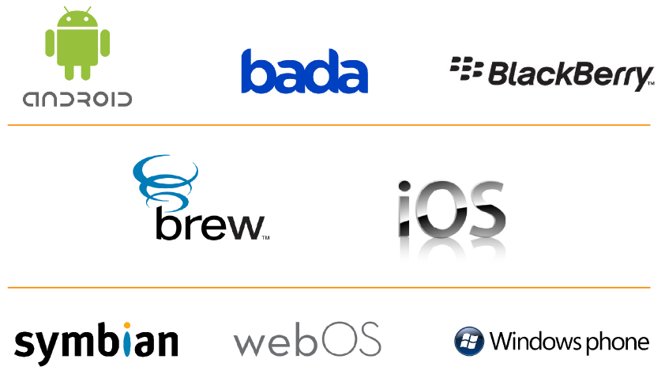
Publishing Apps
The rest of the platforms attempt to strike a balance between openness and quality by moderating testing requirements with fair, predictable approval policies.

Slide 53
Mobile Application Lifecycle Management
As a mobile developer, we should know which tools can help us to be productive, and what other challenges we'll encounter during various application development stages.
The following table is a summary about mobile app lifecycle.

Slide 54
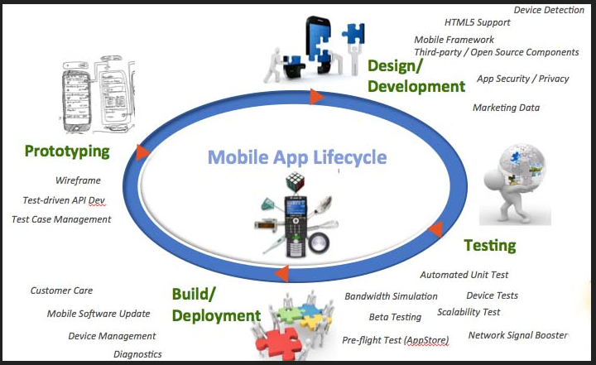

Slide 55
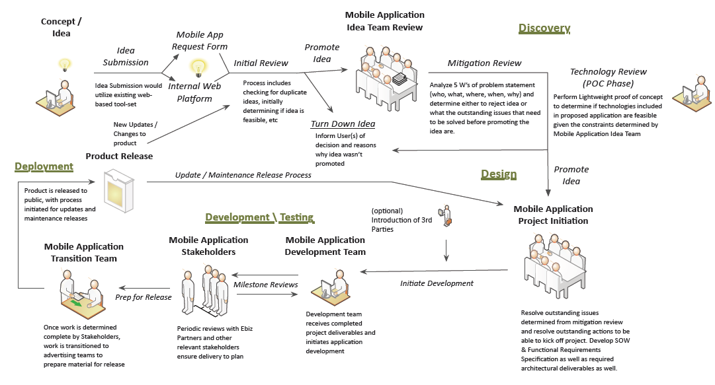

Slide 56
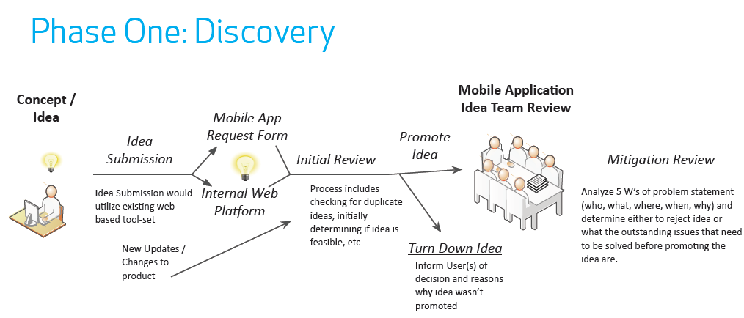

Slide 60
How to make money from apps?
Since applications are locked to the platform, users must acquire buying the platform in order to benefit from applications.
Microsoft Windows is a classic example of a successful application platform. PCs are useless without applications. Since most PC applications are developed for the Windows operating system, it is necessary to buy a license for Windows to use these PC applications.
Doing ads.

Slide 61
How to make money from apps?
The next graph shows the relationship between the number of apps available on particular platform at a particular point in time, and the number of devices shipped for that platform in the quarter just preceding it.
The number of apps available can be considered a metric for how attractive a platform is for developers. Device shipments are likewise a measure of the attractiveness of a platform for its users.

Slide 62
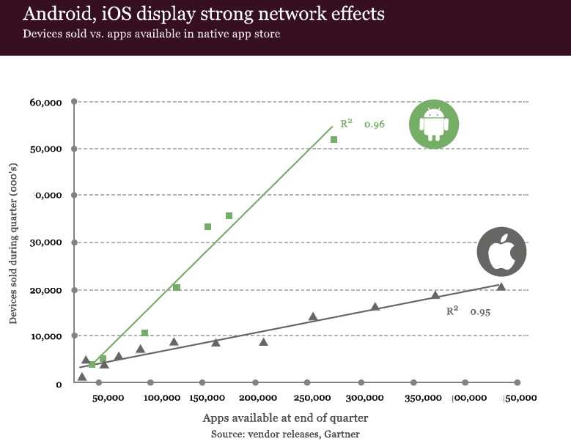

Slide 63
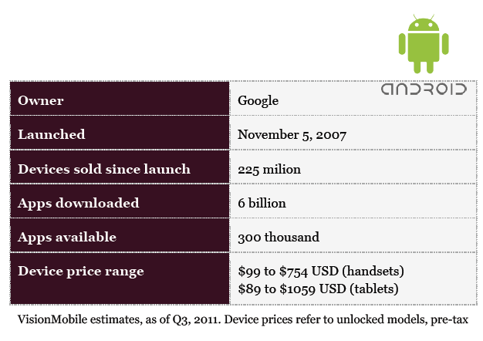
Android

Slide 64
Android App Development
Android allows developers to embed components developed in C/C++ within Java applications. C/C+ development is done using Native Development Kit (NDK). NDK lets developers compile, build and package application components written in C/C++.
Android application frameworks are composed of multiple API groups, including web services based on the WebKit engine, 2D and 3D graphics, SQLite for structured data storage, mobile telephony, Bluetooth, Wi-Fi, camera, location and sensors, and media support for common audio, video, and still image formats.

Slide 65
Android App Development
The Android Market on-device client is the primary method of application discovery.
The client also manages application updates.
The Android Market web store is accessible using any web browser. It offers features such as device compatibility check and web-initiated download of apps (the user click an install button in the web browser, and the application is automatically downloaded to the Android handset registered for the user).
In July 2011, Google announced significant improvements to the Android Market client. These included better application discovery, as well as ability to purchase e-books and video (US only).

Slide 66
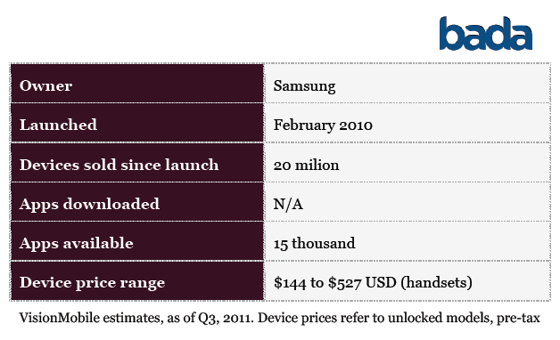
Bada

Slide 68
BlackBerry App Development
BlackBerry OS offers developers multiple options for application development, including Java and web development.
BlackBerry Java applications can be developed and debugged using an Eclipse-based IDE and the BlackBerry Java Plug-in for Eclipse. The latter provides tools to create, debug, optimize and localize Java applications.

Slide 69
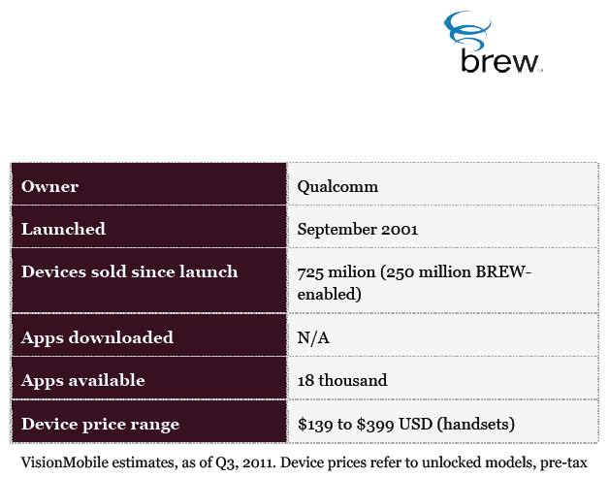
Brew MP

Slide 71
iOS App Development
iOS applications are developed using proprietary Apple tools available only for Apple Mac OS computers. The tools are based on the same “XCode” development suite used to build Mac OS applications.
mostly written in the C language, and include API groups such as Core Foundation, CFNetwork, SQLite, and access to POSIX threads and UNIX sockets, among others.
The Media layer provides API for graphics, audio, and video functionality of the device used for multimedia applications.

Slide 72
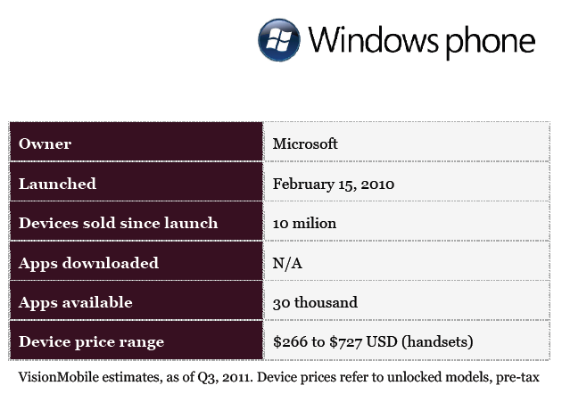

Slide 74
Mobile Application Best Practices
Use Cookies Sparingly
Use Appropriate Client-Side Storage Technologies for Local Data
Ensure the User is Informed About Use of Personal and Device Information
Enable Automatic Sign-in
Cache AJAX Data

Slide 75
Mobile Application Best Practices
Use Transfer Compression
Minimize Application and Data Size
Avoid Redirects
Optimize Network Requests
Minimize External Resources
Aggregate Static Images into a Single Composite Resource (Sprites)

Slide 76
Mobile Application Best Practices
Minimize Perceived Latency
Design for Multiple Interaction Methods
Preserve Focus on Dynamic Page Updates
Use Fragment IDs to Drive Application View
Make Telephone Numbers "Click-to-Call”
Keep DOM Size Reasonable
Optimize For Application Start-up Time

Slide 77
Mobile 3.0

