Slide 1

Object-Oriented Software Testing
Anusha Nataraj
Anna Brjezovskaia

Slide 2
What is this all about?
Brief overview about different problems and research considering Object-oriented Testing
Why is this needed?
  Has home additional difficulties like:
      How to test abstract classes
      How to test inheritated classes and methods?

Slide 3
Agenda
Testing problems
Test strategy
Unit Testing and integration testing
Object state testing
Regression testing
Test tools

Slide 4
Applying Weyuko’s adequacy axioms to OO Testing
When a subclass or superclass is added to a class, the inherited methods must be retested
Retesting even if the overriding and overridden methods are semantically similar
If the order of specification of super classes of a subclass is changed, the subclass must be retested

Slide 5
Some code examples
Class foo
{
protected int i;
public foo()
{
i= 5;
}
public int scaleByI(int n)
{
return i*n;
}
}
Class bar extends foo
{
int z;
public bar()
{
z=0;
}
}
Int main ()
{
bar b = new bar();
foo f = new foo();
b.scaleByI(5);
f.scaleByI(5);
}

Slide 6
Some code examples
Class foo
{
protected Integer i;
public foo()
{
i= 5;
}
public int scaleByI(int n)
{
return i*n;
}
}
Class bar extends foo
{
int z;
public bar()
{
z=0;
}
}
Int main ()
{
bar b = new bar();
foo f = new foo();
b.scaleByI(5);
f.scaleByI(5);
}

Slide 7
Problems according to Kung
Understanding
Complex interdependency
The object state behavior testing
Tool support

Slide 8
Dependencies to keep in mind procedural programming
data dependencies between variables
calling dependencies between modules
functional dependencies between a module and the variables it computes
definitional dependencies between a variable and its type

Slide 9
Dependencies to keep in mind object oriented
class-to-class dependencies
class-to-method dependencies
class-to-message dependencies
class-to-variable dependencies
method-to-variable dependencies
method-to-message dependencies
method-to-method dependencies.

Slide 10
Test strategy
Order to unit and integration testing

Slide 11
A little motivation
Optimal Test order results in
93% savings in Terms of
testing effort

Slide 12
A good strategy according to
M. J. Harrold, J. D. McGregor and K. J. Fitz-patrick
Using the hierarchical structure of the OO Program
Reusing the test information from the parent class incrementally updating it to test the children

Slide 13
How does it work
1) Looking for base classes
2) Designing Test suite for each Base class
for each method
3) Testing history associates each test case
with the attribute its testing

Slide 14
How does it work
4) Subclass test history is derived
from the parents test history
A
5) Child test history is incrementally updated to
reflect differences from the parent
B:A
6) The test history knows which tests to execute
for the subclasses
Inherited attributes are retested
Attributes which require new test cases can be
identified easily

Slide 15
A good strategy according to
Kung
Uses an ORD
Finds the optimal order considering 2 main cases
  ORD is a acyclic directed graph
  →use topological sorting
  ORD is a cyclic directed graph
  → Converting it to a acyclic digraph

Slide 16
Topological search
Pants
Pants
coat
Sox
Shirt
Jeans
Pullover
Jeans
Pullover
coat
Shoes
Shoes
Sox
Shirt

Slide 17
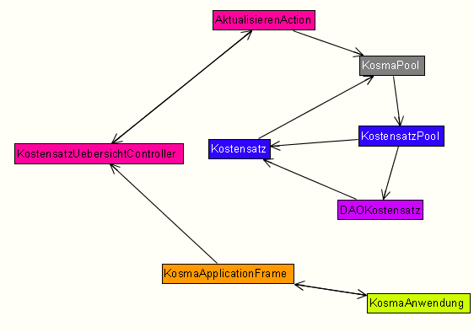
Cyclic digraph

Slide 18
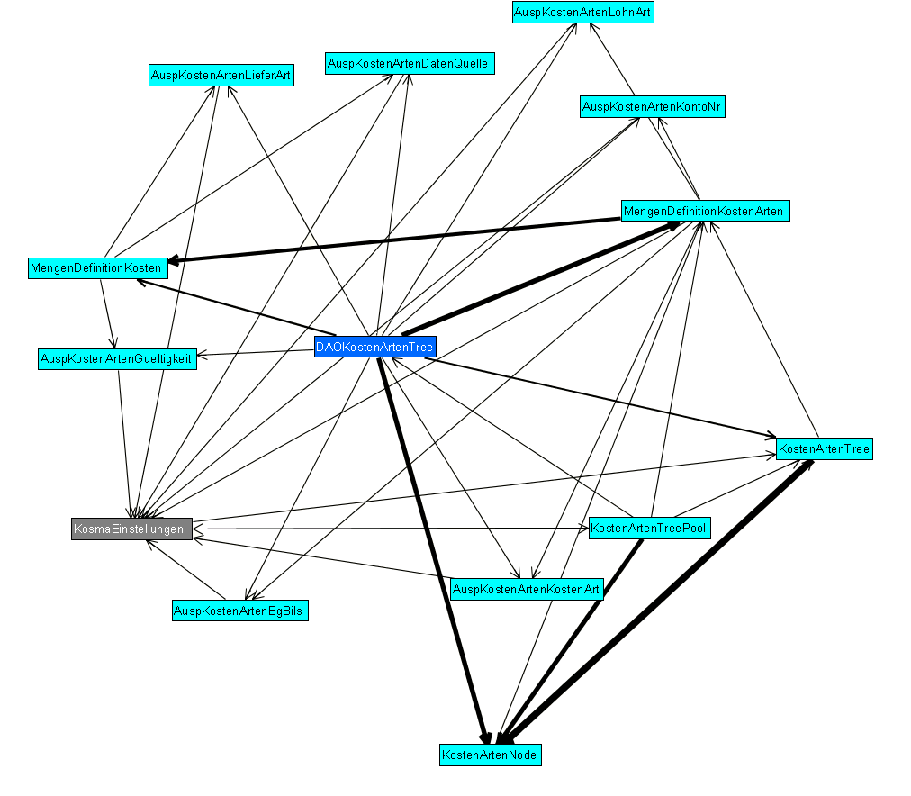
Another cyclic graph

Slide 19
Handling cyclic digraphs
Topological Sorting

Slide 20
Handling cyclic digraphs
?

Slide 21
Unit and Integration Test Problems

Slide 22


What are unit/integration tests?
Unit test
Integration Test

Slide 23
Some questions about unittesting
Can the existing unit test techniques be applied for OO programs
What test models, test generation methods, and test criteria can be used
How to preform unit test systematically

Slide 24
Proposal by
Heechem Kim and Chisu Wu
3 Steps of testing:
  Test each method
  Test data bindings focus on bindings between methods in class
  Testing sequences of methods

Slide 25
Object State testing
In Object Oriented programming it is important to check each state and each transition in every class object to insure our confidence in an 00 program.
Object State Testing focuses on testing the state dependent behaviors of objects.
The state of an object is the combination of all the attribute values of the object.
A state-transition describes the different states and transitions of a class in the context of its position in the inheritance hierarchy. An object may transition from a state to state as a result of an event, which may yield an action.

Slide 26
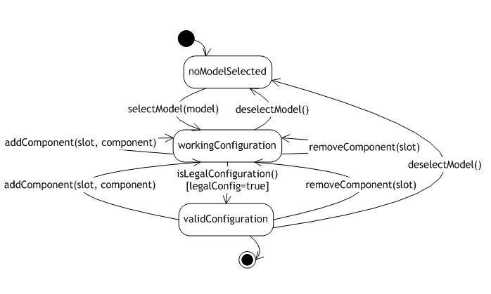
Object state Model
Finite State Machine (FSM)
FSM is used to model the program execution process in terms of stimuli and operations.
    Disadvantages:
1) Inherited state dependent behavior,
2) Object states(or sub-states) and their transitions
Notes:
An AOSD represents the states of a class data and their transitions, and it can be used as a test model to check its dynamic behavior. A COSD is designed to verify the object states and transitions for a class object, it can
be used to represent the dynamic behaviors of its different orthogonal parts.

Slide 27
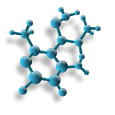
Object state Model
Object StateDiagram(OSD):
The (OSD) is designed as a test model for testing dynamic behavior of objects.
    Two types:
      Atomic Object state diagram (AOSD)
      An AOSD represents the states of a class data and their transitions
      Composite Object State diagram (COSD)
A COSD is designed to verify the object states and transitions for a class object
Notes:
An AOSD represents the states of a class data and their transitions, and it can be used as a test model to check its dynamic behavior. A COSD is designed to verify the object states and transitions for a class object, it can
be used to represent the dynamic behaviors of its different orthogonal parts.

Slide 28
AOSD & COSD
Class Control_switch
Indicator_sw
Display_sw()
Control_sw = Auto
Indicator_sw = On
Set_auto()
Set_control_off()
Set_on()
Set_off()
Display_sw()
Control_sw()
Control_sw = On
Indicator _sw = Off
Set_control_off()
Set_fan()
Display_sw()
Control_sw = Fan_On
Control_sw()
AOSD for control switch class
COSD for control switch class

Slide 29
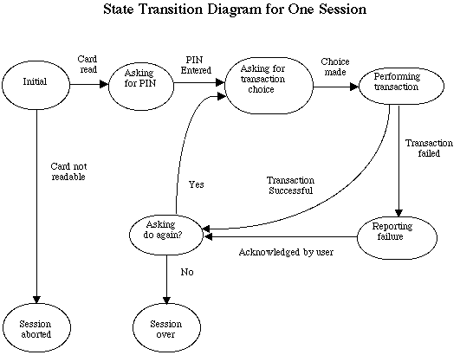
Genral testing Procedure
Tester
Object state model
Test case & Test data
Test results
Run test case
Notes:
1. the tester prepares a testgraph which is essentially a state transition diagram that illustrates the expected state dependent behavior of the
class under test (CUT);
2.

Slide 30
Object state testing – Approach
Class under test
Test cases
and Test data
AOSD & COSD
Tester
Fault analysis
Test results
Run test case

Slide 31
Regression testing
Areas of concern:
  Impact of changed and affected components
  Re-use of existing test cases and test suites
The different techniques are :
  Object Relation Diagram(ORD)
    ORD captures the classes and dependencies.
    Identify impact of changes through dependencies
    Regression testing then focuses on testing the changed and affected classes.
    Determine test order
    Execute tests as per test order

Slide 32
ORD and test order
Class | Relation
A | B,E
B | E
C | B, E, F, G, H
D | B, C, E, F, G, H
E | -
F | -
G | F, H
H | -
D
I
Ag
As
A
B
C
I
I
I
As
E
F
G
As
I
ORD
H
Testing Level | Classes
1 | A, D
2 | C
3 | B, G
4 | E, F, H
Test Order

Slide 33

Regression Testing
  Determine which of the existing test cases should be rerun.
  Control & Data Dependency graph
    Control dependency and data dependency graphs and data dependency graphs.
    An algorithm identifies the changes in statements that produce different results.
    Test cases that run through these statements need to be rerun.
  Software Probes
    Insert software probes in source code
    These probes record which test cases touch which of the classes
    Test cases that relate to changed classes are easily identified and need to be re-run.

Slide 34


Test tools : OOTME
Object-Oriented Testing and Maintenance Environment
The test models are:
Identify Object relation
  ORD, which represent the relationships between different classes.
  Test Order which determines the order based on ORD
  Object state diagrams (OSD) which depict the object state behavior for a class object.
    The object state testing approach
    The reverse engineering tool
    The composite object state testing tool
  Block branch diagrams (BBD) provide the control flow as well as the interface of a function member in a class.

Slide 35
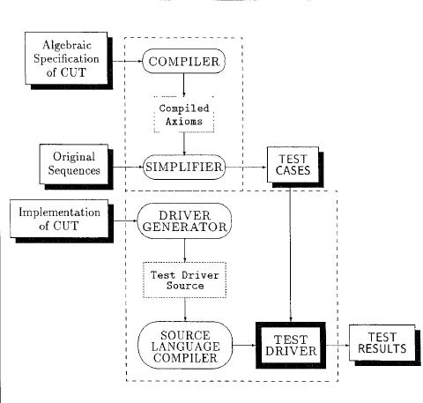
ASTOOT
A Set of Tools for Object-Oriented Testing for Unit testing, which includes an interactive specification based test case generation tool and a tool that automatically generates test drivers.

Slide 36
Object State Testing for Object-Oriented Programs
Jerry Z. Gm, David Kung, Pei. Hsia, Y. Toyoshima, and C. Chen (IEEE explore)
Testing Levels for Object-Oriented Software
Y. Labiche P. Thévenod-Fosse H. Waeselynck M.-H. Durand (ACM)
3. An Object-Oriented Testing and Maintenance Environment
Pei Asia, David Kung ACM O-89791-914-9/97/05
4. The ASTOOT Approach to Testing Object-Oriented Programs
Roong Kodoong and Phillips G. Franki
ACM Transactions on Software Engmeermg and Methodology, Vol. 3, No, 2, April’94.
References

Slide 37

Thank you for listening

