Slide 1

Model-Based Testing
Harvey Alexian
Anthony Arnold

Slide 2

What is software testing?
Testing ! = Finding
Notes:
Learning process to provide us with some information about the quality of the product also understand the risks at implementation of the software.

Slide 3



What are the problems of software testing?
Time is limited
Applications are complex
Requirements are fluid

Slide 4
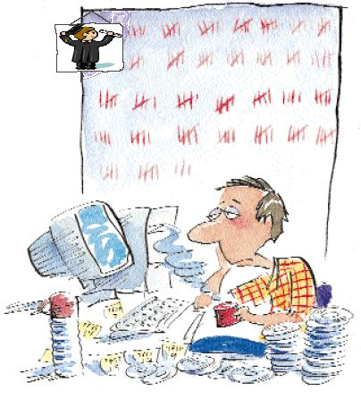
What’s wrong with traditional testing techniques?
Manual Testing
      Unlikely to achieve acceptable coverage
      Not repeatable
      Labor intensive
“One of the saddest sights to me has always been a human at a keyboard doing something by hand that could be automated. It’s sad but hilarious.”
Boris Beizer

Slide 5
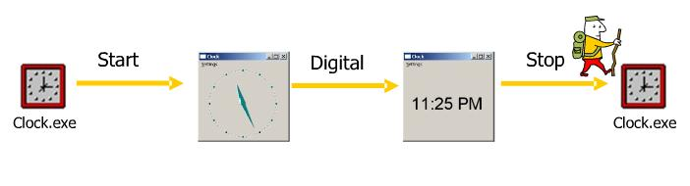
Manual testing
Manual testing is OK sometimes …
…But it can rarely go deep enough
Analog =?
Digital=?
DblClick=?
DblClick=?

Slide 6
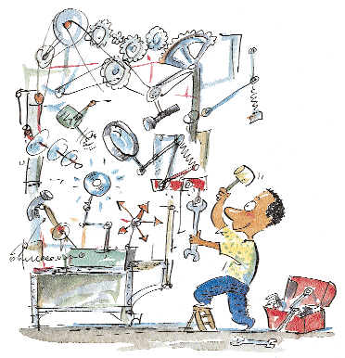
What is wrong with scripting?
        Automated Test scripts Can be as complex as the software to create
        Expensive and timely to modify when the software changes
Scripts are ok for some uses …
Test Case 1: Start Digital Stop Start Analog Stop
Test Case 2: Start DblClk Stop Start DblClk Stop
“Highly repeatable testing can actually minimize the chance of discovering all the important problems , for the same reason that stepping in someone else’s footprints minimizes the chance of being blown up by a land mine.”
James Back
Notes:
Changing software breaks the automated tests.

Slide 7

What is wrong with scripting?
But they pile up quickly …
…And what are you left with?
      Test Case 1: Start Sigital Stop Start Analog Stop
      Test Case 2: Start DblClk Stop Start DblClk Stop
      Test Case 3: Start DblClk Stop Start DblClk Analog Stop
      Test Case 4: Start DblClk Stop Start Dblclk Stop Start Analog Stop
      Test Case 5: ….
      Test Case 6: ….
Notes:
Eventually the scripts require so much maintenance that there was little time left to do testing.

Slide 8
What is a model-based testing?
      Model-based testing is a testing technique where the runtime behavior of a software under test (SUT) is checked against predictions made by a formal specification, or model.
In other words …
  A description of a system’s behavior
  An abstraction of a subset of the system
  Not necessarily represented graphically
      A model describes how a system should behave in response to an action.
      Supply the action and see if the system responds as you expect.
      Creating and maintaining a model of an application should make it easier to generate and update tests for that application.
7
Notes:
Finite state models are excellent tools for understanding and testing software applications. However, a very large state model is needed to describe a complex system in enough detail to do a good job testing. A finite state model used in representing the behavior of an application is likely to have many, many states – so many that it would be tedious and unrealistic to create and maintain the model by hand.
Operational modes are the attributes of a state that determine what user actions are possible in that state and what outcomes will occur when actions are executed. For instance, whether or not the application is currently running is a common operational mode. Typically, if the application is NOT running, the only action the user can execute is to start the application. On the other hand, if the application IS running, the user has a much greater choice of actions that could be performed.

Slide 9

Generic Model Based Testing Flow
Build an abstract model of the system
Validating the model
Definition of test selection criteria (more details later)
Generating abstract tests from the model
Making the abstract test cases executable
Executing the test cases
Assigning of a pass/fail verdict to executed test case
Analyzing the execution result.
  A convenient format is a Finite State Machine (FSM)
8
Notes:
-Validation is typically done by sampling abstract test cases from the model and analyzing them. This step is performed to detect major errors in the model that may even hinder generation of test cases.

Slide 10

Using models to test
      What type of model do I use?
      How do I create the model?
      How do I choose tests?
      How do I verify results?
Notes:
Create a state model of the application
Generate sequence of test actions
Execute the test actions
Determine if the application worked right
Find errors

Slide 11
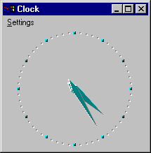
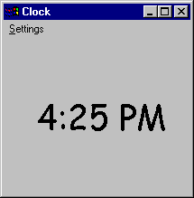
Windows NT clock example
      As a running example throughout this presentation, we will create a simple finite state model of the Windows NT Clock application
Digital
Analog
We could use this very simple state model as a basis for tests, where following a path in the model is equivalent to running a test
Setup: Put the Clock into its Analog display mode
Action: Click on “Settings\Digital”
Outcome: Does the Clock correctly change to the Digital display?
Notes:
Ask yourself the following two questions for every action you are going to test:
1- when is this action possible?
2- what is the outcome when this action is executed?

Slide 12
Requirements for NT clock
For the purposes of this presentation, we will only be concerned with the following actions in the Clock:
Start the Clock application
      If the application is NOT running, the user can execute the Start command.
      If the application is running, the user cannot execute the Start command.
      After the Start command executes, the application is running.
Stop the Clock application
      If the application is NOT running, the user cannot execute the Stop command.
      If the application is running, the user can execute the Stop command.
      After the Stop command executes, the application is not running.
Select Analog setting
      If the application is NOT running, the user cannot execute the Analog command.
      If the application is running, the user can execute the Analog command.
      After the Analog command executes, the application is in Analog display mode.

Slide 13
Requirements for NT clock
Select Digital setting
      If the application is NOT running, the user cannot execute the Digital command.
      If the application is running, the user can execute the Digital command.
      After the Digital command executes, the application is in Digital display mode
Our model in this example will have two operational modes, system mode and setting mode, which can have the following values:
System mode:
      NOT_RUNNING means Clock is not running
      RUNNING means Clock is running
Setting mode:
      ANALOG means Analog display is set
      DIGITAL means Digital display is set

Slide 14






Finite State Machine of NT clock
  A set of states
  A set of input events
  The transitions between the states
Given a state and input event the next state can be determined
Not_Running
Analog
Not_Running
Digital
Stop
Start
Start
Stop
Running
Analog
Digital
Running
Digital
Analog
Analog
Digital

Slide 15
Using Code to Build the Model
      possible = TRUE ‘ assume the action is possible
      if (action = “Stop” ) then ‘ want to do a Stop action?
      if (system_mode = RUNNING) then ‘ if clock is in running mode
      new_system_mode = NOT_RUNNING ‘ clock goes to not running mode
      Else ‘ otherwise
      possible = FALSE ‘ Stop action is not possible
      endif
      endif
      if (possible = TRUE) then ‘ if action is possible
      print system_mode;”.”;setting_mode, ‘ print beginning state
      print action, ‘ print the test action
      print new_system_mode;”.”;new_setting_mode ‘ print ending state
      endif

Slide 16
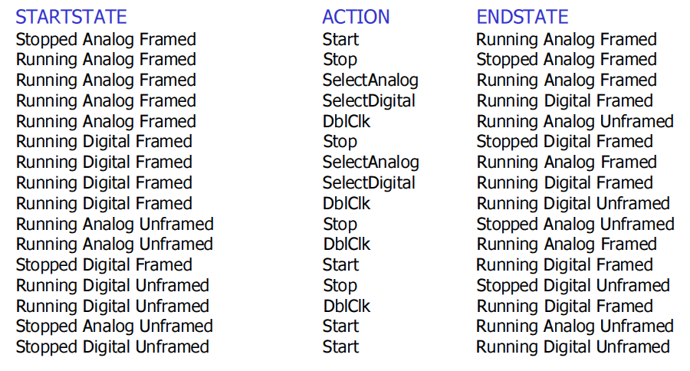
Finite state table

Slide 17
Random Walk Algorithm
      Traversing the graph (FSM) to generate test sequences
Not_Running
Analog
Not_Running
Digital
Start
Analog
Analog
Start
Start
Stop
Stop
Analog
Digital
Running
Analog
Digital
Running
Digital
Stop
Analog
Analog
Digital
Notes:
Traversing the graph (FSM) to generate test sequences

Slide 18
Chinese Postman Tour
Not_Running
Analog
Not_Running
Digital
Start
Analog
Digital
Start
Start
Stop
Stop
Digital
Stop
Running
Analog
Digital
Running
Digital
Start
Analog
Analog
Stop
Analog
Digital

Slide 19
Visual test functions
Run(“C:\WINNT\System32\clock.exe”) | Starts the Clock application
WMenuSelect( “Settings\Analog”) | Chooses the menu item “Analog” on the “Settings”
WSysMenu( 0 ) | Brings up the System menu for the active window
WFndWnd("Clock") | Finds an application window with the caption “Clock”
WMenuChecked("Settings\Analog") | Returns TRUE if menu item “Analog” is check-marked
GetText(0) | Returns the window title of the active window

Slide 20
Executing the test actions
      open "test_sequence.txt" for input as #infile ‘get the list of test actions
      while not (EOF(infile))
      line input #infile, action ‘read in a test action
      select case action
      case “Start“ ‘ Start the Clock
      run("C:\WINNT\System32\clock.exe”) ‘ VT call to start clock
      case “Analog“ ‘ choose Analog mode
      WMenuSelect("Settings\Analog") ‘ VT call to select Analog
      case “Digital“ ‘ choose Digital mode
      WMenuSelect("Settings\Digital") ‘ VT call to select Digital
      case “Stop“ ‘ Stop the Clock
      WSysMenu (0) ‘ VT call to bring up system menu
      WMenuSelect ("Close") ‘ VT call to select Close
      end select
      wend
Notes:
VT- Visual Test functions

Slide 21

Determine if the Application Worked Right
To maximize benefit of Model Based Testing we need a test oracle
An oracle verifies if the actual result of test is equal to expected result
Gives a pass/fail result for every test
Maximizes the efficiencies of Model Based Testing

Slide 22
Test Oracle
      if (system_mode = RUNNING) then
      if ( WFndWnd("Clock") = 0 ) then ‘if no “Clock” running
      print "Error: Clock should be Running" ‘print the error
      stop
      endif
      if ( (setting_mode = ANALOG) _ ‘if analog mode
      AND NOT WMenuChecked("Settings\Analog") ) then ‘but no check next to Analog
      print "Error: Clock should be Analog mode" ‘print the error
      stop
      elseif ( (setting_mode = DIGITAL) _ ‘if digital mode
      AND NOT WMenuChecked("Settings\Digital") ) then ‘but no check next to Digital
      print "Error: Clock should be Digital mode" ‘print the error
      stop
      endif
      endif

Slide 23
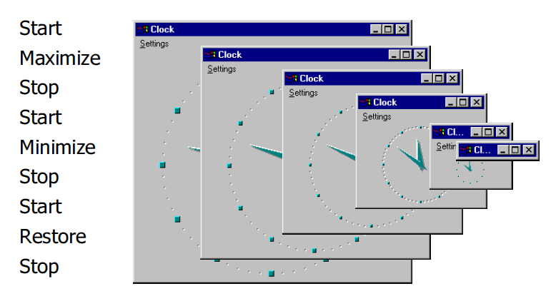
Shrinking clock bug

Slide 24
How does this relate to Model Based Development?
Development methodologies
  Textual Requirements
  Requirements as models
Available toolsets
  Matlab/Simulink
  SCADE
  Rhapsody
  Test Designer
  ModelJUnit
23

Slide 25
Conclusion
Pros:
Easy test case maintenance
Reduced costs
More test cases
Early bug detection
Increased bug count
Time savings
Time to address bigger test issues
Improved tester job satisfaction
Cons:
Need testers who can design , with specific type of set of skills
Models can be a significant upfront investment
Will never catch all the bugs
“All models are wrong, but some are useful”
George E. P Box 1919-

Slide 26

References
Boberg, Jonas. “Early Fault Detection with Model Based Testing”, ACM Erlang ’08, 2008
Robinson, Harry. “Intelligent Test Automation: A model based method for generating tests from a description of an application’s behavior”, Software Testing and Quality Engineering magazine, pp 24-32, 2000
Utting, Mark. “Model Based Testing: Black or White?”, Google Tech Talks, http://video.google.com/videoplay?docid=5521890509476590796#, 2007

