Slide 1
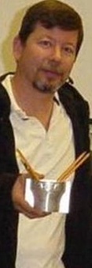
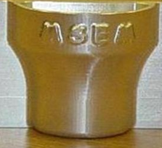
Celebrating our Students
MSEM Dept.
May 22, 2012

Slide 2
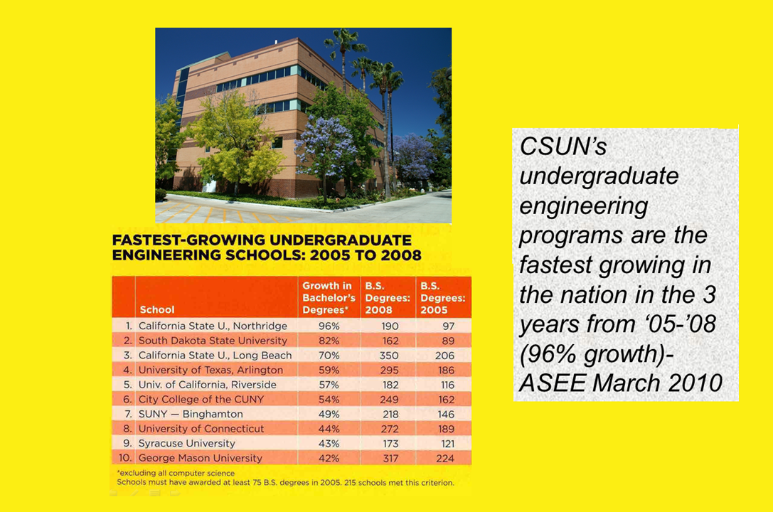

Slide 3
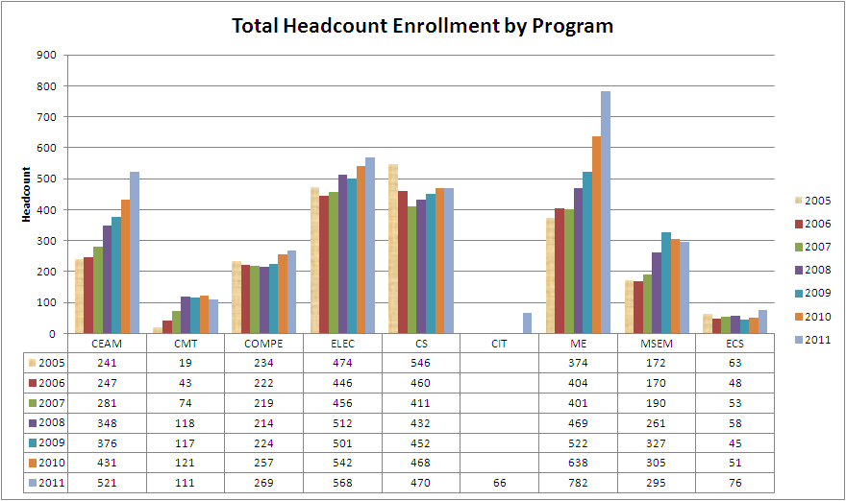

College Headcount Enrollment
College Headcount Enrollment
Fall 04 | 2071
Fall 05 | 2123
Fall 06 | 2040
Fall 07 | 2085
Fall 08 | 2412
Fall 09 | 2564
Fall 10 | 2813
Fall 11 | 3158

Slide 4
CECS receives 5.5M HSI-Stem Grant
September 2011
from Department of Education
collaborative proposal - AIMS² Project
CECS, College of Education, &
2 Community Colleges CO & GCC
support 120 students from all programs in college
student academic success and collaborative curriculum development using technology
continuation funding for year 2 $1.1 million (April)

Slide 5
College FTES Enrollment

Slide 6
MSEM Department Programs
BS MSE
BS EM
Minor in: MSE, Automation CAD/CAM, EM
MS EM - residential
MS EM - online (Fall13)
MS Quality Eng. (SP13)
MS MSE
MS Mat. Eng.
Quality Eng. Certificate

Slide 7
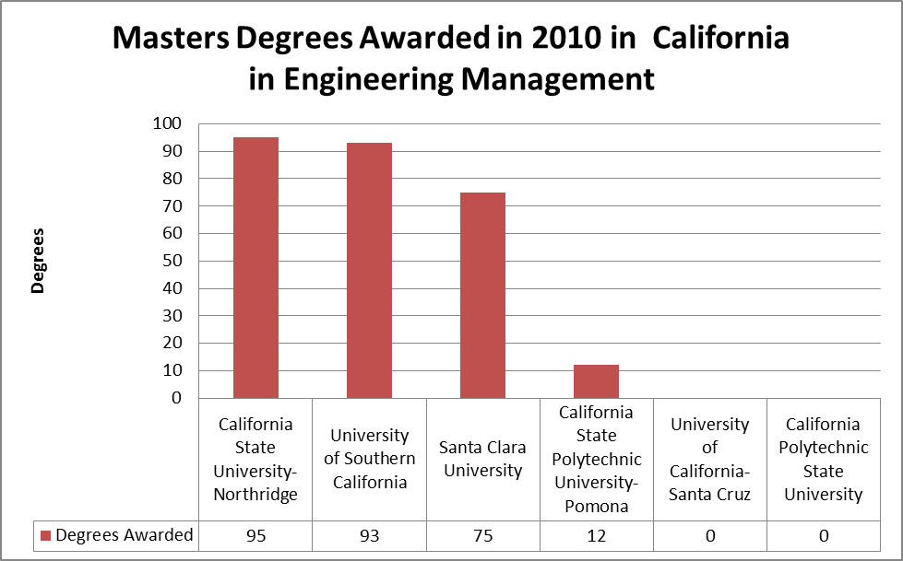
Masters in Engineering Management

Slide 8
MSEM Department
Labs: JD115 (Robots), JD1126 (CAD), JD1128 (CNC & RP) & CAD/CAM Software: AutoCAD, SolidWorks, CATIA, MasterCAM, CACI SimProcess
CNC Machines (MSE488A&B – Senior Design, MSE409/509 CAM, MSE609) & RP (MSE488 & MSE508/L)
Robots (MSE101/L VEX robot), MSE511 and MSE611 (Robotics), 488 (First Robotics)
WESTEC/SME–Conference of choice
Competitions: CSUN Project Showcase/CECS; Manufacturing Challenge/WESTEC, VEX and First Robotics
ACCESS – 101/L Prof. Tarek Shraibati - High Schools

Slide 9
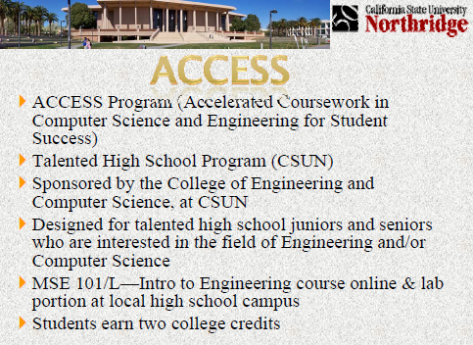

Slide 10
Automated Storage Unit
1st Prize at CSUN Project Showcase April 20, 2012
Students: Joseph Calderon, Hitesh Daggubati, Tigran Galstian, Josue Garcia, Jonathan Hopwood, David Pavell (Project Manager), Curtis Pedersen, Jasbir Sehmbey

Slide 11
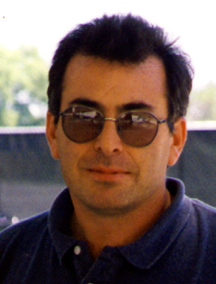
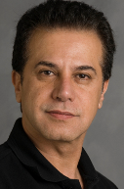
Automated Storage Unit
Student Collaboration:
MSE488 – Design/Manf. & MSE415 – Project Mang.
Tarek Shraibati
Faculty Advisor
Mark Rajai
Faculty Mentor

Slide 12
Dierctor MSEM Professor Mark Rajai

Slide 13
Ernie Schaeffer Center of Innovation and Entrepreneurship
Director MSEM Professor Mark Rajai

Slide 14
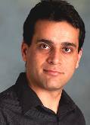

2012-13 CSUN Competition for Research,
Scholarship and Creative Activity Awards
2 MSEM Professors
Expansion Planning of Pressurized Closed-Cell
Road Networks via Metallic Foams
Agent-Based Optimization
Reviewed 115 proposals, 53 selected, 4 in CECS

Slide 15
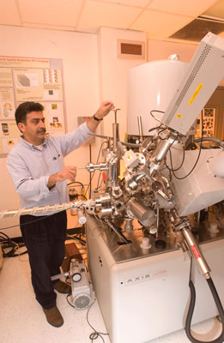
Prof. Behzad Bavarian received the National Association of Corrosion Engineers International 2012 Technical Achievement Award (January 2012)
Guides undergraduate & graduate students in advanced materials engineering research

Slide 16

All projects involve students as integral members of the research team
to test polymers to determine their suitability as coatings to protect the under-the-skin implantable sensors measuring blood fluids and their compatibility with the human body
Sensors attached to a pump simplify insulin regulation in diabetic patients
Pump last 5 to 8 years but the sensors exposed to body fluids degrade and have to be replaced every few months
B ehzad Bavarian
1 of 5 CECS faculty to receive one year grant
from Medtronic Minimed
November 2011.

Slide 17

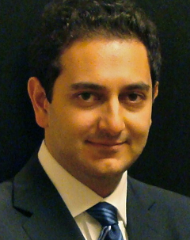
Amir Latifian | Rabeeh Sahranavard;
Anmar Hiassat
Rijul Dhruv | Andres Mata
;
Engineering Management
Student Association
promote culture of academic excellence in the EM program of the MSEM department
bridge between students-industries-faculty

Slide 18
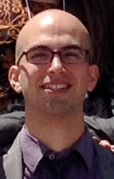
Mazyar Aram :
MSE Graduate Student
Research Assistant at Institute for Sustainability
Researched: energy consumption trend, energy efficiency ; alternative green energy solutions - cooperation of Physical Plant Management (PPM)
Won 2nd best research award of CSUN’s 16th Annual Student Research and Creative Works Symposium, April 2012

Slide 19

Max Aram: MSE Grad Student
Director of Environmental Affairs Committee (EAC)
Survey at Earth Fair 2012, April 18th
  15 questions
  assessment of educational campaign
  students input for environmental issues at CSUN
    Plastic Bags
    Commuting
    Water Bottles
Distributed 900 Chico Bags

Slide 20
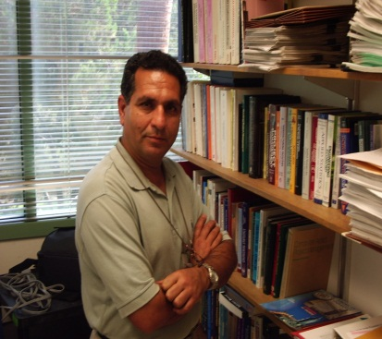
Professor Ahmad Sarfaraz
Published 14 papers in Scientific Journals
Presented 6 papers at Intl. Conferences
Promoted to full professor starting Fall 2012

Slide 21
Some important Questions, and our MSEM Programs

Slide 22
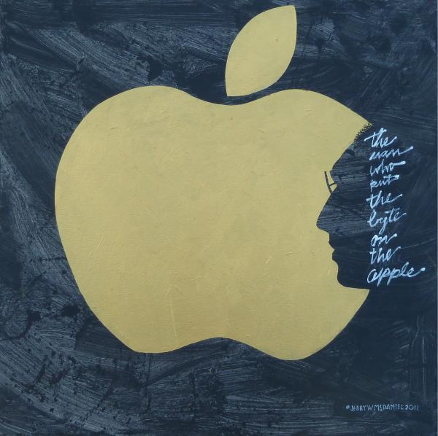
Engineering Management Program
Where to?
Steve Jobs’ success!
Innovative Managing of technology and beyond
in fast changing economy …

Slide 23
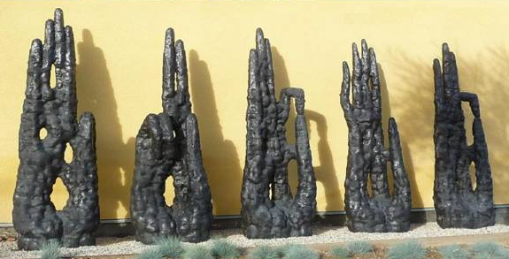
MSE Program
Art is beautiful! True?
Heavenly Hands Sculpture by Patriciu Mateescu 2005 on Plummer
Donated by Ileana Costea & Ion Baroi

Slide 24
Manufacturing is beautiful too!

Slide 25
MSEM Outstanding Students
MS Eng. MGMT: Amirmasoud Latifian
MS MSE: Mazyar Aram
MS Mat. Eng.: Mark R. Micklich
BS MSE: Jonathan Hopwood

Slide 26
Acknowledging Graduating
Students
BS MSE
MS MSE
MS Mat. Eng.
MS EM

Slide 27
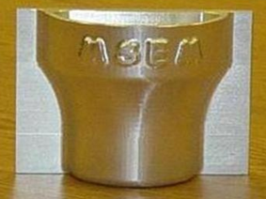
Celebrating our Students
MSEM Department
May 22, 2012

