Slide 1

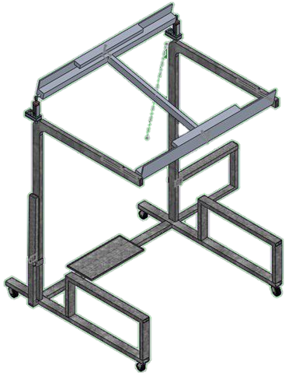

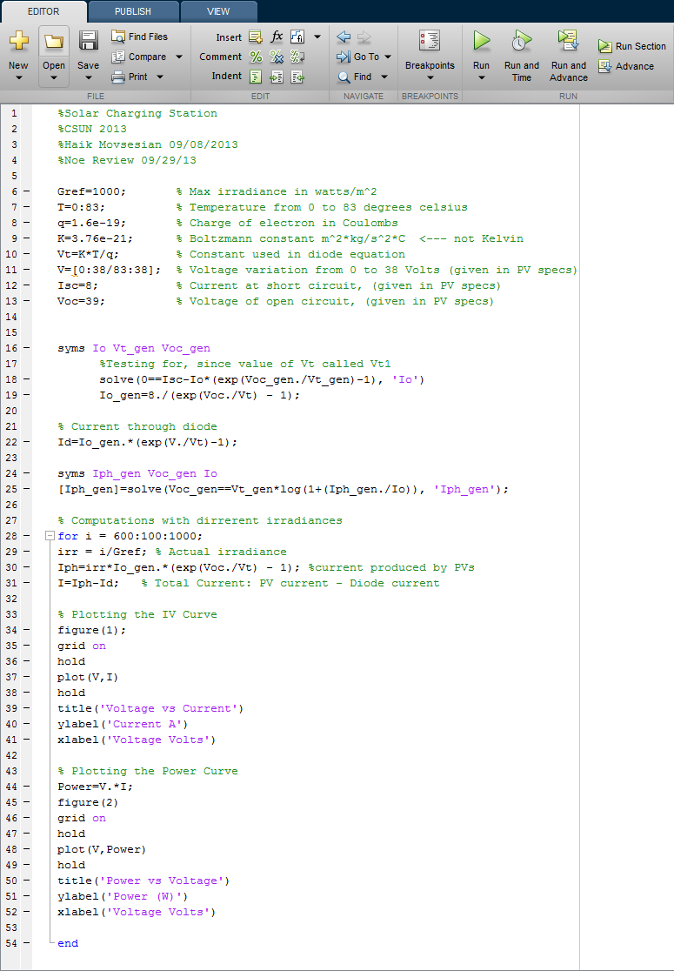
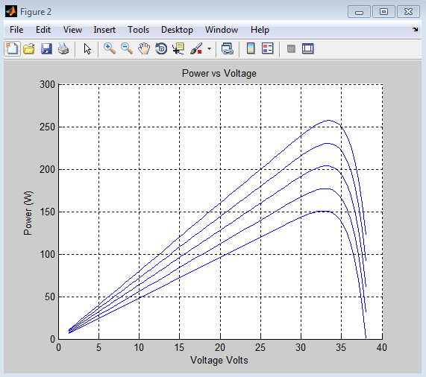
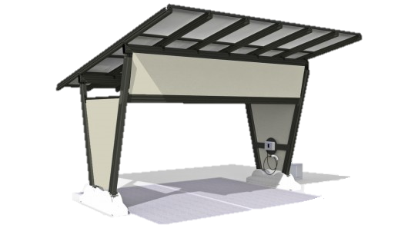
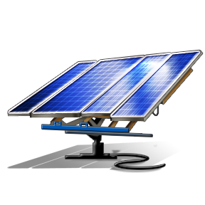
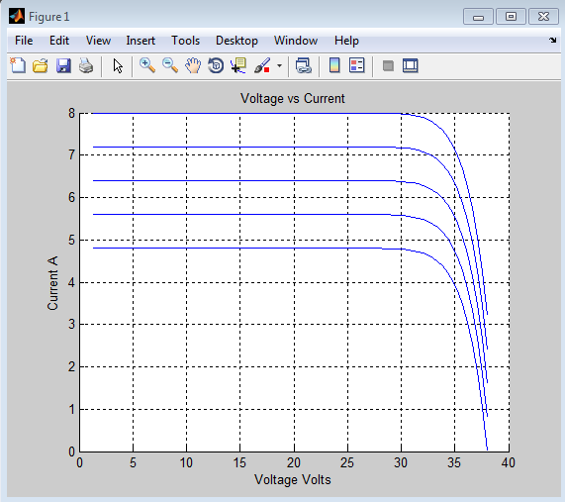
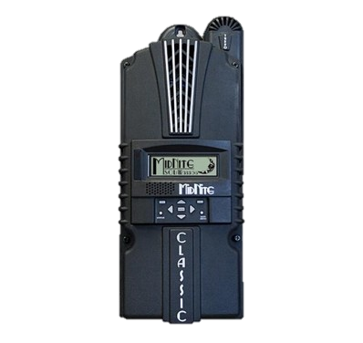
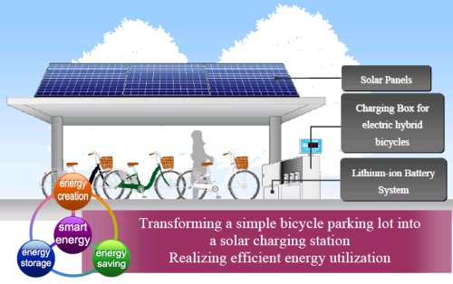
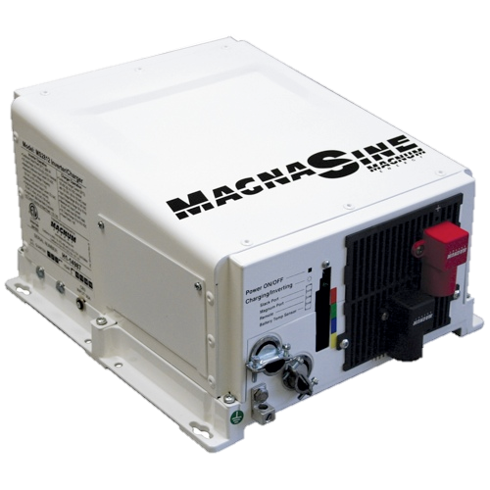
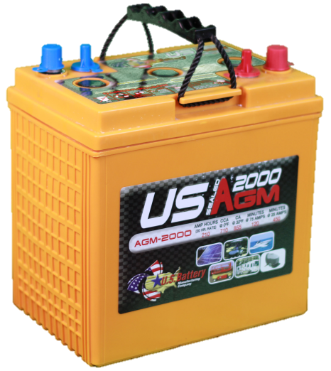

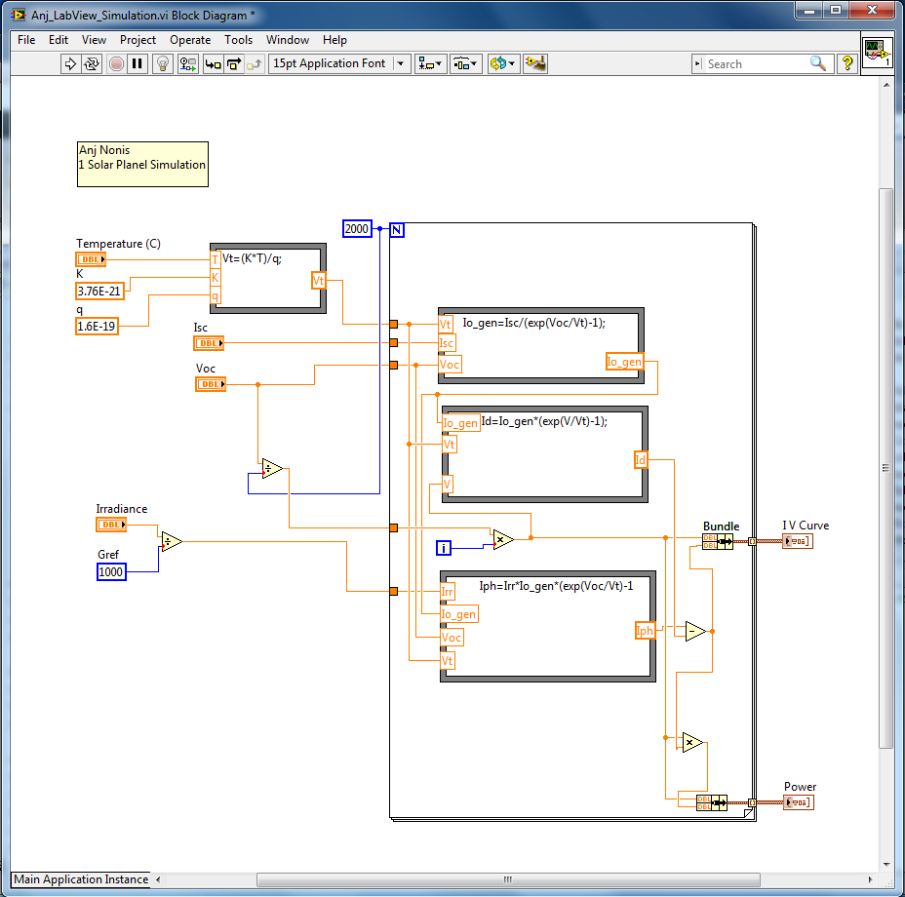
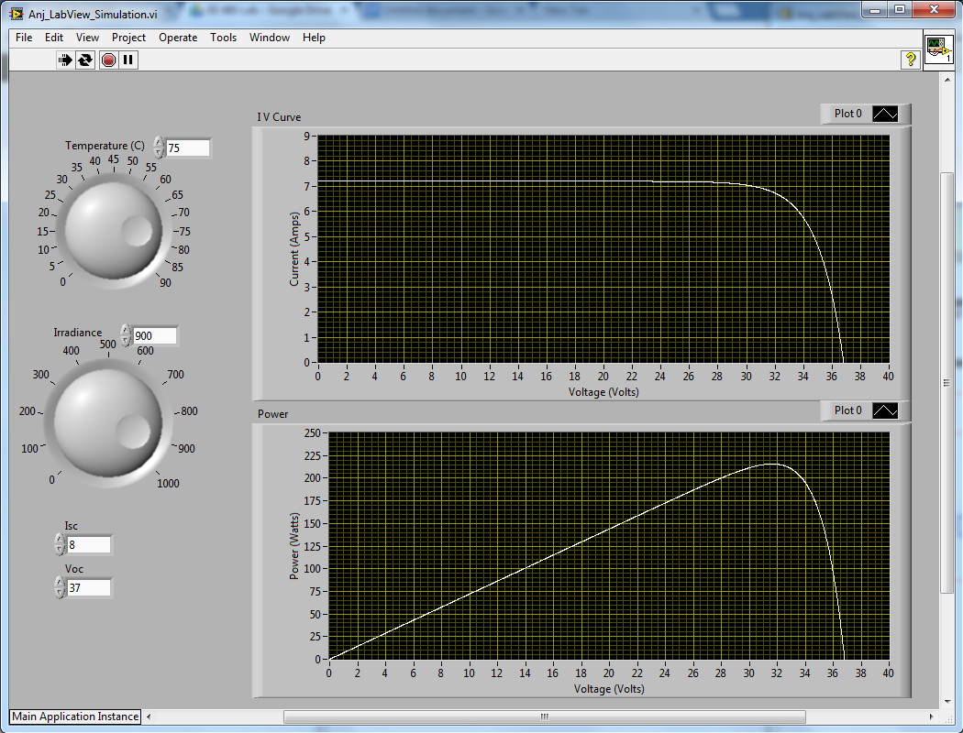
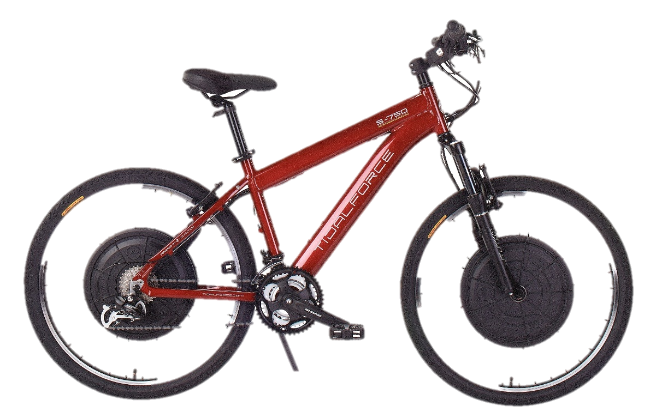
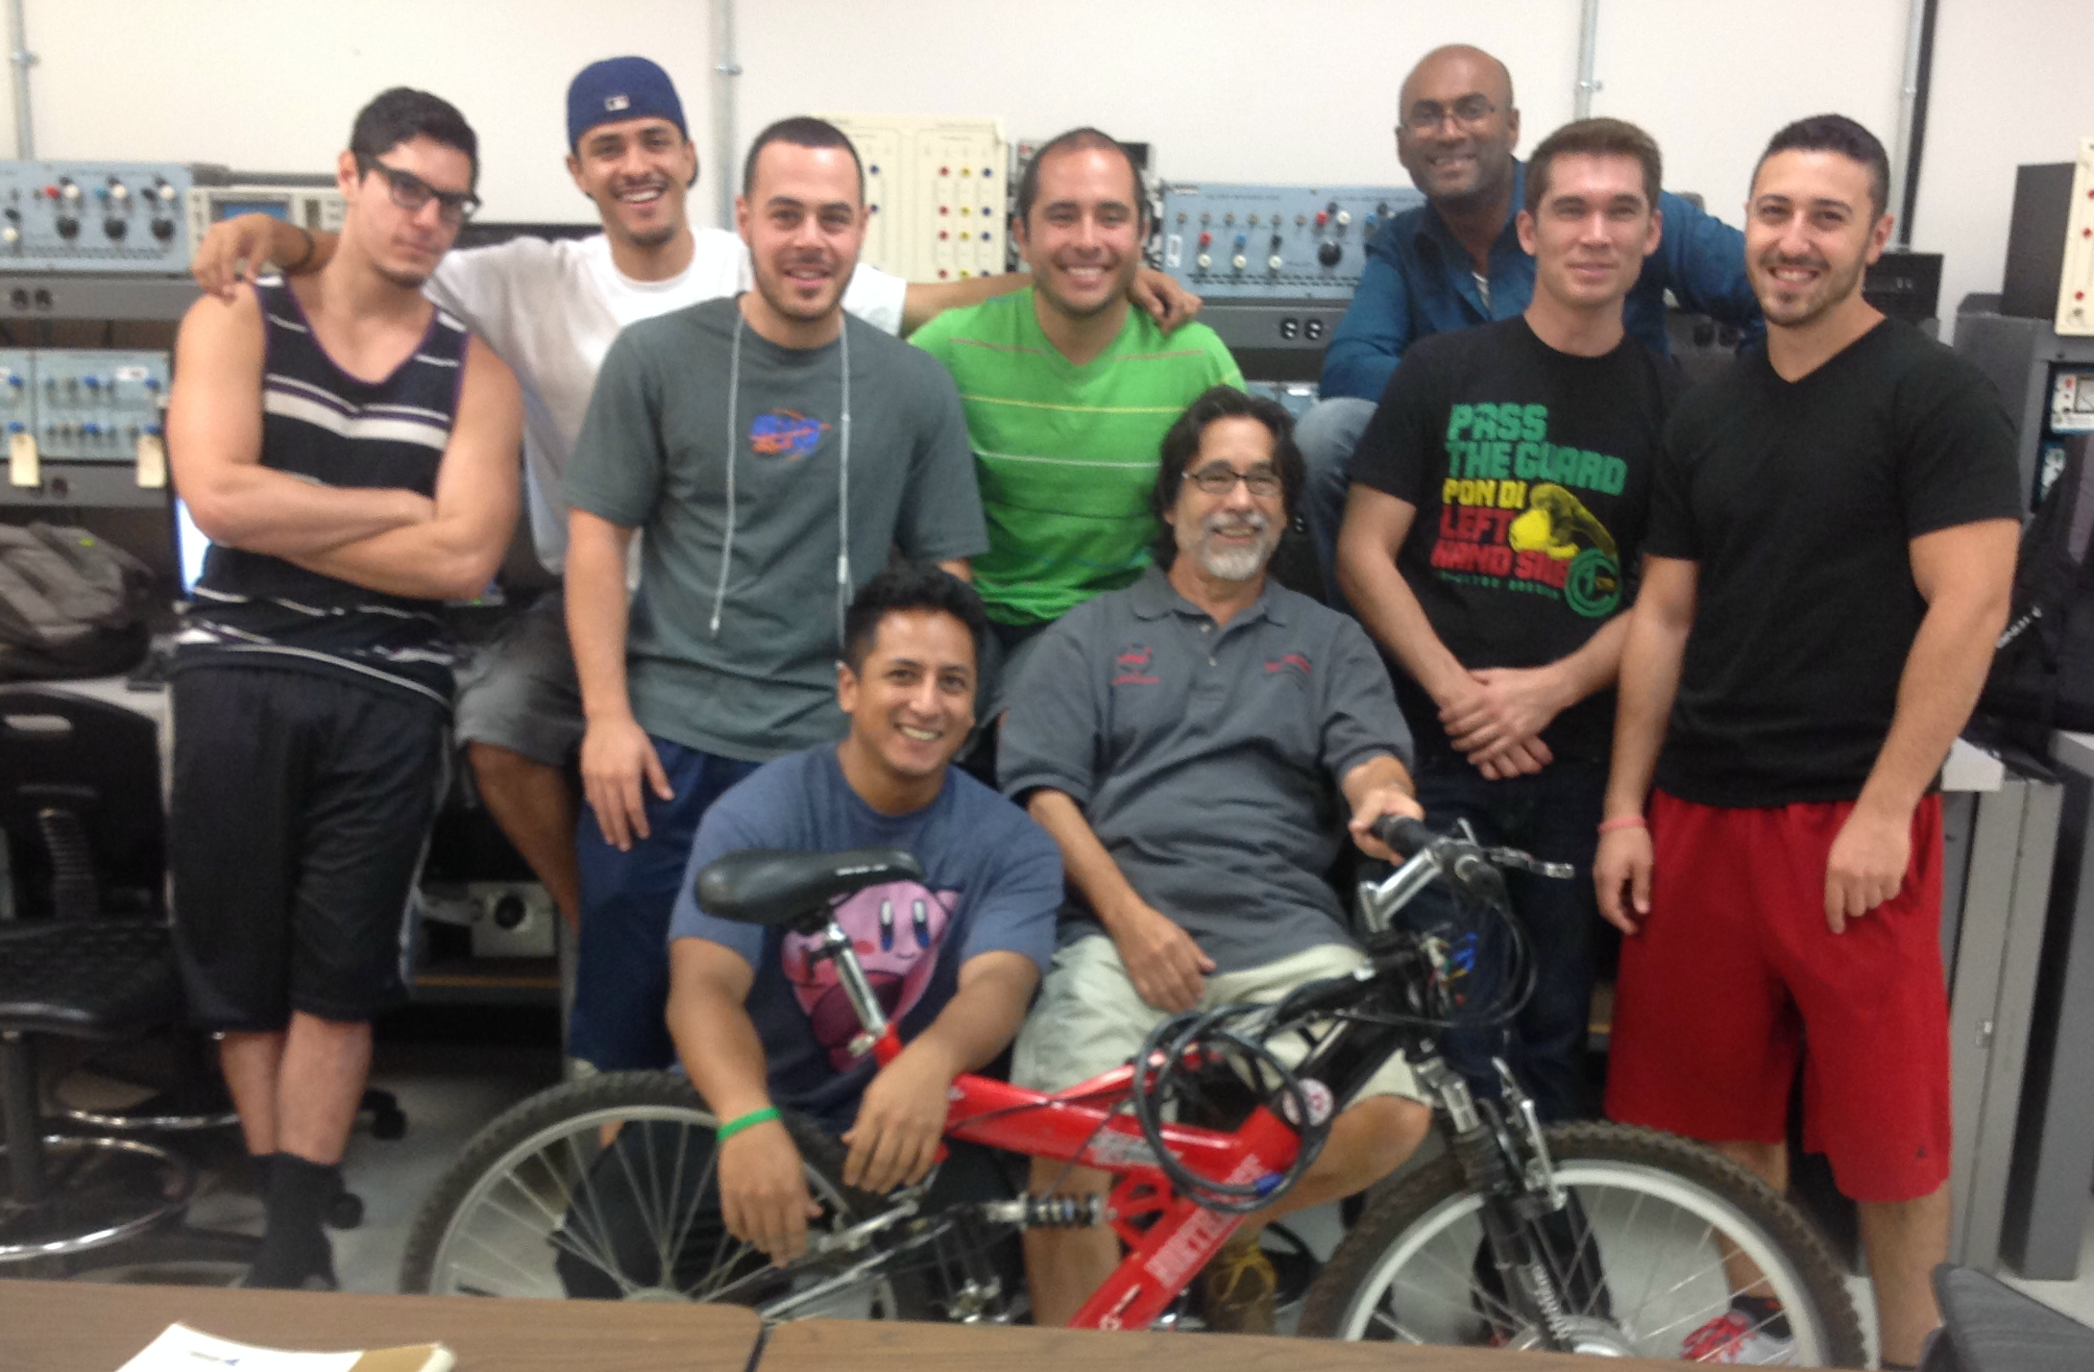
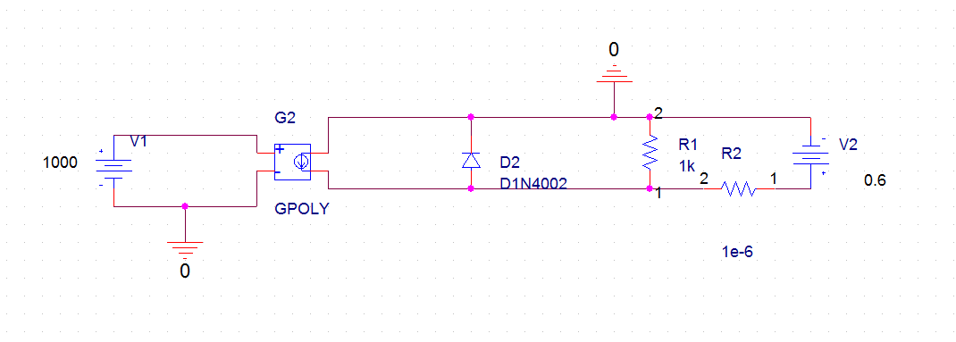

Electric Bicycle Station Design
For a more sustainable CSUN Campus
Team Members: Anj Nonis, Ale Villeda, Andrew Mirzakhanian,
Catherine Hartnek, Edgar Salvador, Eric Gamoning, Eric Webb,
Haik Movsesian, Kian Darian, Manuel Martinez, Noe Gonzalez,
Rafael Esquivel, Ryan Gomez, Sasha Kurkcuoglu
Attract Inspire Mentor
Support Students
AIMS²
Bruno Osorno, Faculty Advisor
Electrical and Computer Engineering Department, California State University Northridge
CHARGING STATION
CHARGE FLOW DIAGRAM
COMPUTER SIMULATIONS
MATLAB / Simulink
SolidWorks Design - Skeleton Structure Beta Version
Made of durable Galvanized Steel
Use of actuators for angle adjustment of panels
Foldable seating for easy transport
Heavy duty caster wheels for ease of mobility and weight support
Tubular steel frame for inside wiring
Solar Irradiance
from the sun
Charge Controller
Solar Panels
Overall Structure will be similar to a bus stop hub, with the panels providing shade for the individuals using the station.
An E-Bike parking lot will be integrated behind the seating bench.
Designated plugs underneath seat for each electronic device, allowing for conservation of battery bank.
May integrate interactive kiosk station for users: Educating users about green energy.
DC / AC Inverter
Battery Bank
LabVIEW
AC Power
DC Power
http://www.cyclelicio.us/2010/electric-rental-bike-solar-recharge-stations
Electric Bicycle/ Battery
TEAM
PSpice
Ease of Transportation for long distances
Charges as user pedals to recharge battery
Li-Ion cells
26V / 9.6 Ah / 248 Wh
Range: 65 km (40 mi.)
Weight: 2.9 kg (6.4 lb.)

