Slide 1
Service Oriented Architecture for Cloud Based Travel Reservation Software as a Service
Comp 684 – Rayna Burgess

Slide 2
Background
Cloud Computing
Software-as-a-Service (SaaS)
Service Oriented Architecture (SOA)

Slide 3
Cloud Computing
National Institute of Standards and Technology
http://csrc.nist.gov/publications/nistpubs/800-145/SP800-145.pdf
Cloud computing is a model for enabling ubiquitous, convenient, on-demand network access to a shared pool of configurable computing resources (e.g., networks, servers, storage, applications, and services) that can be rapidly provisioned and released with minimal management effort or service provider interaction.

Slide 4
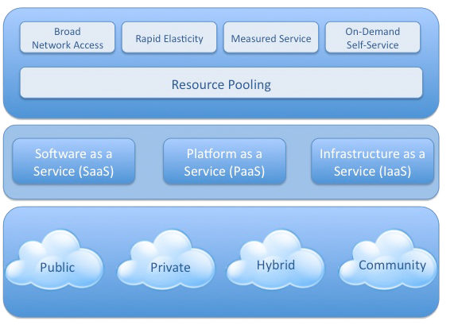
Cloud Model
NIST Definition of Cloud Computing Model
http://www.csrc.nist.gov/groups/SNS/cloud-computing/index.html
Notes:
Resource Pooling: The resources on the cloud are shared, many cients use same resources at same time.
Broad Network Access: Network based, accessible from any standard platform. Lets you do something you would normally do on your own computer on someone elses
Rapid Elasticity: Resources/Capabilities can be quickly scaled out or in. Good for handling spikes, efficient.
Measured Service: Cloud provider bills like the electricity company based on services used.
On-Demand Self Service: Client must be able to access the cloud services without human in loop

Slide 5
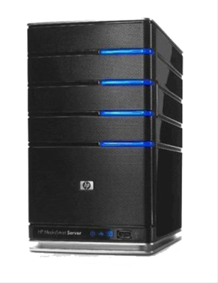
Service Levels
SaaS
GoogleApps,
Salesforce
PaaS
GoogleApp Engine
Windows Azure
IaaS
Amazon EC2,
Rackspace
Notes:
Iaas: Server provides hardware, Client provides OS etc.
Paas: Server provides hardware and OS and engines, Client provides application software
SaaS: Server provides hardware, OS and engines and application, Client customizes and uses

Slide 6
Service Oriented Architecture
Service-Oriented Architecture (SOA)
set of principles and methodologies for designing and developing software in the form of interoperable services.
Well-defined business functionalities that are built as software components that can be reused for different purposes

Slide 7
SOA Service Brokering

Slide 8
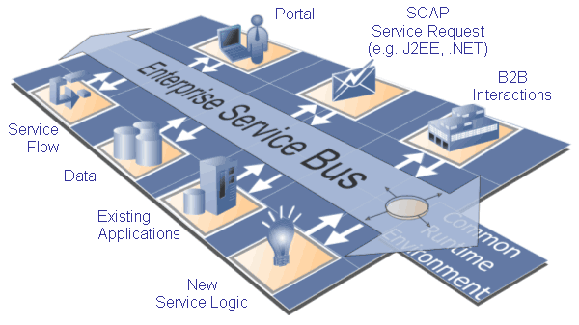
SOA ESB Architecture

Slide 9
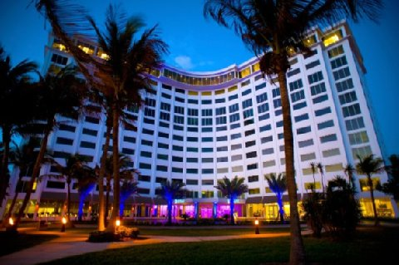
Requirements
Travel Service Consumers
Aggregated Travel Service Providers
Travel Service Providers
TRSaaS

Slide 10
Travel Services Consumers Requirements
Book flights and hotels
Change dates at short notice
Quickly adjust itinerary (flight/hotel)
Sort on price and convenience
Access to worldwide fares/availability
Access to most recent fares/availability
Unique corporate travel policies
Corporations build supplier relationships for benefits
Employees expect easy access to system
Data and transactions handled securely

Slide 11
Travel Services Suppliers Requirements
Increase their market share
Acquire global customers
Attract customers by adding value using collaboration with travel service providers

Slide 12
Aggregated Travel Services Providers Requirements
Easy to use one stop shop for travel services (added value)
Per corporation policies and variations using same application
Interoperate with heterogeneous travel supplier systems
Interoperate with heterogeneous corporate systems
Able to withstand technology advances
Scalable for increased suppliers and corporations

Slide 13
Quality Goals
Reusability
Interoperability
Maintainability
Reliability
Configurability
Customizability
Internationalization
Scalability

Slide 14
Architecture Patterns
Producer/Consumer
Service Directory
Asynchronous Business Process
Event Monitor
Data Transfer Object
Business Object
Master/Worker
Multi-tenant

Slide 15
Multi-tenant Architecture

Slide 16
Logical View

Slide 17
External Interfaces
Thin Clients
Email
Web Services
Consumer Tenant<N> Organization
Airline Supplier<N> Organization
Hotel Supplier<N> Organization
TRSaaS
Aggregated Travel Reservation Service Provider
Bank
Notes:
Customize per tenant

Slide 18
Amazon Services

Slide 19
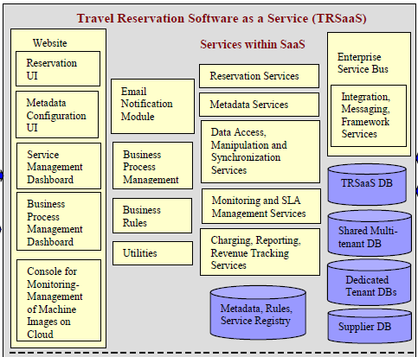
TRSaaS Components

Slide 20
Deployment View

Slide 21
Architecture Evaluation
Efficient solution
Quick solution by using Amazon services
Met the quality goals
Customizable by tenants
REST vs ESB tradeoffs?

Slide 22
Conclusion
Walking through the two architectural views helped:
Communicate ideas
Answer interface questions
Surface the vocabulary specific to this domain
Raise quality concerns and issues
The paper was informative and useful

Slide 23
Questions?

