Slide 1



Software Engineering for Game Development

Slide 2
“Ten or twenty years ago it was all fun and games. Now it’s blood, sweat, and code.”
J.Blow, Game Development Consultant, ACM Queue magazine, 2004
Overview: Omer Azmon
Notes:
When traveling to academic conferences, we are often asked: “Why are video games important? Why should I care?” The mere suggestion that games require special treat- ment often challenges those who believe that software engi- neering, regardless of domain, is fundamentally the same. When speaking to game developers, we hear the flip side of the coin: “Why is software engineering important? If I needed this, I would be using it already. This looks like a waste of time.” As one can tell, working at the intersection of games and software engineering can be disheartening.

Slide 3
GAS’11
The 1st International Workshop on Games and Software Engineering
Sponsored by: ACM SIGSOFT & IEEE CS
5 Papers on using Game Projects to teach Software Engineering
4 Papers on Game Software Engineering:
Software Reuse of AI Modules
Applying MMRPG success in involving people to improve Agile SE
Adding accessibility to a Game
"Serious Game Development as an Iterative User-Centered Agile Software Project"
2 Papers on creating games of a new category: Social Exercise/Outdoor
2 Papers with Observations on Games and Software Engineering
Modding as a Basis for Developing Game Systems
"The Whats and the Whys of Games and Software Engineering"

Slide 4
Purpose
”The intersection of video games and software engineering is not yet well understood”
The problems faced today are complicated and intricate.
In the next “plateau” of software growth, we all should expect to face the same. [our opinion]

Slide 5
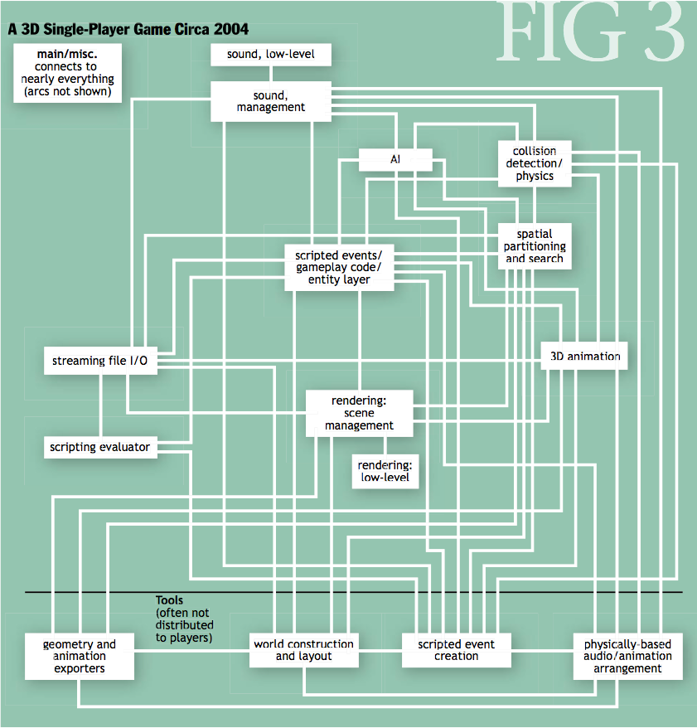
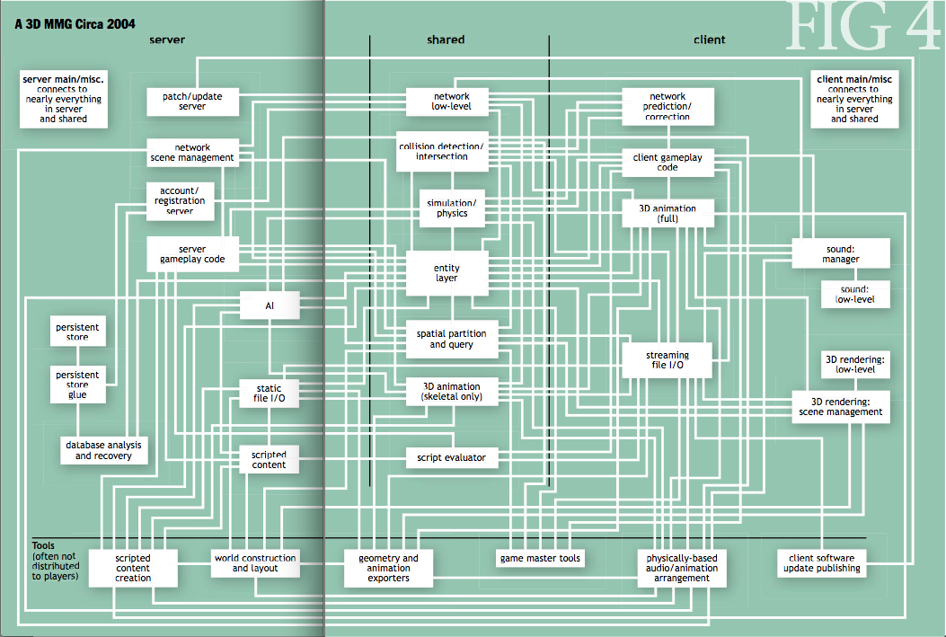
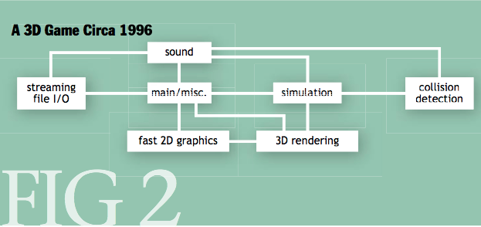
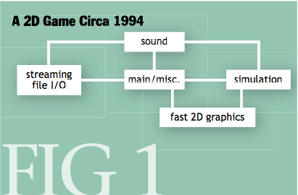
Problems of
Project Size and Complexity
􏰅􏰙􏰓􏰎􏰑􏰑􏰐􏰗􏰈􏰒 􏰣􏰗􏰋􏰎􏰖􏰤􏰚􏰁
􏰅􏰆􏰇􏰈􏰉
􏰅􏰙􏰓􏰎􏰑􏰑􏰐􏰗􏰈􏰒 􏰐􏰐􏰑􏰑􏰗􏰗􏰈􏰈􏰚􏰚􏰚􏰐􏰐􏰗􏰗􏰅􏰅􏰘􏰘􏰛􏰛 􏰣􏰗􏰋􏰎􏰖􏰤􏰚􏰁
􏰣􏰑􏰅􏰙􏰖􏰪􏰕􏰖􏰒􏰓􏰑􏰞􏰝􏰗􏰘􏰅
􏰅􏰅􏰆􏰆􏰇􏰇􏰈􏰈􏰉􏰉

Slide 6
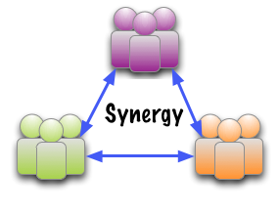
Why should we care about games?
The synergies lie in:
Development,
Design,
Middleware, and
Testing

Slide 7

Problems of
Process, Tools, and Environment
Top cited reasons for failure:
  Pipeline
  Team related (mixing Artists with Engineers)
“To tackle such complexity, it helps to have excellent development tools.”
At the bleeding edge of technical complexity.

Slide 8
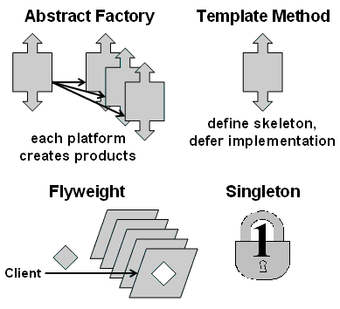
Problems of
Design Patterns and Formal Models
Missing a shared language of Game Design
Such as:
Games suffer from state space explosion
Notes:
“We should be able to play a side-scrolling shooter on a Game Boy, figure out one cool aspect of it, and apply that idea to the 3D simulation we’re build- ing... If we reach this level of understanding, evolution of design across all genres will accelerate... we need a shared language of game design” [6]

Slide 9

Problems of
Creativity Support
What is Creativity support?
Games are particularly amenable to creativity support.
Poses significant systems integration problems.
Notes:
Creativity Support is a field that straddles software engineering, human-computer interfaces, and artificial intelligence.
Games are amenable to creativity support as it is often difficult for a human to maintain an accurate mental model of all the affordance and constraints that a game design offers, whereas a computer is able to quickly assess how modifications to a game’s rules and level design may affect other components
However, a significant systems integration problem has now arisen, with Tschang noting that engines often need rewriting to provide specialized features.

Slide 10

Problems of
Testing the Game and GUI
Emergent software: Software where the system outputs are unpredictable.
  The current state of the art: manually testing, playing the game.
  Limited active research.
  AI is leading to emergence across the board.
GUI testing difficulties not limited to games
GUI testing is still in its infancy.
Notes:
Emergent software: Software where the system outputs are unpredictable.
The current state of the art in games testing is to hire hundreds of human testers to manually play builds of the game at various stages of the development process [27].
The only active research into testing emergent software, that we are aware of, is [17].
Software across all domains is beginning to incorpo- rate more technologies that will lead to emergence, particularly artificial intelligence.
This means, however, that games su↵er from the same GUI testing difficulties as other domains.
GUI testing is still in its infancy. [19] provides a useful summation of the challenges.

Slide 11

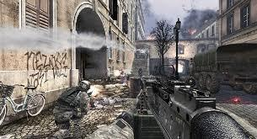
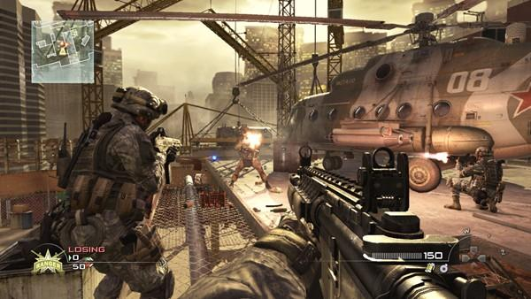

First Person Shooter Games: Chi-Chang Sun

Slide 12
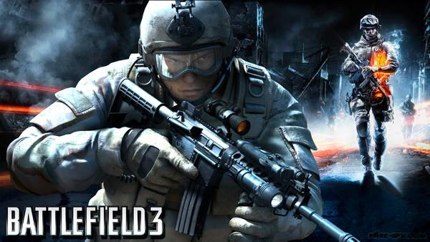
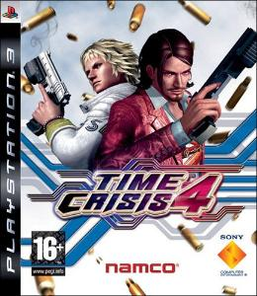

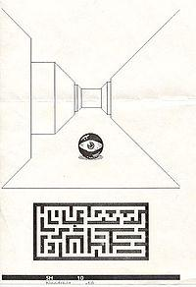

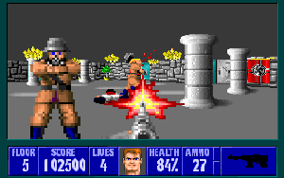
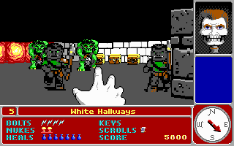
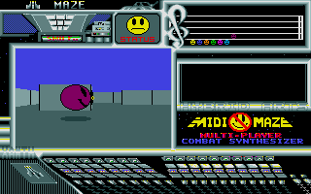
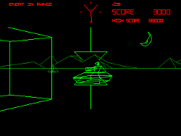

History

Slide 13
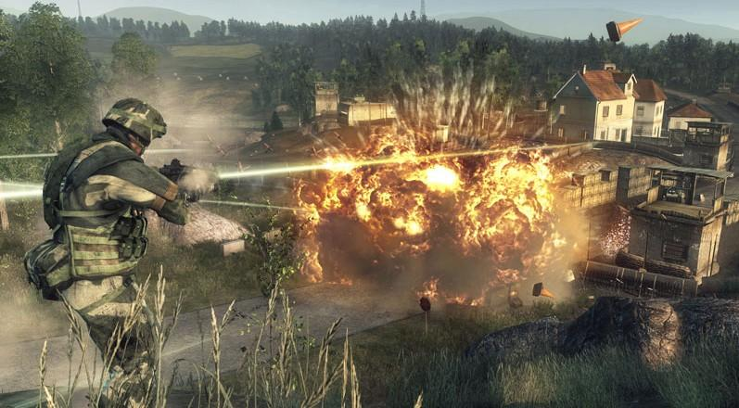

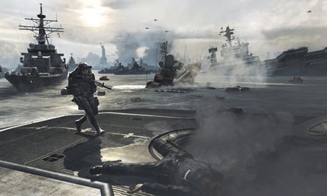
Theme

Slide 14
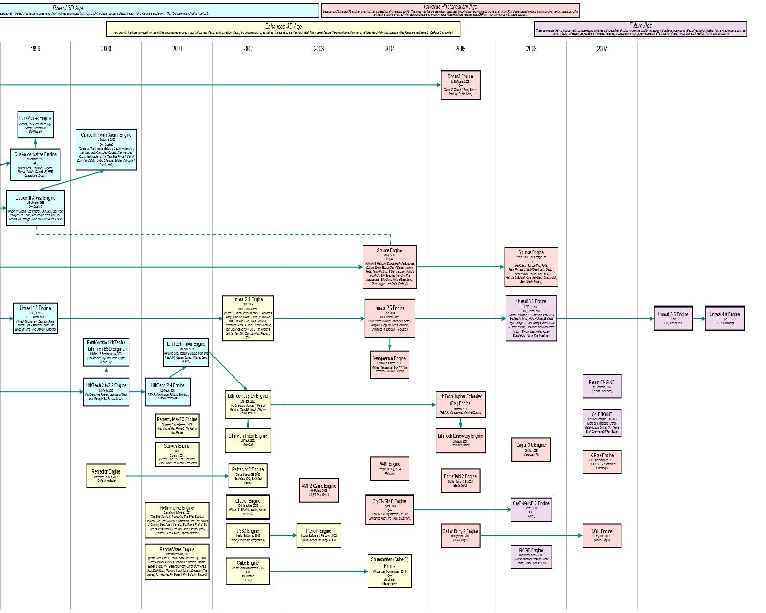



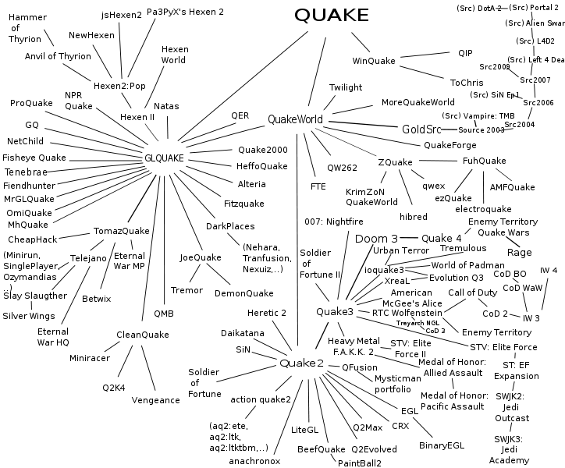

Game engines

Slide 15
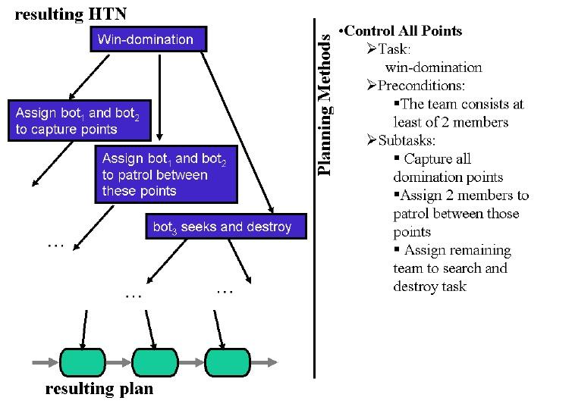
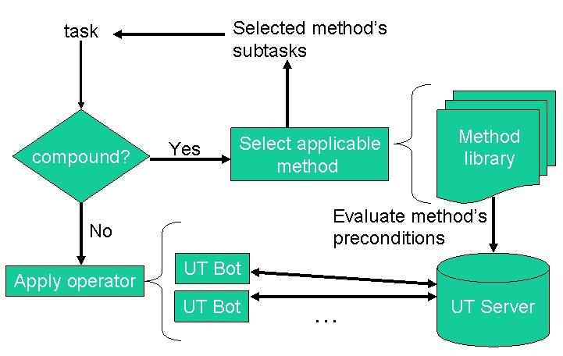
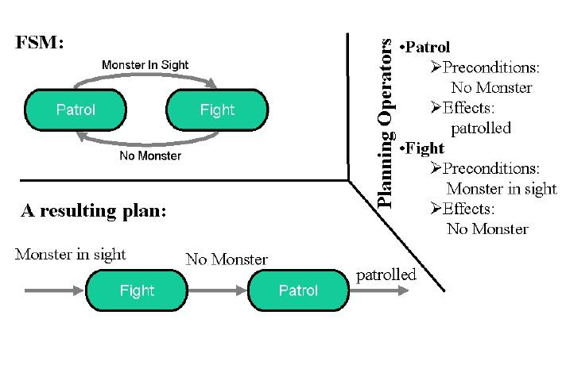
AI

Slide 16
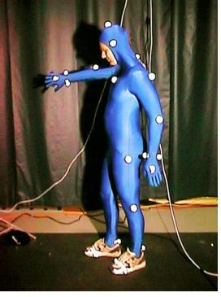
Re-usability
Engine
AI
Graphic
Physic
Theme
Idea

Slide 17
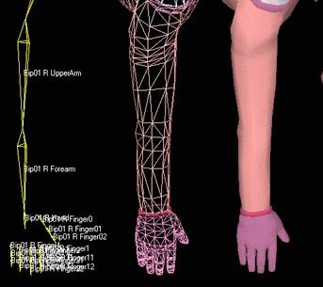

Testing
•Function Testing
•Action Testing
•Game-play
•Graphic Arts

Slide 18


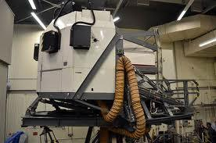
Simulator
A simulator for game attempts to replicate various activities in "real life" in the form of a game for various purposes: training, analysis, or prediction. Usually there are no strictly defined goals in the game, just running around, playing as a character. Well-known examples are war games, business games, and role play simulation.
Starting from three basic types of strategic, planning and learning exercises: games, simulations and case studies,- a number of hybrids may be considered, among which are simulation games and simulation games used as case studies.
The comparisons of the merits of simulation games versus other teaching techniques have been carried out by many researchers and a number of comprehensive reviews have been published
Simulator

Slide 19
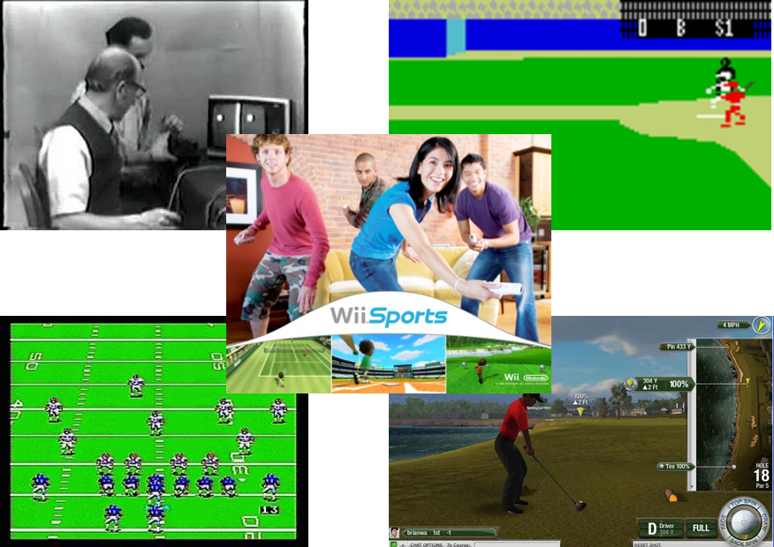
Sports Games: Ted Garcia

Slide 20
Overview
History
Methodologies
Architecture
Data Management
Languages
Take away: General understanding of software engineering for sports games

Slide 21
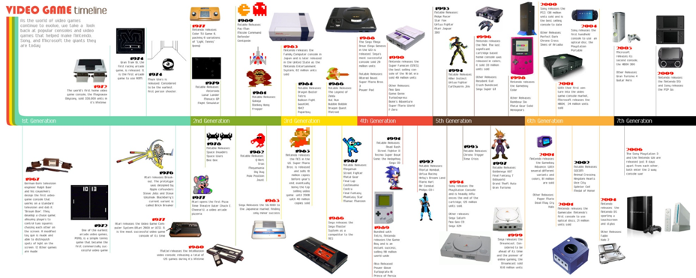
Sports Games – Timeline
What is the most popular sports game of all time?

Slide 22
Sports Games – Timeline
What is the most popular sports game of all time? WII Sports

Slide 23
Early Software Engineering
•1960s - Required mainframe computers and were not available to general public; text-based
•1970s - Commercial game development began
–first generation video game consoles and home computers.
–a lone programmer could develop a full game
–The first video game was a sports game and the game was Atari’s Pong in 1972
•1980s and on - Impossible for a single developer to produce a mainstream game
–In 1983 the first game to incorporate multiple camera angles in a manner resembling a television broadcast.

Slide 24
What is the most common software development method used in sports game development?

Slide 25
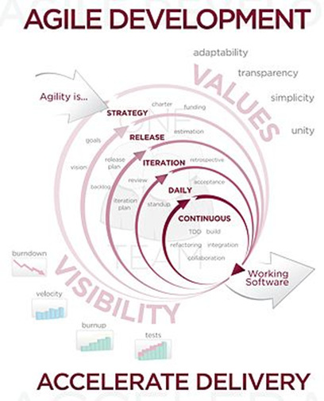

Slide 26
SDLC Methods - Sports Games
Ad Hoc
  In the 1970’s a programmer could develop a game entirely by themselves.
  Assembler was used for the arcade systems and later game consoles.
Formal
  Development became more formal in later years when game teams became too large for ad hoc methods.
Agile
  Sports game development became agile in newer game companies and smaller ones.
Note: Overall game development is not suited for typical software life cycle methods, such as the waterfall model.

Slide 27
Agile Principles applied to
Sports Game Development
"Welcome changing requirements, even late in development. Agile processes harness change for the customer's competitive advantage."
  Must get in every possible feature for launch
"Business people and developers must work together daily throughout the project."
  Artists, actors, engineers, directors, etc.
"The best architectures, requirements, and designs emerge from self-organizing teams."
  Talent attracts other talent which yields synergy and results
*

Slide 28
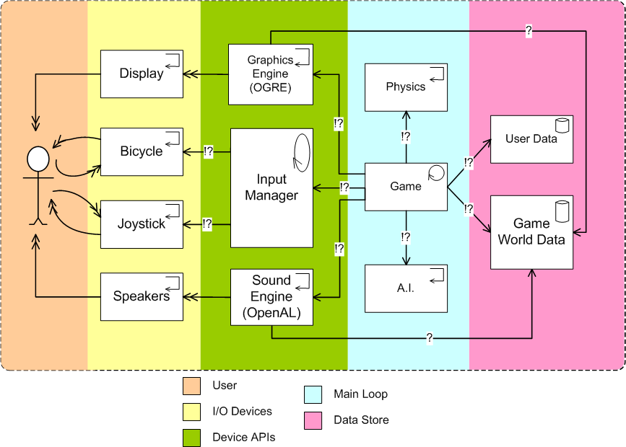

Slide 29
Architecture - Games Challenges
Complexity
  Intelligent games
  Multi-player
  Internet
Bleeding edge technology
  Latest user interactive devices
  Latest video drivers
  High-res art and animation
Competitive market
Lack of portability
  Computers, Phones and tablets
  Game consoles
What is the most popular architecture paradigm?

Slide 30
Architecture - Object Orientation
Object-oriented Design
  UML is often used
Components and classes
  Graphics component - art render engine
  Game play component - what the user does
  Device controls
  Characters
  Artificial intelligence
  Game logic rules

Slide 31
Architecture -
Game Engine Commodization
Evolution of componentry
  First games were done from scratch
  Then there were libraries
  Now there is major components called “engines”
Game Engines
  OGRE by Open Source; BigFly Baseball
  Unity by Unity Technologies; Tiger Woods
  Proprietary by EA; NCAA Baseball
Accelerates development and testing
Provides a platform for many games

Slide 32
Data Management
Challenges
  Players perform conflicting actions at a very high rate
  Traditional approaches such as locking transactions are too slow
  Concurrency violations in scripting languages are one of the largest source of bugs
  Data separation between software engineers and game designers

Slide 33
Data Management
Some solutions
  Intelligent Checkpointing - in-memory databases
  Data-driven design
  Common data structures such as user info may be in RDBMS
  XML specification language - allows players to customize the user interface
  Integrate with external databases - Tiger Woods golf courses

Slide 34
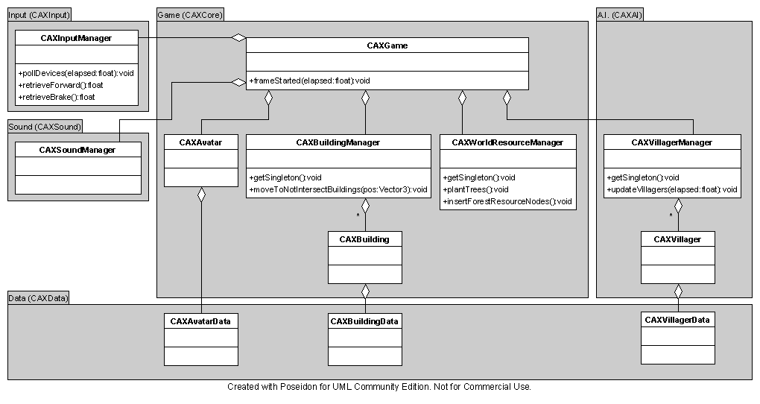
Languages

Slide 35
Languages
Diversity
Parallel programming improves performance
Low-level - assembler for devices
Middle-tier - C, C++
Application - scripting, scripting, scripting
  Character behavior
  Game play
  Shaders
  Animation

Slide 36
References
http://www.cs.cornell.edu/bigreddata/games/tutorial-sigmod2009.pdf
*Source or quoted text: http://agilemanifesto.org/principles.html
http://en.wikipedia.org/wiki/Game_development
http://en.wikipedia.org/wiki/Sports_game
http://en.wikipedia.org/wiki/Game_programmer
http://dundee.cs.queensu.ca/wiki/index.php/CAX_Game_Architecture

Slide 37
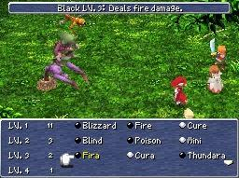
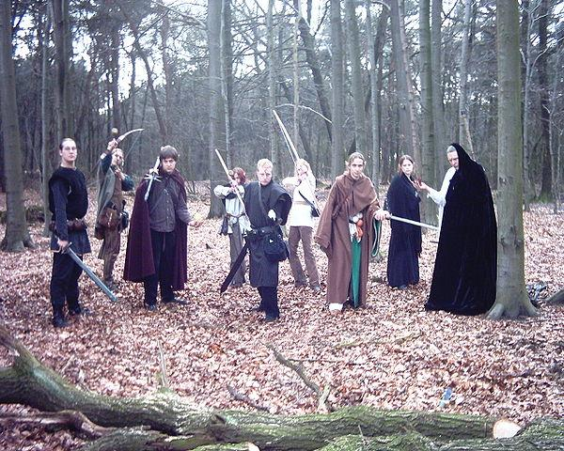
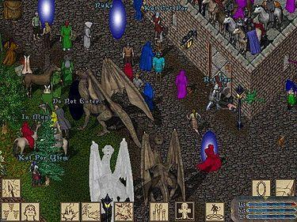
Role Playing Games: Shahdat Hossain

Slide 38

Overview
Background
Game Making Software
Tools
HTML5 and RPG Games
Game Database
Mobile RPG Games
Language, Frameworks and Testing

Slide 39
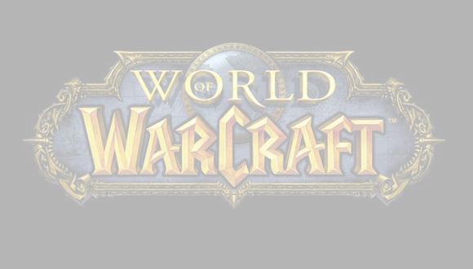
Background
What are RPGs. - A role-playing game (RPG and sometimes roleplaying game) is a game in which players assume the roles of characters in a fictional setting.
Examples - Final Fantasy, The Legend of Zelda, Dragon Slayer.
How they differ from Other type -The premise of most-role-playing games tasks the player with saving the world. There are often twists and turns as the story progresses, such as the surprise appearance of estranged relatives, or enemies who become friends or vice versa.

Slide 40

A RPG Game - 4story

Slide 41

Game Making Software
Free
3D Adventure Studio, Game Maker, RPG Maker XP
Commercial
DarkBasic Pro, GLBasic, The 3D Gamemaker, GameSpace, GameStudio

Slide 42
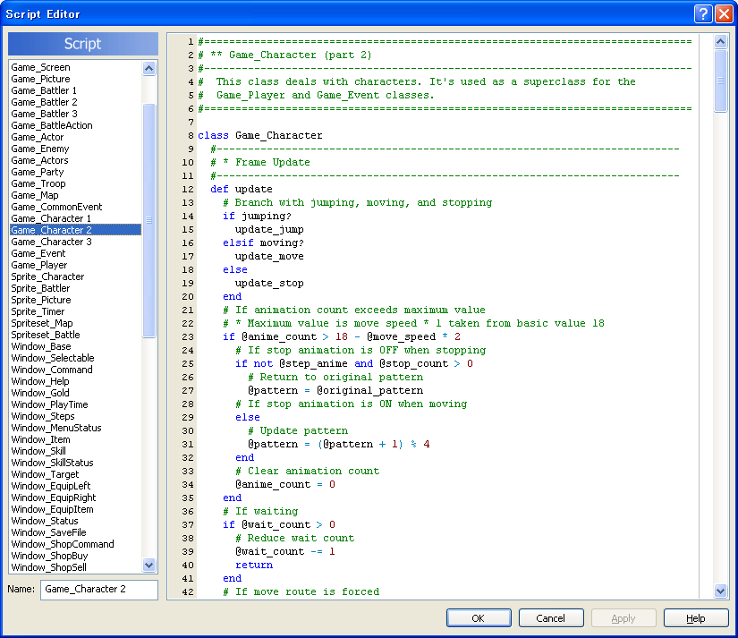
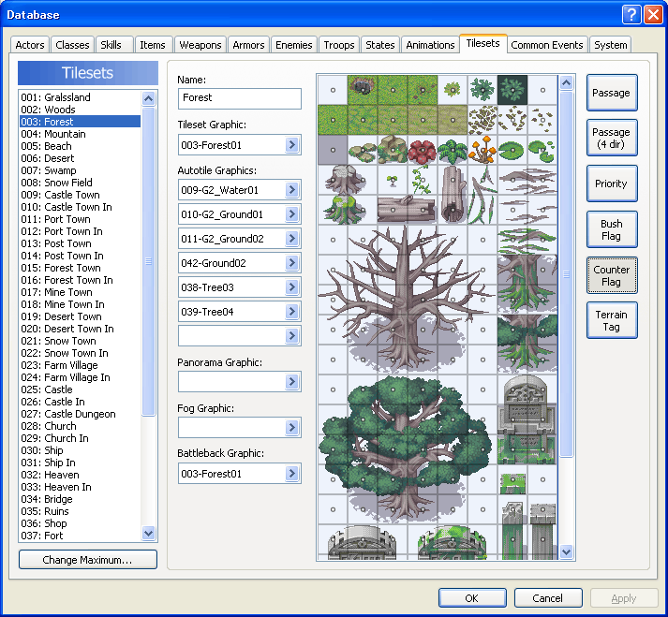
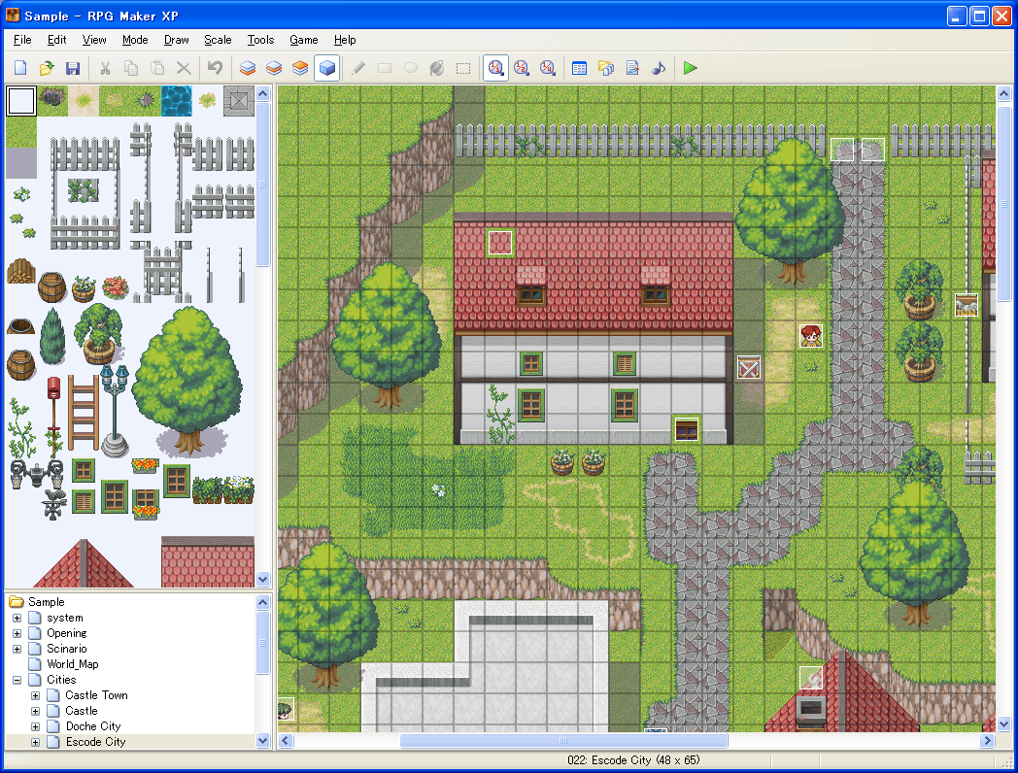
Game Making Software: RPG Maker

Slide 43
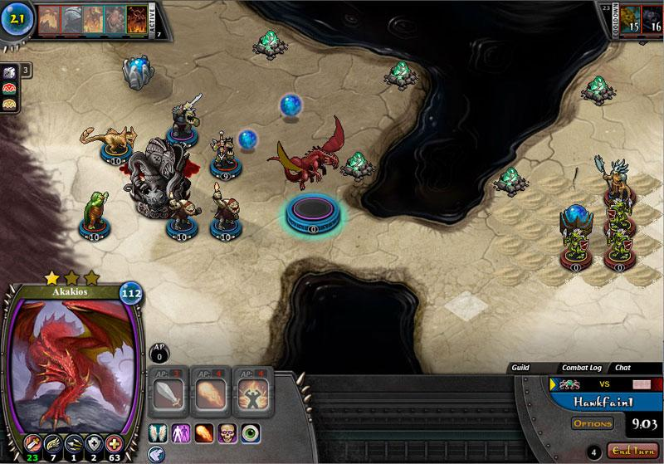
Tools
Virtual Table Tops - Virtual tabletop software (sometimes referred to as VT or VTT) is designed to enable one or more users to play games on their computer that are traditionally played on or around a table. In the case of multiple users, players, or participants, this is generally done online. A VT is like a shared whiteboard, but with features that are specifically geared to facilitate gaming in particular.
3rd Party Engine such as Abyssal. - The Abyssal Game Engine is a powerful professional game creation tool kit and rendering system for creating quality 3D software. The technology is designed to reduce development time while empowering developers with a strong suite of tools needed to produce great visual effects and support immersive online game worlds.

Slide 44
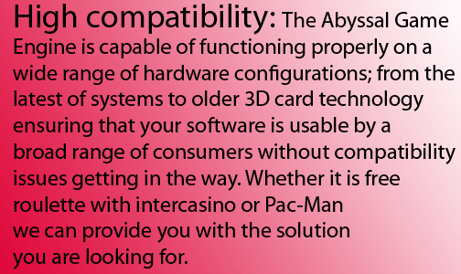
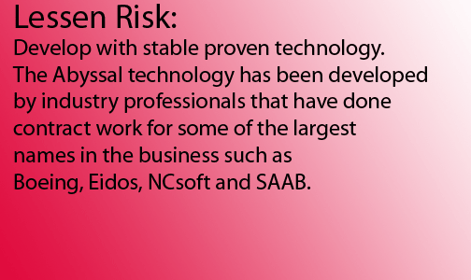

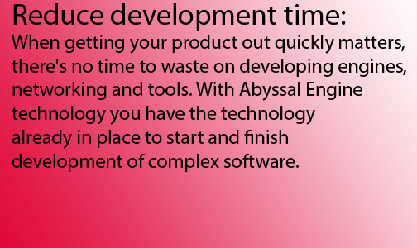
Advantage of 3rd party Engines

Slide 45

HTML5 and RPG Games
Promising proof-of-concepts
HTML5 Game Libraries: Impact, Akhiabara, Rocket Engine, LimJS
They help with the heavy lifting: Asset management, animation, physics, keyboard / mouse input, processing of sounds and graphics
Hybrid model: Open Source with commercial licensing = free to use / experiment with cheap to commercialize.

Slide 46

HTML5 Pros for RPG
Cross Platform: Any device with an HTML5-enabled browser (including about 160 million iOS devices)
More CPU-efficient than Flash
Frictionless distribution: Put it online and the entire world can play it
Client-Server / Network Functionality: Just like building any other online application.
Network functionality plays a major role for the Multi Player RPG games.

Slide 47
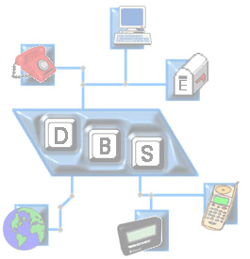
RPG Game Database
Many modern computer games are authored using data-driven development techniques. In data-driven development, the game content is separated as much as possible from the game software, and placed in auxiliary data files.

Slide 48
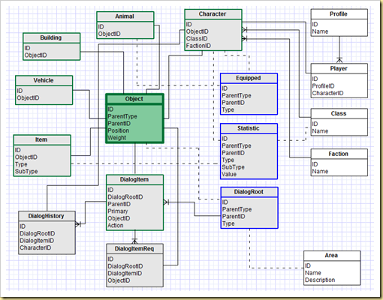
Sample RPG Game Database

Slide 49
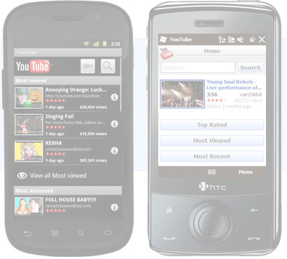
RPGs on Mobile Applications
Many mobile friendly RPG games are available such as Battle Heart, Dungeon Defenders and Order and Chaos.
One way to get out of HTML5 related issues are to go with iOS or Android app store. This bypasses a lot of cons that sometime HTML5 offers..

Slide 50
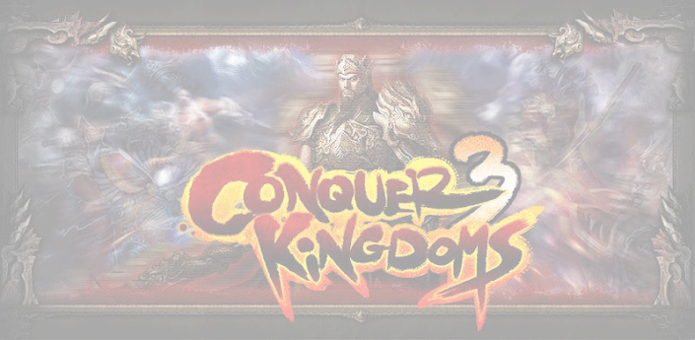
RPG Game Languages
C++ with a library such as SDL or Allegro, Scratch, C# has XNA and even an RPG template you can play with.
And also...lots of scripting..scripting and scripting!!

Slide 51

XNA Framework
One of the popular framework that is used for RPG game development is XNA Framework.
The XNA Framework is based on the native implementation of .NET Compact Framework 2.0 for Xbox 360 development and .NET Framework 2.0 on Windows.
XNA Game Studio 4.0 now supports the latest version of Visual Studio, LINQ and .NET.

Slide 52

Testing
Young crowd to test the game in real time - Extensive software testing is done by internal QA teams and then game is open to the target audience to find all the bugs!
Multiple client-server testing - BOX360, PS3 and many other game console requires extensive players across many countries - thus testers across many countries.
Code and Graphics - Code and graphics is really proprietary and internal company software engineers as well as QA takes care of them.

Slide 53

References
http://www.slideshare.net/mdecatur/html5-games-an-introduction
http://en.wikipedia.org/wiki/Microsoft_XNA
http://en.wikipedia.org/wiki/Role-playing_game
http://msdn.microsoft.com/en-us/aa937791

Slide 54
“{Would be nice to put a "light" quote here, if you got one}”
Wrap up by Omer Azmon

Slide 55
Conclusion
As we have seen, the problems that Game Software Engineering faces today foreshadow “the complexity and intricacy” we all should expect to face in the next “plateau” of software growth."

Slide 56
Bibliography
Game Development: Harder Than You Think http://dl.acm.org/ft_gateway.cfm?id=971590&type=pdf&coll=DL&dl=ACM&CFID=67931479&CFTOKEN=76754782
Balancing the tensions between rationalization and creativity in the video games industry, F. Ted Tschang (2007) http://go.galegroup.com/ps/i.do?action=interpret&id=GALE|A182605015&v=2.1&u=csunorthridge&it=r&p=ITOF&sw=w&authCount=1
The Whats and the Whys of Games and Software Engineering Chris Lewis, and Jim Whitehead
Proceedings of the GAS 2011

