Slide 1
Six Sigma
Melissa Schwartz
David Sanders
Rayna Burgess
Mike Epler

Slide 2
Scott Adams not a fan!

Slide 3
Main goals of Six Sigma
Six Sigma is a business management strategy that seeks to improve the quality of process outputs by:
Identifying and removing causes of defects (errors)
Minimizing variability in manufacturing and business processes
Attains these goals using:
A set of quality management methods, including statistical methods (DMAIC and DMADV)
A special infrastructure of people within the organization that ranks experts in these methods

Slide 4
What motivated this initiative?
Motivated by quality improvement methodologies developed decades earlier:
Quality Control, TQM, Zero Defects, etc.
Motorola originally developed Six Sigma to streamline the companies manufacturing processes (1986)

Slide 5
More Scott Adams Cynicism

Slide 6
Who is behind Six Sigma?
Bill Smith – “The Father of Six Sigma”
Graduated US Naval Academy in 1952
Studied at the University of Minnesota
35 years in engineering / quality assurance
Joined Motorola in 1986
VP & Senior QA manager - Land Mobile Products Sector

Slide 7
When was Six Sigma initiated?
B. Smith introduced statistical method
Smith lobbied outgoing CEO Bob Galvin for implementation
Implemented in 1987
Memo dated January 15, 1987 from Galvin to all employees launches Six Sigma Program
Smith and Galvin are inaugural members of the Six Sigma Hall of Fame

Slide 8
Scott Adams doesn’t like Lean Six Sigma either…

Slide 9
Who uses Six Sigma?
Notes:
This chart was made in 2004 but Wikipedia still lists over 120 companies doing six sigma
Many of these are using six sigma for manufacturing but several are using it for software development

Slide 10
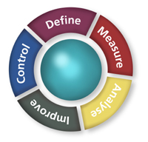
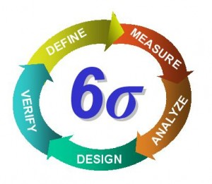
Main/unique features
Focus on measurable, quantifiable financial returns
Emphasis on passionate management
“Champions,” “Master Black Belts,” “Black Belts,” etc.
Methods:

Slide 12
Relationships, similarities, & differences with other approaches?
 | Relationship | Process Areas | Markets
Six Sigma | ASQ Influence | Generic Product and Process model | financial, manufacturing
CMMI | Incorporates portions of ISO 15504 | Software process model: process, customers, deliverables, policy, training | manufacturing, military, and aerospace
ISO 9001 |  | Originally for manufacturing but applicable as a generic quality model | manufacturing
Malcom Baldridge | Influence from ASQ and APQC | High level holistic quality model. Processes: customer, leadership, process, strategic planning, human resources, information and analysis, business | all
ISO 15504 | Process Lifecycle derived from ISO 12207 Maturity Models from Bootstrap, Trillium, and CMM. | Processes: organizational, management, engineering, acquisition supply, support, operations | automotive, space, medical systems, military and aerospace
ISO 12207 | DoD-STD-2167A MIL-STD-7935 | Processes: acquisition, supply, development, maintenance, and operation | military and aerospace

Slide 13
Our opinion of Six Sigma
Embraces Continual Organizational Process Change Focusing on Business, Operational and Process Metrics
Profit
Cycle times
Marketplace response
Resources
Good for Incremental Product Improvement
Ramp Up Drawback due to a Complex Set of Metric Tooling
Implementation of a Personnel Change Management Plan is Critical
Doesn’t address the product creative processes

