Slide 1

William Stallings
Computer Organization and Architecture
9th Edition
Notes:
Lecture slides prepared for “Computer Organization and Architecture”, 9/e, by William Stallings, Chapter 14 “Processor Structure and Function ”.

Slide 2
Chapter 14
Processor Structure and Function
Notes:
This chapter discusses aspects of the processor not yet covered in Part Three and sets the stage for the discussion of RISC and superscalar architecture in Chapters 15 and 16.
We begin with a summary of processor organization. Registers, which form the internal memory of the processor, are then analyzed. We are then in a position to return to the discussion (begun in Section 3.2) of the instruction cycle. A description of the instruction cycle and a common technique known as instruction pipelining complete our description. The chapter concludes with an examination of some aspects of the x86 and ARM organizations.

Slide 3
Processor Organization
Processor Requirements:
Fetch instruction
  The processor reads an instruction from memory (register, cache, main memory)
Interpret instruction
  The instruction is decoded to determine what action is required
Fetch data
  The execution of an instruction may require reading data from memory or an I/O module
Process data
  The execution of an instruction may require performing some arithmetic or logical operation on data
Write data
  The results of an execution may require writing data to memory or an I/O module
In order to do these things the processor needs to store some data temporarily and therefore needs a small internal memory
Notes:
22
To understand the organization of the processor, let us consider the requirements placed on the processor, the things that it must do:
Fetch instruction: The processor reads an instruction from memory (register, cache, main memory).
Interpret instruction: The instruction is decoded to determine what action is required.
Fetch data: The execution of an instruction may require reading data from memory or an I/O module.
Process data: The execution of an instruction may require performing some arithmetic or logical operation on data.
Write data: The results of an execution may require writing data to memory or an I/O module.
To do these things, it should be clear that the processor needs to store some data temporarily. It must remember the location of the last instruction so that it can know where to get the next instruction. It needs to store instructions and data temporarily while an instruction is being executed. In other words, the processor needs a small internal memory.

Slide 4
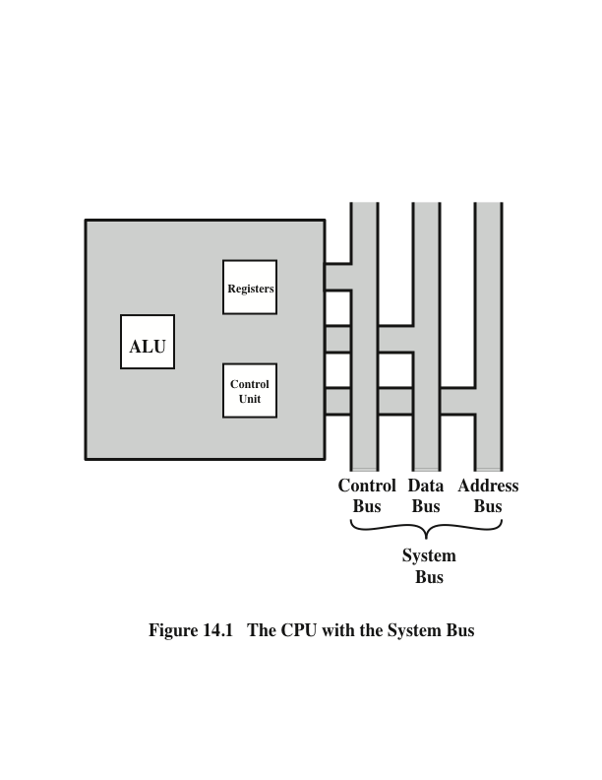
CPU With the System Bus
Notes:
Figure 14.1 is a simplified view of a processor, indicating its connection to the rest of the system via the system bus. A similar interface would be needed for any of the interconnection structures described in Chapter 3. The reader will recall that the major components of the processor are an arithmetic and logic unit (ALU) and a control unit (CU). The ALU does the actual computation or processing of data. The control unit controls the movement of data and instructions into and out of the processor and controls the operation of the ALU. In addition, the figure shows a minimal internal memory, consisting of a set of storage locations, called registers.

Slide 5
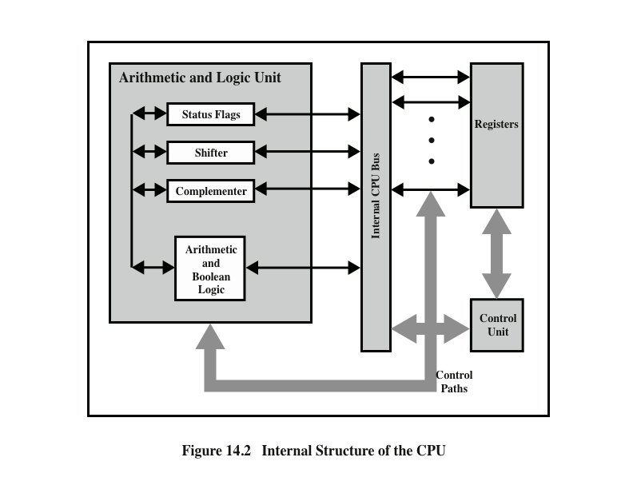
CPU Internal Structure
Notes:
Figure 14.2 is a slightly more detailed view of the processor. The data transfer and logic control paths are indicated, including an element labeled internal
processor bus. This element is needed to transfer data between the various registers and the ALU because the ALU in fact operates only on data in the internal processor memory. The figure also shows typical basic elements of the ALU. Note the similarity between the internal structure of the computer as a whole and the internal structure of the processor. In both cases, there is a small collection of major elements (computer: processor, I/O, memory; processor: control unit, ALU, registers) connected by data paths.

Slide 6
Register Organization
Within the processor there is a set of registers that function as a level of memory above main memory and cache in the hierarchy
The registers in the processor perform two roles:
User-Visible Registers
Control and Status Registers
Enable the machine or assembly language programmer to minimize main memory references by optimizing use of registers
Used by the control unit to control the operation of the processor and by privileged operating system programs to control the execution of programs
Notes:
23
As we discussed in Chapter 4, a computer system employs a memory hierarchy. At higher levels of the hierarchy, memory is faster, smaller, and more expensive (per bit). Within the processor, there is a set of registers that function as a level of memory above main memory and cache in the hierarchy. The registers in the processor perform two roles:
User-visible registers: Enable the machine- or assembly language programmer to minimize main memory references by optimizing use of registers.
Control and status registers: Used by the control unit to control the operation of the processor and by privileged, operating system programs to control the execution of programs.
There is not a clean separation of registers into these two categories. For example, on some machines the program counter is user visible (e.g., x86), but on many it is not. For purposes of the following discussion, however, we will use these categories.

Slide 7
User-Visible Registers
Notes:
24
A user-visible register is one that may be referenced by means of the machine language that the processor executes. We can characterize these in the following categories:
General purpose
Data
Address
Condition codes
General-purpose registers can be assigned to a variety of functions by the programmer. Sometimes their use within the instruction set is orthogonal to the operation. That is, any general-purpose register can contain the operand for any opcode. This provides true general-purpose register use. Often, however, there are restrictions. For example, there may be dedicated registers for floating-point and stack operations.
In some cases, general-purpose registers can be used for addressing functions (e.g., register indirect, displacement). In other cases, there is a partial or clean separation between data registers and address registers. Data registers may be used only to hold data and cannot be employed in the calculation of an operand address.
Address registers may themselves be somewhat general purpose, or they may be
devoted to a particular addressing mode. Examples include the following:
Segment pointers: In a machine with segmented addressing (see Section 8.3), a segment register holds the address of the base of the segment. There may be multiple registers: for example, one for the operating system and one for the current process.
Index registers: These are used for indexed addressing and may be autoindexed.
Stack pointer: If there is user-visible stack addressing, then typically there is a dedicated register that points to the top of the stack. This allows implicit ad- dressing; that is, push, pop, and other stack instructions need not contain an explicit stack operand.
There are several design issues to be addressed here. An important issue is whether to use completely general-purpose registers or to specialize their use. We have already touched on this issue in the preceding chapter because it affects instruction set design. With the use of specialized registers, it can generally be implicit in the opcode which type of register a certain operand specifier refers to. The operand specifier must only identify one of a set of specialized registers rather than one out of all the registers, thus saving bits. On the other hand, this specialization limits the programmer’s flexibility.
Another design issue is the number of registers, either general purpose or data plus address, to be provided. Again, this affects instruction set design because more registers require more operand specifier bits. As we previously discussed, somewhere between 8 and 32 registers appears optimum [LUND77]. Fewer registers result in more memory references; more registers do not noticeably reduce memory references (e.g., see [WILL90]). However, a new approach, which finds advantage in the use of hundreds of registers, is exhibited in some RISC systems and is discussed in Chapter 15.
Finally, there is the issue of register length. Registers that must hold addresses obviously must be at least long enough to hold the largest address. Data registers should be able to hold values of most data types. Some machines allow two contiguous registers to be used as one for holding double-length values.
A final category of registers, which is at least partially visible to the user, holds condition codes (also referred to as flags). Condition codes are bits set by the processor hardware as the result of operations. For example, an arithmetic operation may produce a positive, negative, zero, or overflow result. In addition to the result itself being stored in a register or memory, a condition code is also set. The code may subsequently be tested as part of a conditional branch operation.
Condition code bits are collected into one or more registers. Usually, they form part of a control register. Generally, machine instructions allow these bits to be read by implicit reference, but the programmer cannot alter them.

Slide 8
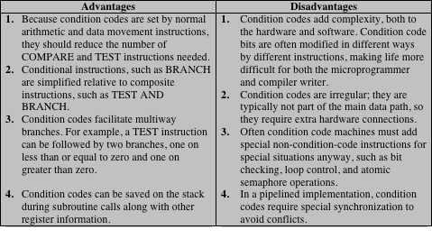
Table 14.1
Condition Codes
Notes:
27
Many processors, including those based on the IA-64 architecture and the MIPS processors, do not use condition codes at all. Rather, conditional branch instructions specify a comparison to be made and act on the result of the comparison, without storing a condition code. Table 14.1, based on [DERO87], lists key advantages and disadvantages of condition codes.
In some machines, a subroutine call will result in the automatic saving of all user-visible registers, to be restored on return. The processor performs the saving and restoring as part of the execution of call and return instructions. This allows each subroutine to use the user-visible registers independently. On other machines, it is the responsibility of the programmer to save the contents of the relevant user- visible registers prior to a subroutine call, by including instructions for this purpose in the program.

Slide 9
Control and Status Registers
Four registers are essential to instruction execution:
Program counter (PC)
  Contains the address of an instruction to be fetched
Instruction register (IR)
  Contains the instruction most recently fetched
Memory address register (MAR)
  Contains the address of a location in memory
Memory buffer register (MBR)
  Contains a word of data to be written to memory or the word most recently read
Notes:
30
There are a variety of processor registers that are employed to control the operation of the processor. Most of these, on most machines, are not visible to the user. Some of them may be visible to machine instructions executed in a control or operating system mode.
Of course, different machines will have different register organizations and use different terminology. We list here a reasonably complete list of register types, with a brief description.
Four registers are essential to instruction execution:
Program counter (PC): Contains the address of an instruction to be fetched.
Instruction register (IR): Contains the instruction most recently fetched.
Memory address register (MAR): Contains the address of a location in memory.
Memory buffer register (MBR): Contains a word of data to be written to memory or the word most recently read.
Not all processors have internal registers designated as MAR and MBR, but some equivalent buffering mechanism is needed whereby the bits to be transferred to the system bus are staged and the bits to be read from the data bus are temporarily stored.
Typically, the processor updates the PC after each instruction fetch so that the PC always points to the next instruction to be executed. A branch or skip instruction will also modify the contents of the PC. The fetched instruction is loaded into an IR, where the opcode and operand specifiers are analyzed. Data are exchanged with memory using the MAR and MBR. In a bus- organized system, the MAR connects directly to the address bus, and the MBR connects directly to the data bus. User-visible registers, in turn, exchange data with the MBR.
The four registers just mentioned are used for the movement of data between the processor and memory. Within the processor, data must be presented to the ALU for processing. The ALU may have direct access to the MBR and user-visible registers. Alternatively, there may be additional buffering registers at the boundary to the ALU; these registers serve as input and output registers for the ALU and exchange data with the MBR and user-visible registers.

Slide 10
Program Status Word (PSW)
Notes:
31
Many processor designs include a register or set of registers, often known as the program status word (PSW), that contain status information. The PSW typically contains condition codes plus other status information. Common fields or flags include the following:
Sign: Contains the sign bit of the result of the last arithmetic operation.
Zero: Set when the result is 0.
Carry: Set if an operation resulted in a carry (addition) into or borrow (sub- traction) out of a high-order bit. Used for multiword arithmetic operations.
Equal: Set if a logical compare result is equality.
Overflow: Used to indicate arithmetic overflow.
Interrupt Enable/Disable: Used to enable or disable interrupts.
Supervisor: Indicates whether the processor is executing in supervisor or user mode. Certain privileged instructions can be executed only in supervisor mode, and certain areas of memory can be accessed only in supervisor mode.

Slide 11
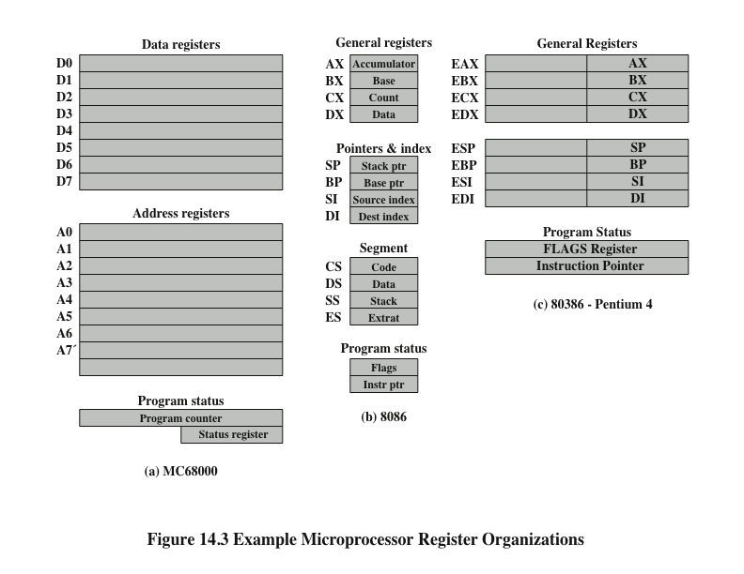
Example
Microprocessor
Register Organizations
Notes:
It is instructive to examine and compare the register organization of comparable systems. In this section, we look at two 16-bit microprocessors that were designed at about the same time: the Motorola MC68000 [STRI79] and the Intel 8086 [MORS78]. Figures 14.3a and b depict the register organization of each; purely internal registers, such as a memory address register, are not shown.
The MC68000 partitions its 32-bit registers into eight data registers and nine address registers. The eight data registers are used primarily for data manipulation and are also used in addressing as index registers. The width of the registers allows 8-, 16-, and 32-bit data operations, determined by opcode. The address registers contain 32-bit (no segmentation) addresses; two of these registers are also used as stack pointers, one for users and one for the operating system, depending on the current execution mode. Both registers are numbered 7, because only one can be used at a time. The MC68000 also includes a 32-bit program counter and a 16-bit status register.
The Intel 8086 takes a different approach to register organization. Every register is special purpose, although some registers are also usable as general purpose. The 8086 contains four 16-bit data registers that are addressable on a byte or 16-bit basis, and four 16-bit pointer and index registers. The data registers can be used as general purpose in some instructions. In others, the registers are used implicitly. For example, a multiply instruction always uses the accumulator. The four pointer registers are also used implicitly in a number of operations; each contains a segment offset. There are also four 16-bit segment registers. Three of the four segment registers are used in a dedicated, implicit fashion, to point to the segment of the current instruction (useful for branch instructions), a segment containing data, and a segment containing a stack, respectively. These dedicated and implicit uses provide for compact encoding at the cost of reduced flexibility. The 8086 also includes an instruction pointer and a set of 1-bit status and control flags.
The point of this comparison should be clear. There is no universally accepted philosophy concerning the best way to organize processor registers [TOON81]. As with overall instruction set design and so many other processor design issues, it is still a matter of judgment and taste.
A second instructive point concerning register organization design is illustrated in Figure 14.3c. This figure shows the user-visible register organization for the Intel 80386 [ELAY85], which is a 32-bit microprocessor designed as an extension of the 8086.1 The 80386 uses 32-bit registers. However, to provide upward compatibility for programs written on the earlier machine, the 80386 retains the original register organization embedded in the new organization. Given this design constraint, the architects of the 32-bit processors had limited flexibility in designing the register organization.

Slide 12
Instruction Cycle
Notes:
35
In Section 3.2, we described the processor’s instruction cycle (Figure 3.9). To recall, an instruction cycle includes the following stages:
Fetch: Read the next instruction from memory into the processor.
Execute: Interpret the opcode and perform the indicated operation.
Interrupt: If interrupts are enabled and an interrupt has occurred, save the current process state and service the interrupt.
We are now in a position to elaborate somewhat on the instruction cycle. First, we must introduce one additional stage, known as the indirect cycle.

Slide 13
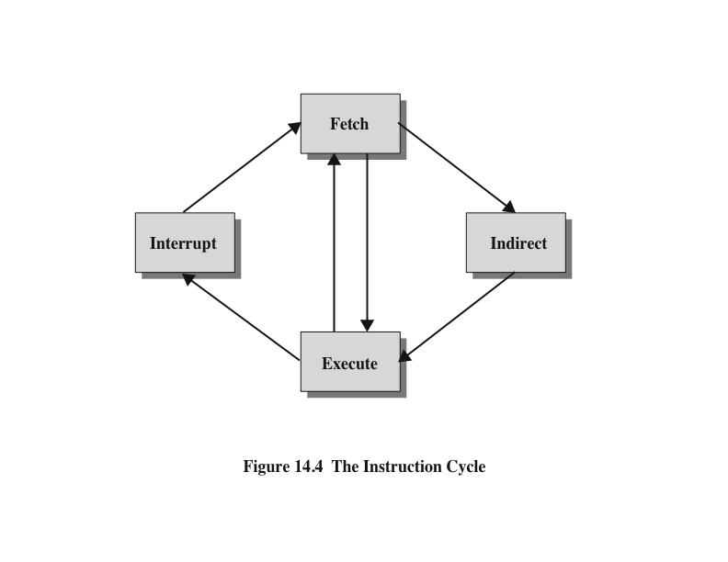
Instruction Cycle
Notes:
We have seen, in Chapter 13, that the execution of an instruction may involve one or more operands in memory, each of which requires a memory access. Further, if indirect addressing is used, then additional memory accesses are required.
We can think of the fetching of indirect addresses as one more instruction stages. The result is shown in Figure 14.4. The main line of activity consists of alternating instruction fetch and instruction execution activities. After an instruction is fetched, it is examined to determine if any indirect addressing is involved. If so, the required operands are fetched using indirect addressing. Following execution, an interrupt may be processed before the next instruction fetch.

Slide 14
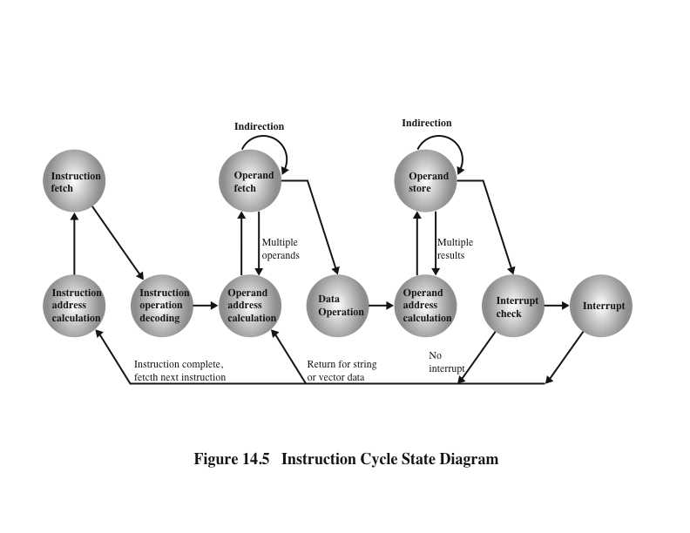
Instruction Cycle State Diagram
Notes:
Another way to view this process is shown in Figure 14.5, which is a revised version of Figure 3.12. This illustrates more correctly the nature of the instruction cycle. Once an instruction is fetched, its operand specifiers must be identified. Each input operand in memory is then fetched, and this process may require indirect addressing. Register-based operands need not be fetched. Once the opcode is executed, a similar process may be needed to store the result in main memory.

Slide 15
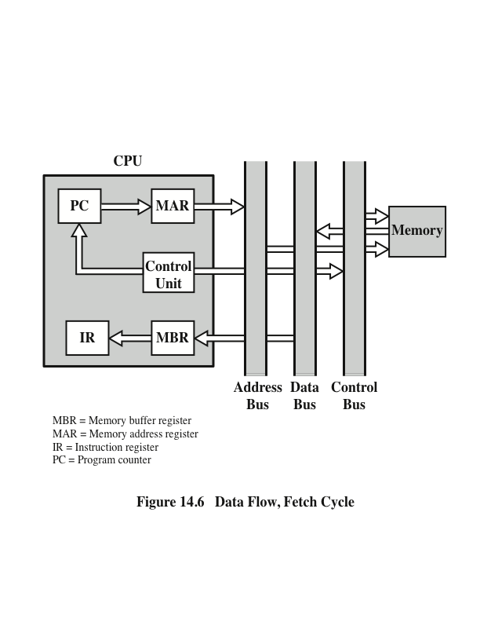
Data Flow, Fetch Cycle
Notes:
The exact sequence of events during an instruction cycle depends on the design of the processor. We can, however, indicate in general terms what must happen. Let us assume that a processor that employs a memory address register (MAR), a memory buffer register (MBR), a program counter (PC), and an instruction register (IR).
During the fetch cycle, an instruction is read from memory. Figure 14.6 shows the flow of data during this cycle. The PC contains the address of the next instruction to be fetched. This address is moved to the MAR and placed on the address bus. The control unit requests a memory read, and the result is placed on the data bus and copied into the MBR and then moved to the IR. Meanwhile, the PC is incremented by 1, preparatory for the next fetch.

Slide 16
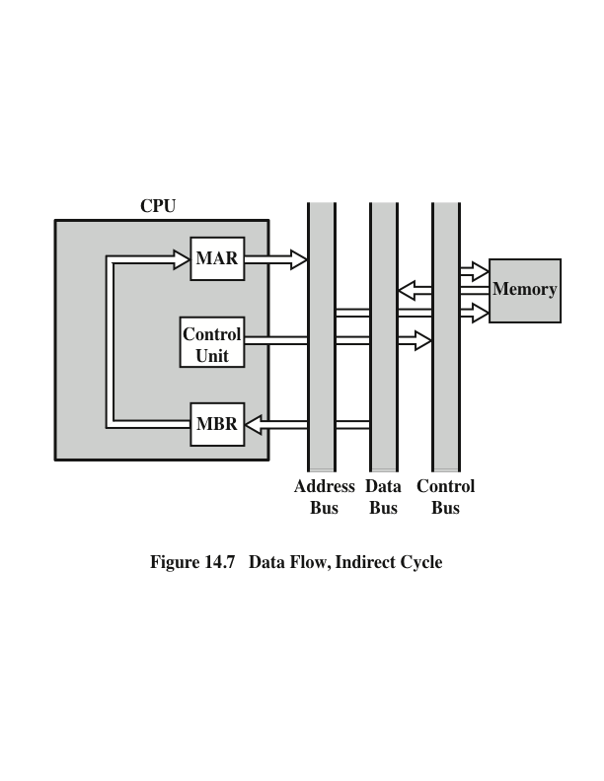
Data Flow, Indirect Cycle
Notes:
Once the fetch cycle is over, the control unit examines the contents of the IR to determine if it contains an operand specifier using indirect addressing. If so, an indirect cycle is performed. As shown in Figure 14.7, this is a simple cycle. The right- most N bits of the MBR, which contain the address reference, are transferred to the MAR. Then the control unit requests a memory read, to get the desired address of the operand into the MBR.
The fetch and indirect cycles are simple and predictable. The execute cycle takes many forms; the form depends on which of the various machine instructions is in the IR. This cycle may involve transferring data among registers, read or write from memory or I/O, and/or the invocation of the ALU.

Slide 17
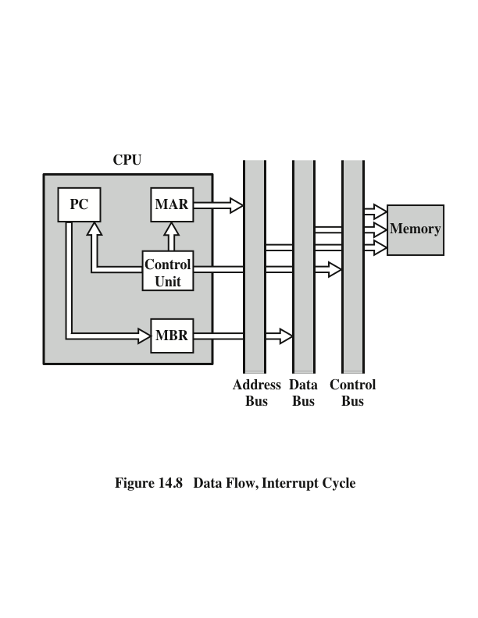
Data Flow, Interrupt Cycle
Notes:
Like the fetch and indirect cycles, the interrupt cycle is simple and predictable (Figure 14.8). The current contents of the PC must be saved so that the processor can resume normal activity after the interrupt. Thus, the contents of the PC are transferred to the MBR to be written into memory. The special memory location reserved for this purpose is loaded into the MAR from the control unit. It might, for example, be a stack pointer. The PC is loaded with the address of the interrupt routine. As a result, the next instruction cycle will begin by fetching the appropriate instruction.

Slide 18
Pipelining Strategy
Notes:
38
Instruction pipelining is similar to the use of an assembly line in a manufacturing plant. An assembly line takes advantage of the fact that a product goes through various stages of production. By laying the production process out in an assembly line, products at various stages can be worked on simultaneously. This process is also referred to as pipelining, because, as in a pipeline, new inputs are accepted at one end before previously accepted inputs appear as outputs at the other end.
To apply this concept to instruction execution, we must recognize that, in fact, an instruction has a number of stages. Figures 14.5, for example, breaks the instruction cycle up into 10 tasks, which occur in sequence. Clearly, there should be some opportunity for pipelining.

Slide 19
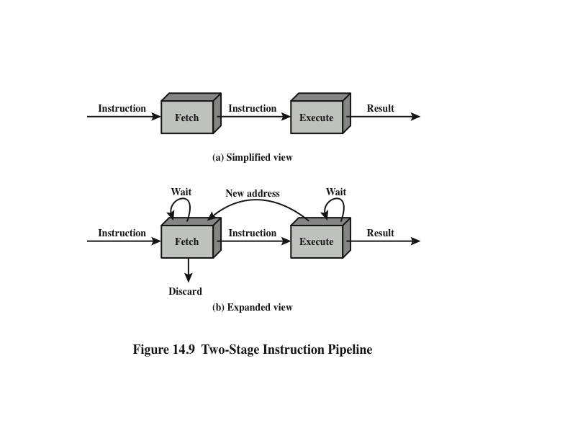
Two-Stage Instruction Pipeline
Notes:
As a simple approach, consider subdividing instruction processing into two stages: fetch instruction and execute instruction. There are times during the execution of an instruction when main memory is not being accessed. This time could be used to fetch the next instruction in parallel with the execution of the current one. Figure 14.9a depicts this approach. The pipeline has two independent stages. The first stage fetches an instruction and buffers it. When the second stage is free, the first stage passes it the buffered instruction. While the second stage is executing the instruction, the first stage takes advantage of any unused memory cycles to fetch and buffer the next instruction. This is called instruction prefetch or fetch overlap. Note that this approach, which involves instruction buffering, requires more registers. In general, pipelining requires registers to store data between stages.
It should be clear that this process will speed up instruction execution. If the fetch and execute stages were of equal duration, the instruction cycle time would be halved. However, if we look more closely at this pipeline (Figure 14.9b), we will see that this doubling of execution rate is unlikely for two reasons:
The execution time will generally be longer than the fetch time. Execution will involve reading and storing operands and the performance of some operation. Thus, the fetch stage may have to wait for some time before it can empty its buffer.
A conditional branch instruction makes the address of the next instruction to be fetched unknown. Thus, the fetch stage must wait until it receives the next instruction address from the execute stage. The execute stage may then have to wait while the next instruction is fetched.
Guessing can reduce the time loss from the second reason. A simple rule is the following: When a conditional branch instruction is passed on from the fetch to the execute stage, the fetch stage fetches the next instruction in memory after the branch instruction. Then, if the branch is not taken, no time is lost. If the branch is taken, the fetched instruction must be discarded and a new instruction fetched.

Slide 20
Additional Stages
Fetch instruction (FI)
  Read the next expected instruction into a buffer
Decode instruction (DI)
  Determine the opcode and the operand specifiers
Calculate operands (CO)
  Calculate the effective address of each source operand
  This may involve displacement, register indirect, indirect, or other forms of address calculation
Fetch operands (FO)
  Fetch each operand from memory
  Operands in registers need not be fetched
Execute instruction (EI)
  Perform the indicated operation and store the result, if any, in the specified destination operand location
Write operand (WO)
  Store the result in memory
Notes:
While these factors reduce the potential effectiveness of the two-stage pipe- line, some speedup occurs. To gain further speedup, the pipeline must have more stages. Let us consider the following decomposition of the instruction processing.
Fetch instruction (FI): Read the next expected instruction into a buffer.
Decode instruction (DI): Determine the opcode and the operand specifiers.
Calculate operands (CO): Calculate the effective address of each source operand. This may involve displacement, register indirect, indirect, or other forms of address calculation.
Fetch operands (FO): Fetch each operand from memory. Operands in registers need not be fetched.
Execute instruction (EI): Perform the indicated operation and store the result, if any, in the specified destination operand location.
Write operand (WO): Store the result in memory.
With this decomposition, the various stages will be of more nearly equal duration.

Slide 21
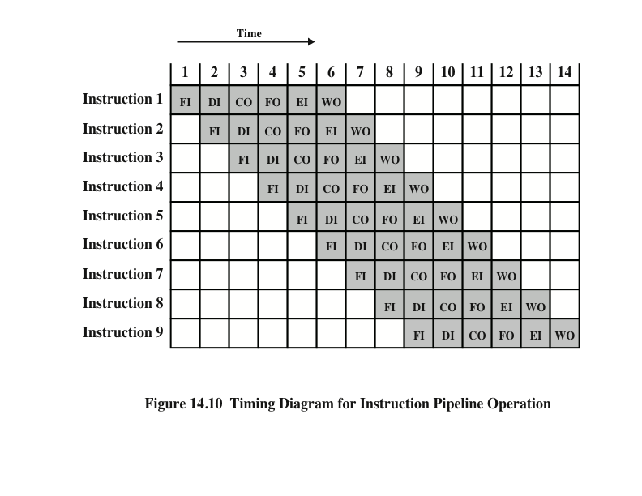
Timing Diagram for Instruction Pipeline Operation
Notes:
39
For the sake of illustration, let us assume equal duration. Using this assumption, Figure 14.10 shows that a six-stage pipeline can reduce the execution time for 9 instructions from 54 time units to 14 time units.
Several comments are in order: The diagram assumes that each instruction goes through all six stages of the pipeline. This will not always be the case. For example, a load instruction does not need the WO stage. However, to simplify the pipeline hardware, the timing is set up assuming that each instruction requires all six stages. Also, the diagram assumes that all of the stages can be performed in parallel. In particular, it is assumed that there are no memory conflicts. For example, the FI, FO, and WO stages involve a memory access. The diagram implies that all these accesses can occur simultaneously. Most memory systems will not permit that. However, the desired value may be in cache, or the FO or WO stage may be null. Thus, much of the time, memory conflicts will not slow down the pipeline.

Slide 22
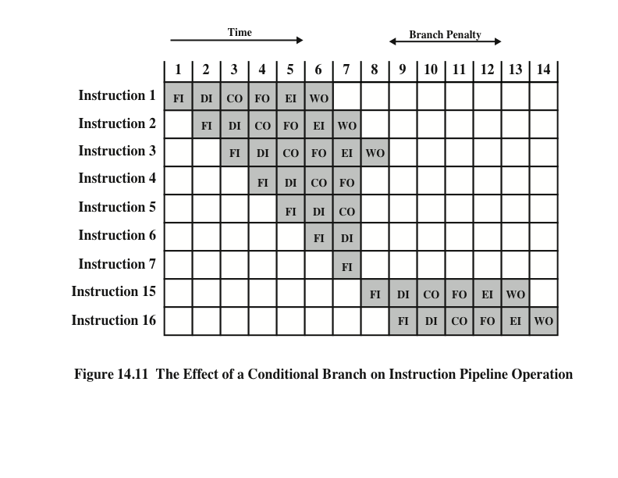
The Effect of a Conditional Branch on Instruction Pipeline Operation
Notes:
40
Several other factors serve to limit the performance enhancement. If the six stages are not of equal duration, there will be some waiting involved at various pipe- line stages, as discussed before for the two-stage pipeline. Another difficulty is the conditional branch instruction, which can invalidate several instruction fetches. A similar unpredictable event is an interrupt. Figure 14.11 illustrates the effects of the conditional branch, using the same program as Figure 14.10. Assume that instruction 3 is a conditional branch to instruction 15. Until the instruction is executed, there is no way of knowing which instruction will come next. The pipeline, in this example, simply loads the next instruction in sequence (instruction 4) and proceeds. In Figure 14.10, the branch is not taken, and we get the full performance benefit of the enhancement. In Figure 14.11, the branch is taken. This is not determined until the end of time unit 7. At this point, the pipeline must be cleared of instructions that are not useful. During time unit 8, instruction 15 enters the pipeline. No instructions complete during time units 9 through 12; this is the performance penalty incurred because we could not anticipate the branch.

Slide 23
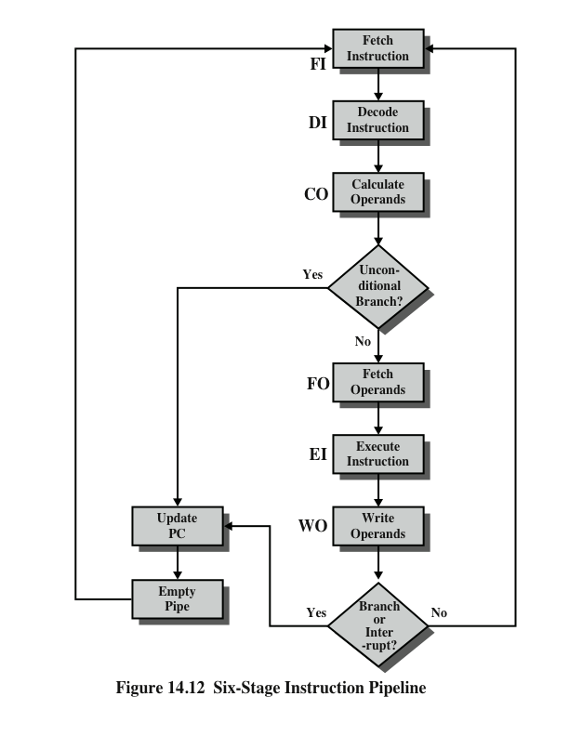
Six Stage
Instruction Pipeline
Notes:
Figure 14.12 indicates the logic needed for pipelining to account for branches and interrupts.
Other problems arise that did not appear in our simple two-stage organization. The CO stage may depend on the contents of a register that could be altered by a previous instruction that is still in the pipeline. Other such register and memory conflicts could occur. The system must contain logic to account for this type of conflict.

Slide 24
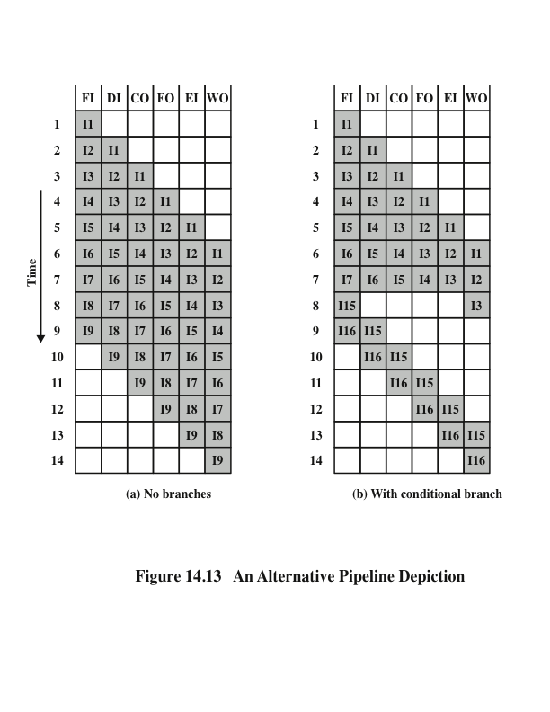
Alternative Pipeline Depiction
Notes:
To clarify pipeline operation, it might be useful to look at an alternative depiction. Figures 14.10 and 14.11 show the progression of time horizontally across the figures, with each row showing the progress of an individual instruction. Figure 14.13 shows same sequence of events, with time progressing vertically down the figure, and each row showing the state of the pipeline at a given point in time. In Figure 14.13a (which corresponds to Figure 14.10), the pipeline is full at time 6, with 6 different instructions in various stages of execution, and remains full through time 9; we assume that instruction I9 is the last instruction to be executed. In Figure 14.13b, (which corresponds to Figure 14.11), the pipeline is full at times 6 and 7. At time 7, instruction 3 is in the execute stage and executes a branch to instruction 15. At this point, instructions I4 through I7 are flushed from the pipeline, so that at time 8, only two instructions are in the pipeline, I3 and I15.

Slide 25
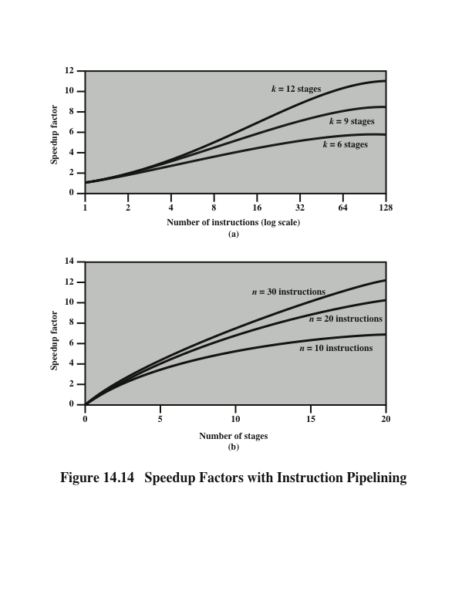
Speedup Factors with Instruction
Pipelining
Notes:
Figure 14.14a plots the speedup factor as a function of the number of instructions that are executed without a branch.
Figure 14.14b shows the speedup factor as a function of the number of stages in the instruction pipeline
Thus, the larger the number of pipeline stages, the greater the potential for speedup. However, as a practical matter, the potential gains of additional pipe- line stages are countered by increases in cost, delays between stages, and the fact that branches will be encountered requiring the flushing of the pipeline.

Slide 26
Pipeline Hazards
Notes:
In the previous subsection, we mentioned some of the situations that can result in less than optimal pipeline performance. In this subsection, we examine this issue in a more systematic way. Chapter 16 revisits this issue, in more detail, after we have introduced the complexities found in superscalar pipeline organizations.
A pipeline hazard occurs when the pipeline, or some portion of the pipeline, must stall because conditions do not permit continued execution. Such a pipe- line stall is also referred to as a pipeline bubble. There are three types of hazards: resource, data, and control.

Slide 27
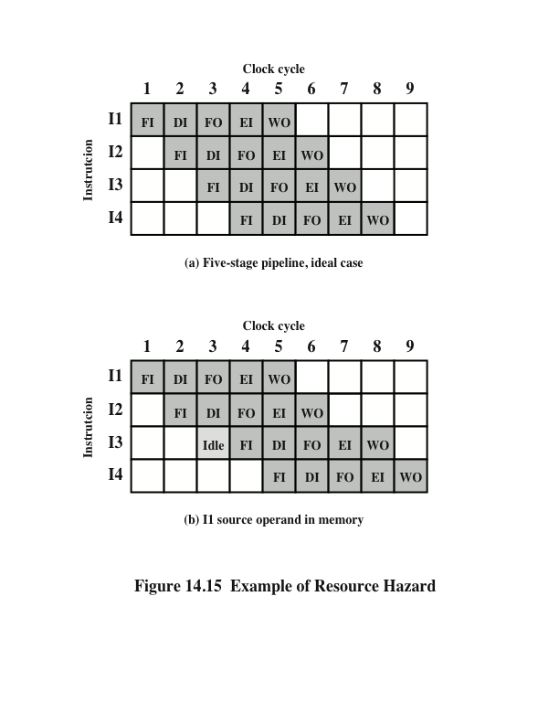
Resource
Hazards
A resource hazard occurs when two or more instructions that are already in the pipeline need the same resource
The result is that the instructions must be executed in serial rather than parallel for a portion of the pipeline
A resource hazard is sometimes referred to as a structural hazard
Notes:
A resource hazard occurs when two (or more) instructions that are already in the pipeline need the same resource. The result is that the instructions must be executed in serial rather than parallel for a portion of the pipeline. A resource hazard is sometime referred to as a structural hazard.
Let us consider a simple example of a resource hazard. Assume a simplified five-stage pipeline, in which each stage takes one clock cycle. Figure 14.15a shows the ideal case, in which a new instruction enters the pipeline each clock cycle. Now assume that main memory has a single port and that all instruction fetches and data reads and writes must be performed one at a time. Further, ignore the cache. In this case, an operand read to or write from memory cannot be performed in parallel with an instruction fetch. This is illustrated in Figure 14.15b, which assumes that the source operand for instruction I1 is in memory, rather than a register. Therefore, the fetch instruction stage of the pipeline must idle for one cycle before beginning the instruction fetch for instruction I3. The figure assumes that all other operands are in registers.
Another example of a resource conflict is a situation in which multiple instructions are ready to enter the execute instruction phase and there is a single ALU. One solutions to such resource hazards is to increase available resources, such as having multiple ports into main memory and multiple ALU units.

Slide 28
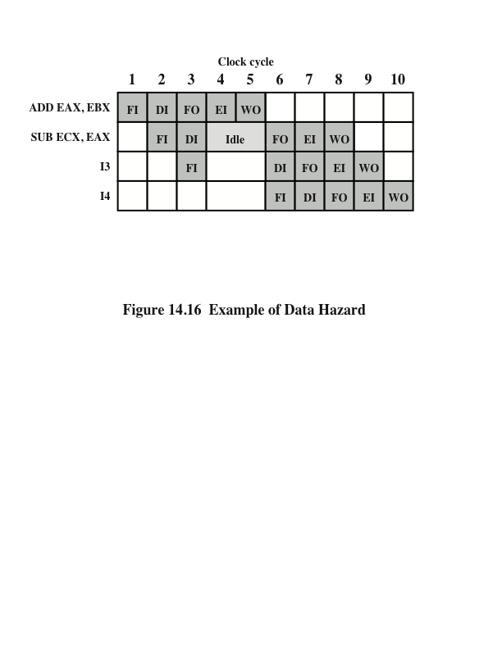
Data Hazards
RAW
Hazard
A data hazard occurs when there is a conflict in the access of an operand location
Notes:
A data hazard occurs when there is a conflict in the access of an operand location. In general terms, we can state the hazard in this form: Two instructions in a program are to be executed in sequence and both access a particular memory or register operand. If the two instructions are executed in strict sequence, no problem occurs. However, if the instructions are executed in a pipeline, then it is possible for the operand value to be updated in such a way as to produce a different result than would occur with strict sequential execution. In other words, the program produces an incorrect result because of the use of pipelining.

Slide 29
Types of Data Hazard
Read after write (RAW), or true dependency
  An instruction modifies a register or memory location
  Succeeding instruction reads data in memory or register location
  Hazard occurs if the read takes place before write operation is complete
Write after read (WAR), or antidependency
  An instruction reads a register or memory location
  Succeeding instruction writes to the location
  Hazard occurs if the write operation completes before the read operation takes place
Write after write (WAW), or output dependency
  Two instructions both write to the same location
  Hazard occurs if the write operations take place in the reverse order of the intended sequence
Notes:
There are three types of data hazards;
• Read after write (RAW), or true dependency: An instruction modifies a register or memory location and a succeeding instruction reads the data in that memory or register location. A hazard occurs if the read takes place before the write operation is complete.
• Write after read (WAR), or antidependency: An instruction reads a register or memory location and a succeeding instruction writes to the location. A hazard occurs if the write operation completes before the read operation takes place.
• Write after write (WAW), or output dependency: Two instructions both write to the same location. A hazard occurs if the write operations take place in the reverse order of the intended sequence.
The example of Figure 14.16 is a RAW hazard. The other two hazards are best discussed in the context of superscalar organization, discussed in Chapter 16.

Slide 30
Control Hazard
Also known as a branch hazard
Occurs when the pipeline makes the wrong decision on a branch prediction
Brings instructions into the pipeline that must subsequently be discarded
Dealing with Branches:
  Multiple streams
  Prefetch branch target
  Loop buffer
  Branch prediction
  Delayed branch
Notes:
A control hazard, also known as a branch hazard, occurs when the pipeline makes the wrong decision on a branch prediction and therefore brings instructions into the pipeline that must subsequently be discarded. We discuss approaches to dealing with control hazards next.
One of the major problems in designing an instruction pipeline is assuring a steady flow of instructions to the initial stages of the pipeline. The primary impediment, as we have seen, is the conditional branch instruction. Until the instruction is actually executed, it is impossible to determine whether the branch will be taken or not.
A variety of approaches have been taken for dealing with conditional branches:
Multiple streams
Prefetch branch target
Loop buffer
Branch prediction
Delayed branch

Slide 31
Multiple Streams
Notes:
42
A simple pipeline suffers a penalty for a branch instruction because it must choose one of two instructions to fetch next and may make the wrong choice. A brute-force approach is to replicate the initial portions of the pipeline and allow the pipeline to fetch both instructions, making use of two streams. There are two problems with this approach:
With multiple pipelines there are contention delays for access to the registers and to memory.
Additional branch instructions may enter the pipeline (either stream) before the original branch decision is resolved. Each such instruction needs an additional stream.
Despite these drawbacks, this strategy can improve performance. Examples of machines with two or more pipeline streams are the IBM 370/168 and the IBM 3033.

Slide 32
Prefetch Branch Target
When a conditional branch is recognized, the target of the branch is prefetched, in addition to the instruction following the branch
Target is then saved until the branch instruction is executed
If the branch is taken, the target has already been prefetched
IBM 360/91 uses this approach
Notes:
43
When a conditional branch is recognized, the target of the branch is prefetched, in addition to the instruction following the branch. This target is then saved until the branch instruction is executed. If the branch is taken, the target has already been prefetched.
The IBM 360/91 uses this approach.

Slide 33
Loop Buffer
Small, very-high speed memory maintained by the instruction fetch stage of the pipeline and containing the n most recently fetched instructions, in sequence
Benefits:
  Instructions fetched in sequence will be available without the usual memory access time
  If a branch occurs to a target just a few locations ahead of the address of the branch instruction, the target will already be in the buffer
  This strategy is particularly well suited to dealing with loops
  Similar in principle to a cache dedicated to instructions
  Differences:
    The loop buffer only retains instructions in sequence
    Is much smaller in size and hence lower in cost
Notes:
44
A loop buffer is a small, very-high-speed memory maintained by the instruction fetch stage of the pipeline and containing the n most recently fetched instructions, in sequence. If a branch is to be taken, the hardware first checks whether the branch target is within the buffer. If so, the next instruction is fetched from the buffer. The loop buffer has three benefits:
1. With the use of prefetching, the loop buffer will contain some instruction sequentially ahead of the current instruction fetch address. Thus, instructions fetched in sequence will be available without the usual memory access time.
2. If a branch occurs to a target just a few locations ahead of the address of the branch instruction, the target will already be in the buffer. This is useful for the rather common occurrence of IF–THEN and IF–THEN–ELSE sequences.
3. This strategy is particularly well suited to dealing with loops, or iterations; hence the name loop buffer. If the loop buffer is large enough to contain all the instructions in a loop, then those instructions need to be fetched from memory only once, for the first iteration. For subsequent iterations, all the needed instructions are already in the buffer.
The loop buffer is similar in principle to a cache dedicated to instructions. The differences are that the loop buffer only retains instructions in sequence and is much smaller in size and hence lower in cost.

Slide 34
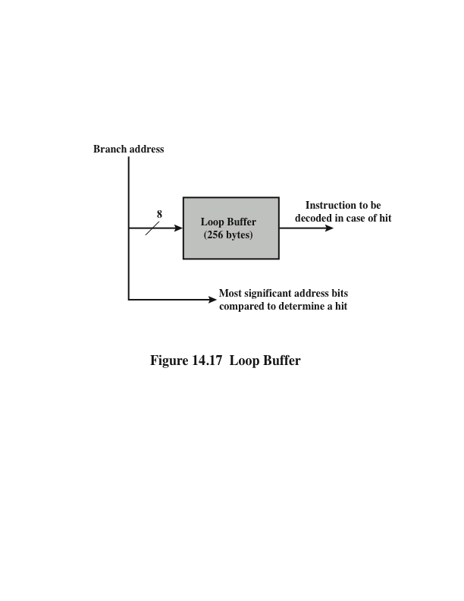
Loop Buffer
Notes:
Figure 14.17 gives an example of a loop buffer. If the buffer contains 256 bytes, and byte addressing is used, then the least significant 8 bits are used to index the buffer. The remaining most significant bits are checked to determine if the branch target lies within the environment captured by the buffer.
Among the machines using a loop buffer are some of the CDC machines (Star- 100, 6600, 7600) and the CRAY-1. A specialized form of loop buffer is available on the Motorola 68010, for executing a three-instruction loop involving the DBcc (decrement and branch on condition) instruction (see Problem 14.14). A three-word buffer is maintained, and the processor executes these instructions repeatedly until the loop condition is satisfied.

Slide 35
Branch Prediction
Various techniques can be used to predict whether a branch will be taken:
  Predict never taken
  Predict always taken
  Predict by opcode
  Taken/not taken switch
  Branch history table
  These approaches are static
  They do not depend on the execution history up to the time of the conditional branch instruction
  These approaches are dynamic
  They depend on the execution history
Notes:
45
Various techniques can be used to predict whether a branch will be taken. Among the more common are the following:
• • • • •
Predict never taken
Predict always taken
Predict by opcode
Taken/not taken switch
Branch history table
The first three approaches are static: they do not depend on the execution history up to the time of the conditional branch instruction. The latter two approaches are dynamic: They depend on the execution history.
The first two approaches are the simplest. These either always assume that the branch will not be taken and continue to fetch instructions in sequence, or they always assume that the branch will be taken and always fetch from the branch tar- get. The predict-never-taken approach is the most popular of all the branch prediction methods.
Studies analyzing program behavior have shown that conditional branches are taken more than 50% of the time [LILJ88], and so if the cost of prefetching from either path is the same, then always prefetching from the branch target address should give better performance than always prefetching from the sequential path. However, in a paged machine, prefetching the branch target is more likely to cause a page fault than prefetching the next instruction in sequence, and so this performance penalty should be taken into account. An avoidance mechanism may be employed to reduce this penalty.
The final static approach makes the decision based on the opcode of the branch instruction. The processor assumes that the branch will be taken for certain branch opcodes and not for others. [LILJ88] reports success rates of greater than 75% with this strategy.
Dynamic branch strategies attempt to improve the accuracy of prediction by recording the history of conditional branch instructions in a program. For example, one or more bits can be associated with each conditional branch instruction that reflect the recent history of the instruction. These bits are referred to as a taken/ not taken switch that directs the processor to make a particular decision the next time the instruction is encountered. Typically, these history bits are not associated with the instruction in main memory. Rather, they are kept in temporary high- speed storage. One possibility is to associate these bits with any conditional branch instruction that is in a cache. When the instruction is replaced in the cache, its history is lost. Another possibility is to maintain a small table for recently executed branch instructions with one or more history bits in each entry. The processor could access the table associatively, like a cache, or by using the low-order bits of the branch instruction’s address.

Slide 36
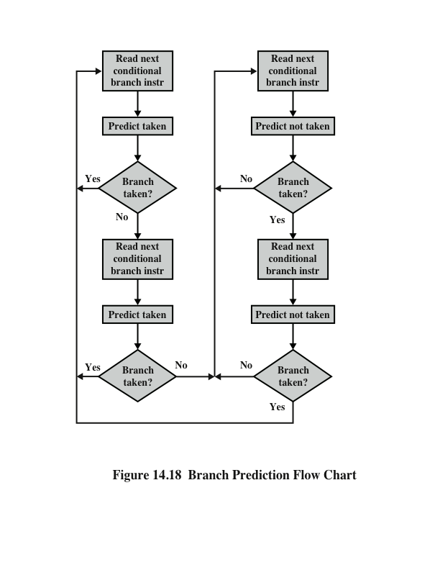
Branch Prediction Flow Chart
Notes:
With a single bit, all that can be recorded is whether the last execution of this instruction resulted in a branch or not. A shortcoming of using a single bit appears in the case of a conditional branch instruction that is almost always taken, such as a loop instruction. With only one bit of history, an error in prediction will occur twice for each use of the loop: once on entering the loop, and once on exiting.
If two bits are used, they can be used to record the result of the last two instances of the execution of the associated instruction, or to record a state in some other fashion. Figure 14.18 shows a typical approach (see Problem 14.13 for other possibilities). Assume that the algorithm starts at the upper-left-hand corner of the flowchart. As long as each succeeding conditional branch instruction that is encountered is taken, the decision process predicts that the next branch will be taken. If a single prediction is wrong, the algorithm continues to predict that the next branch is taken. Only if two successive branches are not taken does the algorithm shift to the right-hand side of the flowchart. Subsequently, the algorithm will predict that branches are not taken until two branches in a row are taken. Thus, the algorithm requires two consecutive wrong predictions to change the prediction decision.

Slide 37
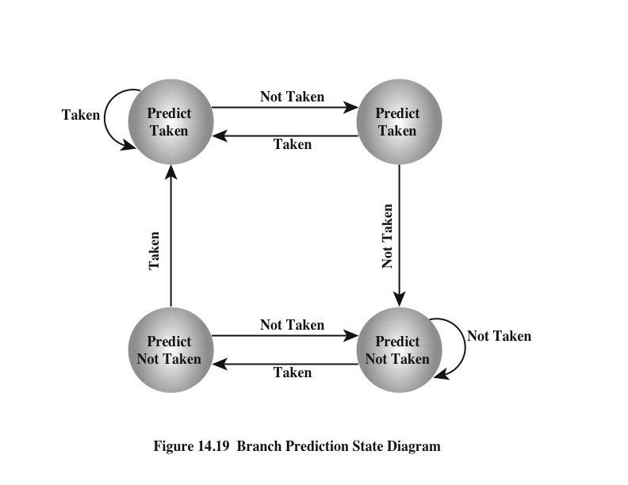
Branch Prediction State Diagram
Notes:
The decision process can be represented more compactly by a finite-state machine, shown in Figure 14.19. The finite-state machine representation is commonly used in the literature.
The use of history bits, as just described, has one drawback: If the decision is made to take the branch, the target instruction cannot be fetched until the tar- get address, which is an operand in the conditional branch instruction, is decoded. Greater efficiency could be achieved if the instruction fetch could be initiated as soon as the branch decision is made. For this purpose, more information must be saved, in what is known as a branch target buffer, or a branch history table.
The branch history table is a small cache memory associated with the instruction fetch stage of the pipeline. Each entry in the table consists of three elements: the address of a branch instruction, some number of history bits that record the state of use of that instruction, and information about the target instruction. In most proposals and implementations, this third field contains the address of the target instruction. Another possibility is for the third field to actually contain the target instruction. The trade-off is clear: Storing the target address yields a smaller table but a greater instruction fetch time compared with storing the target instruction [RECH98].

Slide 38
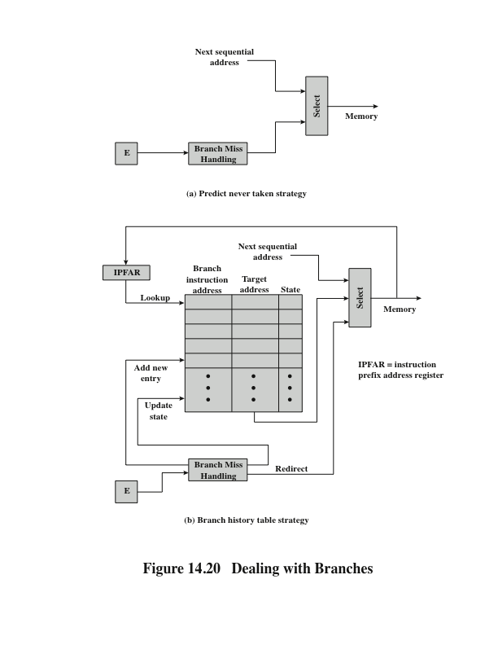
Dealing With
Branches
Notes:
Figure 14.20 contrasts this scheme with a predict-never-taken strategy. With the former strategy, the instruction fetch stage always fetches the next sequential address. If a branch is taken, some logic in the processor detects this and instructs that the next instruction be fetched from the target address (in addition to flushing the pipeline). The branch history table is treated as a cache. Each prefetch triggers a lookup in the branch history table. If no match is found, the next sequential address is used for the fetch. If a match is found, a prediction is made based on the state of the instruction: Either the next sequential address or the branch target address is fed to the select logic.
When the branch instruction is executed, the execute stage signals the branch history table logic with the result. The state of the instruction is updated to reflect a correct or incorrect prediction. If the prediction is incorrect, the select logic is redirected to the correct address for the next fetch. When a conditional branch instruction is encountered that is not in the table, it is added to the table and one of the existing entries is discarded, using one of the cache replacement algorithms discussed in Chapter 4.
A refinement of the branch history approach is referred to as two-level or correlation-based branch history [YEH91]. This approach is based on the assumption that whereas in loop-closing branches, the past history of a particular branch instruction is a good predictor of future behavior, with more complex control-flow structures, the direction of a branch is frequently correlated with the direction of related branches. An example is an if-then-else or case structure. There are a number of strategies possible. Typically, recent global branch history (i.e., the history of the most recent branches not just of this branch instruction) is used in addition to the history of the current branch instruction. The general structure is defined as an (m, n) correlator, which uses the behavior of the last m branches to choose from 2^{m} n-bit branch predictors for the current branch instruction. In other words, an n-bit history is kept for a give branch for each possible combination of branches taken by the most recent m branches.

Slide 39
Intel 80486 Pipelining
Fetch
  Objective is to fill the prefetch buffers with new data as soon as the old data have been consumed by the instruction decoder
  Operates independently of the other stages to keep the prefetch buffers full
Decode stage 1
  All opcode and addressing-mode information is decoded in the D1 stage
  3 bytes of instruction are passed to the D1 stage from the prefetch buffers
  D1 decoder can then direct the D2 stage to capture the rest of the instruction
Decode stage 2
  Expands each opcode into control signals for the ALU
  Also controls the computation of the more complex addressing modes
Execute
  Stage includes ALU operations, cache access, and register update
Write back
  Updates registers and status flags modified during the preceding execute stage
Notes:
An instructive example of an instruction pipeline is that of the Intel 80486. The 80486 implements a five-stage pipeline:
Fetch: Instructions are fetched from the cache or from external memory and placed into one of the two 16-byte prefetch buffers. The objective of the fetch stage is to fill the prefetch buffers with new data as soon as the old data have been consumed by the instruction decoder. Because instructions are of variable length (from 1 to 11 bytes not counting prefixes), the status of the prefetcher relative to the other pipeline stages varies from instruction to instruction. On average, about five instructions are fetched with each 16-byte load [CRAW90]. The fetch stage operates independently of the other stages to keep the prefetch buffers full.
Decode stage 1: All opcode and addressing-mode information is decoded in the D1 stage. The required information, as well as instruction-length information, is included in at most the first 3 bytes of the instruction. Hence, 3 bytes are passed to the D1 stage from the prefetch buffers. The D1 decoder can then direct the D2 stage to capture the rest of the instruction (displacement and immediate data), which is not involved in the D1 decoding.
Decode stage 2: The D2 stage expands each opcode into control signals for the ALU. It also controls the computation of the more complex addressing modes.
Execute: This stage includes ALU operations, cache access, and register update.
Write back: This stage, if needed, updates registers and status flags modified during the preceding execute stage. If the current instruction updates memory, the computed value is sent to the cache and to the bus-interface write buffers at the same time.
With the use of two decode stages, the pipeline can sustain a throughput of close to one instruction per clock cycle. Complex instructions and conditional branches can slow down this rate.

Slide 40
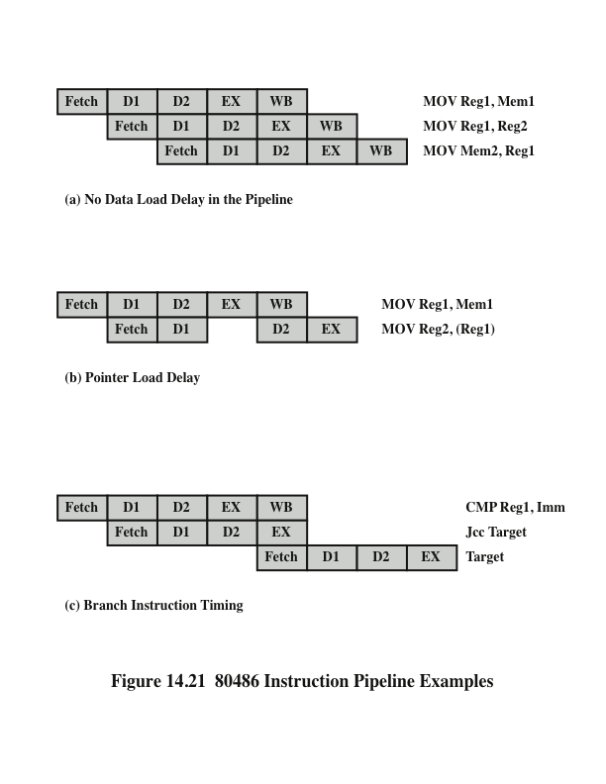
80486
Instruction
Pipeline
Examples
Notes:
Figure 14.21 shows examples of the operation of the pipeline. Figure 14.21a shows that there is no delay introduced into the pipeline when a memory access is required. However, as Figure 14.21b shows, there can be a delay for values used to compute memory addresses. That is, if a value is loaded from memory into a register and that register is then used as a base register in the next instruction, the processor will stall for one cycle. In this example, the processor accesses the cache in the EX stage of the first instruction and stores the value retrieved in the register during the WB stage. However, the next instruction needs this register in its D2 stage. When the D2 stage lines up with the WB stage of the previous instruction, bypass signal paths allow the D2 stage to have access to the same data being used by the WB stage for writing, saving one pipeline stage.
Figure 14.21c illustrates the timing of a branch instruction, assuming that the branch is taken. The compare instruction updates condition codes in the WB stage, and bypass paths make this available to the EX stage of the jump instruction at the same time. In parallel, the processor runs a speculative fetch cycle to the target of the jump during the EX stage of the jump instruction. If the processor determines a false branch condition, it discards this prefetch and continues execution with the next sequential instruction (already fetched and decoded).

Slide 41
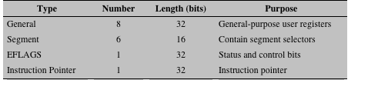
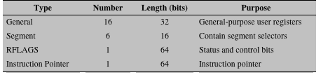
Table 14.2 x86 Processor Registers
Notes:
The register organization includes the following types of registers (Table 14.2):
• General: There are eight 32-bit general-purpose registers (see Figure 14.3c). These may be used for all types of x86 instructions; they can also hold operands for address calculations. In addition, some of these registers also serve special purposes. For example, string instructions use the contents of the ECX, ESI, and EDI registers as operands without having to reference these registers explicitly in the instruction. As a result, a number of instructions can be encoded more compactly. In 64-bit mode, there are 16 64-bit general-purpose registers.
• Segment: The six 16-bit segment registers contain segment selectors, which index into segment tables, as discussed in Chapter 8. The code segment (CS) register references the segment containing the instruction being executed. The stack segment (SS) register references the segment containing a user-visible stack. The remaining segment registers (DS, ES, FS, GS) enable the user to reference up to four separate data segments at a time.
• Flags: The 32-bit EFLAGS register contains condition codes and various mode bits. In 64-bit mode, this register is extended to 64 bits and referred
to as RFLAGS. In the current architecture definition, the upper 32 bits of RFLAGS are unused.
Instruction pointer: Contains the address of the current instruction.
There are also registers specifically devoted to the floating-point unit:
Numeric: Each register holds an extended-precision 80-bit floating-point number. There are eight registers that function as a stack, with push and pop operations available in the instruction set.
Control: The 16-bit control register contains bits that control the operation of the floating-point unit, including the type of rounding control; single, double, or extended precision; and bits to enable or disable various exception conditions.
Status: The 16-bit status register contains bits that reflect the current state of the floating-point unit, including a 3-bit pointer to the top of the stack; condition codes reporting the outcome of the last operation; and exception flags.
Tagword: This 16-bit register contains a 2-bit tag for each floating-point numeric register, which indicates the nature of the contents of the corresponding register.
The four possible values are valid, zero, special (NaN, infinity, denormalized), and empty. These tags enable programs to check the contents of a numeric register without performing complex decoding of the actual data in the register. For example, when a context switch is made, the processor need not save any floating-point registers that are empty.
The use of most of the aforementioned registers is easily understood. Let us elaborate briefly on several of the registers.

Slide 42
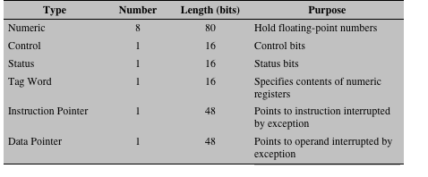
Table 14.2 x86 Processor Registers
Notes:
Table 14.2 continued.

Slide 43
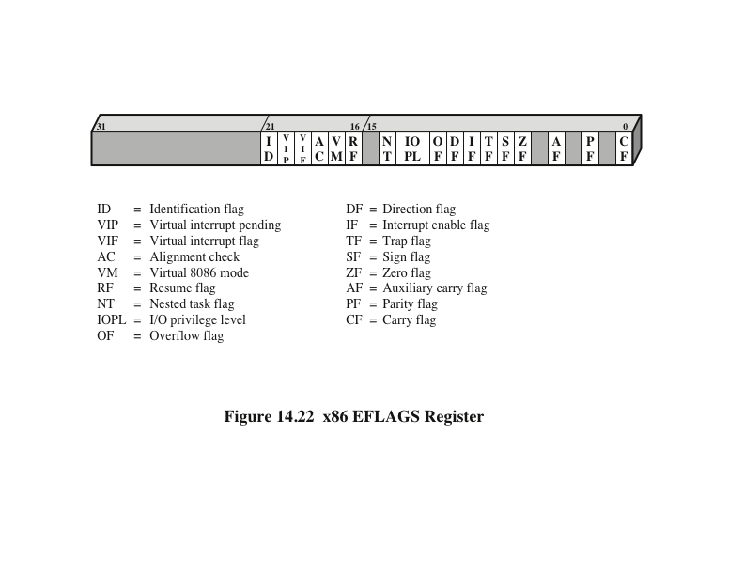
x86 EFLAGS Register
Notes:
The EFLAGS register (Figure 14.22) indicates the condition of the processor and helps to control its operation. It includes the six condition codes defined in Table 12.9 (carry, parity, auxiliary, zero, sign, overflow), which report the results of an integer operation. In addition, there are bits in the register that may be referred to as control bits:
Trap flag (TF): When set, causes an interrupt after the execution of each instruction. This is used for debugging.
Interrupt enable flag (IF): When set, the processor will recognize external interrupts.
Direction flag (DF): Determines whether string processing instructions increment or decrement the 16-bit half-registers SI and DI (for 16-bit operations) or the 32-bit registers ESI and EDI (for 32-bit operations).
I/O privilege flag (IOPL): When set, causes the processor to generate an exception on all accesses to I/O devices during protected-mode operation.
Resume flag (RF): Allows the programmer to disable debug exceptions so that the instruction can be restarted after a debug exception without immediately causing another debug exception.
Alignment check (AC): Activates if a word or doubleword is addressed on a nonword or nondoubleword boundary.
Identification flag (ID): If this bit can be set and cleared, then this processor supports the processorID instruction. This instruction provides information about the vendor, family, and model.
In addition, there are 4 bits that relate to operating mode. The Nested Task (NT) flag indicates that the current task is nested within another task in protected- mode operation. The Virtual Mode (VM) bit allows the programmer to enable or disable virtual 8086 mode, which determines whether the processor runs as an 8086 machine. The Virtual Interrupt Flag (VIF) and Virtual Interrupt Pending (VIP) flag are used in a multitasking environment.

Slide 44
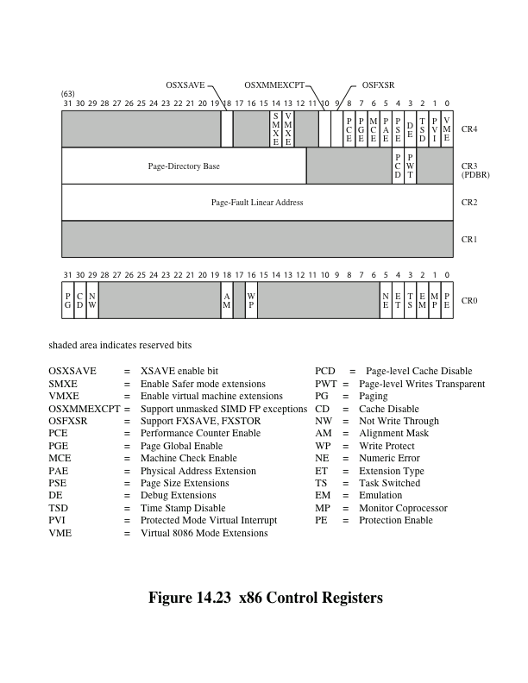
Control
Registers
Notes:
The x86 employs four control registers (register CR1 is unused) to control various aspects of processor operation (Figure 14.23). All of the registers except CR0 are either 32 bits or 64 bits long, depending on whether the implementation supports the x86 64-bit architecture. The CR0 register contains system control flags, which control modes or indicate states that apply generally to the processor rather than
to the execution of an individual task. The flags are as follows:
Protection Enable (PE): Enable/disable protected mode of operation.
Monitor Coprocessor (MP): Only of interest when running programs from earlier machines on the x86; it relates to the presence of an arithmetic coprocessor.
Emulation (EM): Set when the processor does not have a floating-point unit, and causes an interrupt when an attempt is made to execute floating-point instructions.
Task Switched (TS): Indicates that the processor has switched tasks.
Extension Type (ET): Not used on the Pentium and later machines; used to
indicate support of math coprocessor instructions on earlier machines.
Numeric Error (NE): Enables the standard mechanism for reporting floating- point errors on external bus lines.
Write Protect (WP): When this bit is clear, read-only user-level pages can be written by a supervisor process. This feature is useful for supporting process creation in some operating systems.
Alignment Mask (AM): Enables/disables alignment checking.
Not Write Through (NW): Selects mode of operation of the data cache. When
this bit is set, the data cache is inhibited from cache write-through operations.
Cache Disable (CD): Enables/disables the internal cache fill mechanism.
Paging (PG): Enables/disables paging.
When paging is enabled, the CR2 and CR3 registers are valid. The CR2 register holds the 32-bit linear address of the last page accessed before a page fault interrupt. The leftmost 20 bits of CR3 hold the 20 most significant bits of the base address of the page directory; the remainder of the address contains zeros. Two bits of CR3 are used to drive pins that control the operation of an external cache. The page- level cache disable (PCD) enables or disables the external cache, and the page-level writes transparent (PWT) bit controls write through in the external cache.
• • • • • •
Nine additional control bits are defined in CR4:
Virtual-8086 Mode Extension (VME): Enables support for the virtual interrupt flag in virtual-8086 mode.
Protected-mode Virtual Interrupts (PVI): Enables support for the virtual interrupt flag in protected mode.
Time Stamp Disable (TSD): Disables the read from time stamp counter (RDTSC) instruction, which is used for debugging purposes.
Debugging Extensions (DE): Enables I/O breakpoints; this allows the processor to interrupt on I/O reads and writes.
Page Size Extensions (PSE): Enables large page sizes (2 or 4-MByte pages) when set; restricts pages to 4 KBytes when clear.
Physical Address Extension (PAE): Enables address lines A35 through A32 whenever a special new addressing mode, controlled by the PSE, is enabled.
Machine Check Enable (MCE): Enables the machine check interrupt, which occurs when a data parity error occurs during a read bus cycle or when a bus cycle is not successfully completed.
Page Global Enable (PGE): Enables the use of global pages. When PGE =1 and a task switch is performed, all of the TLB entries are flushed with the exception of those marked global.
Performance Counter Enable (PCE): Enables the execution of the RDPMC (read performance counter) instruction at any privilege level. Two performance counters are used to measure the duration of a specific event type and the number of occurrences of a specific event type.

Slide 45
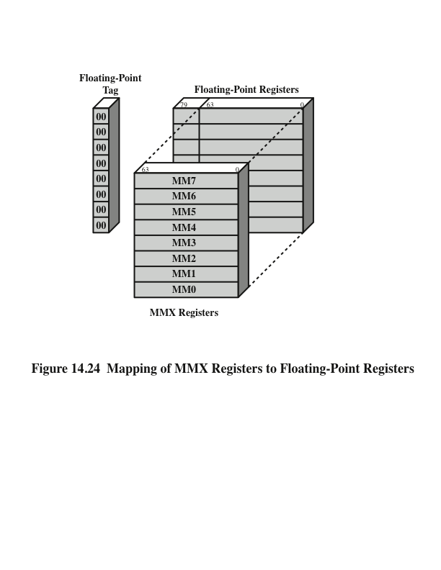
Mapping of MMX Registers to
Floating-Point Registers
Notes:
Recall from Section 10.3 that the x86 MMX capability makes use of several 64-bit data types. The MMX instructions make use of 3-bit register address fields, so that eight MMX registers are supported. In fact, the processor does not include specific MMX registers. Rather, the processor uses an aliasing technique (Figure 14.24). The existing floating-point registers are used to store MMX values. Specifically, the low-order 64 bits (mantissa) of each floating-point register are used to form the eight MMX registers. Thus, the older 32-bit x86 architecture is easily extended to support the MMX capability. Some key characteristics of the MMX use of these registers are as follows:
• Recall that the floating-point registers are treated as a stack for floating-point operations. For MMX operations, these same registers are accessed directly.
• The first time that an MMX instruction is executed after any floating-point operations, the FP tag word is marked valid. This reflects the change from stack operation to direct register addressing.
The EMMS (Empty MMX State) instruction sets bits of the FP tag word to indicate that all registers are empty. It is important that the programmer insert this instruction at the end of an MMX code block so that subsequent floating- point operations function properly.
When a value is written to an MMX register, bits [79:64] of the corresponding FP register (sign and exponent bits) are set to all ones. This sets the value in the FP register to NaN (not a number) or infinity when viewed as a floating- point value. This ensures that an MMX data value will not look like a valid floating-point value.

Slide 46
Interrupt Processing
Interrupts and Exceptions
Interrupts
  Generated by a signal from hardware and it may occur at random times during the execution of a program
  Maskable
  Nonmaskable
Exceptions
  Generated from software and is provoked by the execution of an instruction
  Processor detected
  Programmed
Interrupt vector table
  Every type of interrupt is assigned a number
  Number is used to index into the interrupt vector table
Notes:
Two classes of events cause the x86 to suspend execution of the current instruction stream and respond to the event: interrupts and exceptions. In both cases, the processor saves the context of the current process and transfers to a predefined routine to service the condition. An interrupt is generated by a signal from hardware, and it may occur at random times during the execution of a program. An exception is generated from software, and it is provoked by the execution of an instruction. There are two sources of interrupts and two sources of exceptions:
1. Interrupts
Maskable interrupts: Received on the processor’s INTR pin. The processor does not recognize a maskable interrupt unless the interrupt enable flag (IF) is set.
Nonmaskable interrupts: Received on the processor’s NMI pin. Recognition of such interrupts cannot be prevented.
2. Exceptions
Processor-detected exceptions: Results when the processor encounters an
error while attempting to execute an instruction.
Programmed exceptions: These are instructions that generate an exception (e.g., INTO, INT3, INT, and BOUND).
Interrupt processing on the x86 uses the interrupt vector table. Every type of interrupt is assigned a number, and this number is used to index into the interrupt vector table. This table contains 256 32-bit interrupt vectors, which is the address (segment and offset) of the interrupt service routine for that interrupt number.

Slide 47
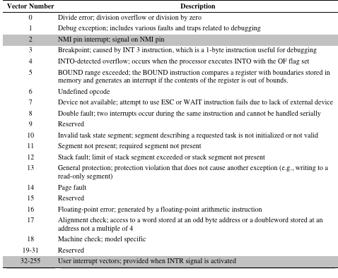
Table 14.3 x86 Exception and Interrupt Vector Table
Unshaded: exceptions Shaded: interrupts
Notes:
Table 14.3 shows the assignment of numbers in the interrupt vector table; shaded entries represent interrupts, while nonshaded entries are exceptions. The NMI hardware interrupt is type 2. INTR hardware interrupts are assigned numbers in the range of 32 to 255; when an INTR interrupt is generated, it must be accompanied on the bus with the interrupt vector number for this interrupt. The remaining vector numbers are used for exceptions.
If more than one exception or interrupt is pending, the processor services them in a predictable order. The location of vector numbers within the table does not reflect priority. Instead, priority among exceptions and interrupts is organized into five classes. In descending order of priority, these are
• • • • •
Class 1: Traps on the previous instruction (vector number 1)
Class 2: External interrupts (2, 32–255)
Class 3: Faults from fetching next instruction (3, 14)
Class 4: Faults from decoding the next instruction (6, 7)
Class 5: Faults on executing an instruction (0, 4, 5, 8, 10–14, 16, 17)

Slide 48
The ARM Processor
ARM is primarily a RISC system with the following attributes:
Moderate array of uniform registers
A load/store model of data processing in which operations only perform on operands in registers and not directly in memory
A uniform fixed-length instruction of 32 bits for the standard set and 16 bits for the Thumb instruction set
Separate arithmetic logic unit (ALU) and shifter units
A small number of addressing modes with all load/store addresses determined from registers and instruction fields
Auto-increment and auto-decrement addressing modes are used to improve the operation of program loops
Conditional execution of instructions minimizes the need for conditional branch instructions, thereby improving pipeline efficiency, because pipeline flushing is reduced
Notes:
ARM is primarily a RISC system with the following notable attributes:
• A moderate array of uniform registers, more than are found on some CISC systems but fewer than are found on many RISC systems.
* A load/store model of data processing, in which operations only perform on operands in registers and not directly in memory. All data must be loaded into registers before an operation can be performed; the result can then be used for further processing or stored into memory.
* A uniform fixed-length instruction of 32 bits for the standard set and 16 bits for the Thumb instruction set.
* To make each data processing instruction more flexible, either a shift or rotation can preprocess one of the source registers. To efficiently support this feature, there are separate arithmetic logic unit (ALU) and shifter units.
A small number of addressing modes with all load/store addressees deter- mined from registers and instruction fields. Indirect or indexed addressing involving values in memory are not used.
Auto-increment and auto-decrement addressing modes are used to improve the operation of program loops.
Conditional execution of instructions minimizes the need for conditional branch instructions, thereby improving pipeline efficiency, because pipeline flushing is reduced.

Slide 49
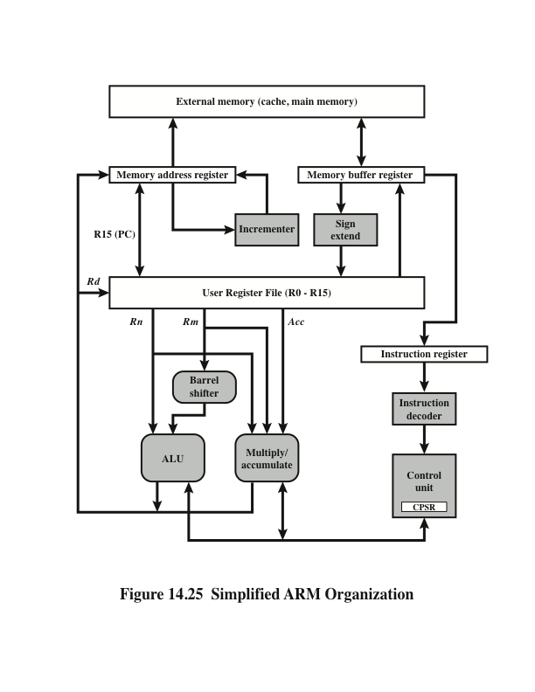
Simplified ARM Organization
Notes:
The ARM processor organization varies substantially from one implementation to the next, particularly when based on different versions of the ARM architecture. However, it is useful for the discussion in this section to present a simplified, generic ARM organization, which is illustrated in Figure 14.25. In this figure, the arrows indicate the flow of data. Each box represents a functional hardware unit or a storage unit.
Data are exchanged with the processor from external memory through a data bus. The value transferred is either a data item, as a result of a load or store instruction, or an instruction fetch. Fetched instructions pass through an instruction decoder before execution, under control of a control unit. The latter includes pipeline logic and provides control signals (not shown) to all the hardware elements of the processor. Data items are placed in the register file, consisting of a set of 32-bit registers. Byte or halfword items treated as twos-complement numbers are sign-extended to 32 bits.
ARM data processing instructions typically have two source registers, Rn and Rm, and a single result or destination register, Rd. The source register values feed into the ALU or a separate multiply unit that makes use of an additional register to accumulate partial results. The ARM processor also includes a hardware unit that can shift or rotate the Rm value before it enters the ALU. This shift or rotate occurs within the cycle time of the instruction and increases the power and flexibility of many data processing operations.
The results of an operation are fed back to the destination register. Load/store instructions may also use the output of the arithmetic units to generate the memory address for a load or store.

Slide 50
Processor Modes
Notes:
The ARM architecture supports seven execution modes. Most application programs execute in user mode. While the processor is in user mode, the program being executed is unable to access protected system resources or to change mode, other than by causing an exception to occur.
The remaining six execution modes are referred to as privileged modes. These modes are used to run system software. There are two principal advantages to defining so many different privileged modes: (1) The OS can tailor the use of system software to a variety of circumstances, and (2) certain registers are dedicated for use for each of the privileged modes, allows swifter changes in context.

Slide 51
Exception Modes
Notes:
The exception modes have full access to system resources and can change modes freely. Five of these modes are known as exception modes. These are entered when specific exceptions occur. Each of these modes has some dedicated registers that substitute for some of the user mode registers, and which are used to avoid corrupting User mode state information when the exception occurs. The exception modes are as follows:
* Supervisor mode: Usually what the OS runs in. It is entered when the processor encounters a software interrupt instruction. Software interrupts are a standard way to invoke operating system services on ARM.
* Abort mode: Entered in response to memory faults.
* Undefined mode: Entered when the processor attempts to execute an instruction
that is supported neither by the main integer core nor by one of the coprocessors.
* Fast interrupt mode: Entered whenever the processor receives an interrupt signal from the designated fast interrupt source. A fast interrupt cannot be interrupted, but a fast interrupt may interrupt a normal interrupt.
• Interrupt mode: Entered whenever the processor receives an interrupt signal from any other interrupt source (other than fast interrupt). An interrupt may only be interrupted by a fast interrupt.
The remaining privileged mode is the System mode. This mode is not entered by any exception and uses the same registers available in User mode. The System mode is used for running certain privileged operating system tasks. System mode tasks may be interrupted by any of the five exception categories.

Slide 52
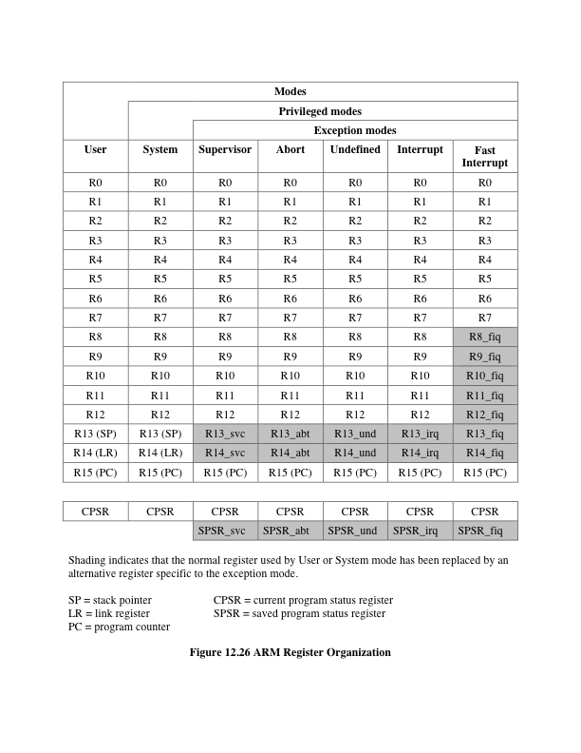
Figure 14.26
ARM
Register
Organization
Notes:
Figure 14.26 depicts the user-visible registers for the ARM. The ARM processor has a total of 37 32-bit registers, classified as follows:
• Thirty-one registers referred to in the ARM manual as general-purpose registers. In fact, some of these, such as the program counters, have special purposes.
• Six program status registers.
Registers are arranged in partially overlapping banks, with the current processor mode determining which bank is available. At any time, sixteen numbered registers and one or two program status registers are visible, for a total of 17 or 18 software-visible registers. Figure 14.26 is interpreted as follows:
Registers R0 through R7, register R15 (the program counter) and the current program status register (CPSR) are visible in and shared by all modes.
RegistersR8throughR12aresharedbyallmodesexceptfastinterrupt,which has its own dedicated registers R8_fiq through R12_fiq.
All the exception modes have their own versions of registers R13 and R14.
All the exception modes have a dedicated saved program status register (SPSR)

Slide 53
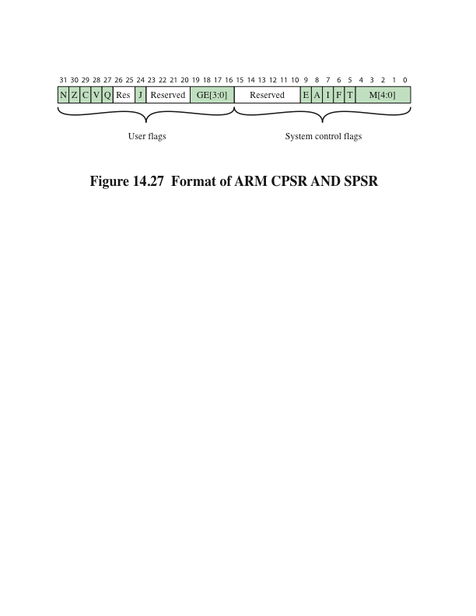
Format of ARM CPSR and SPSR
Notes:
The CPSR is accessible in all processor modes. Each exception mode also has a dedicated SPSR that is used to preserve the value of the CPSR when the associated exception occurs.
The 16 most significant bits of the CPSR contain user flags visible in User mode, and which can be used to affect the operation of a program (Figure 14.27). These are as follows:
• Condition code flags: The N, Z, C, and V flags, which are discussed in Chapter 12.
* Q flag: used to indicate whether overflow and/or saturation has occurred in
some SIMD-oriented instructions.
* J bit: indicates the use of special 8-bit instructions, known as Jazelle instructions, which are beyond the scope of our discussion.
GE[3:0] bits: SIMD instructions use bits [19:16] as Greater than or Equal (GE) flags for individual bytes or halfwords of the result.
The 16 least significant bits of the CPSR contain system control flags that can only be altered when the processor is in a privileged mode. The fields are as follows:
• Ebit: Controls load and store endianness for data; ignored for instruction fetches.
* Interrupt disable bits: The A bit disables imprecise data aborts when set; the I bit
disables IRQ interrupts when set; and the F bit disables FIQ interrupts when set.
T bit: Indicates whether instructions should be interpreted as normal ARM instructions or Thumb instructions.
* Mode bits: Indicates the processor mode.

Slide 54
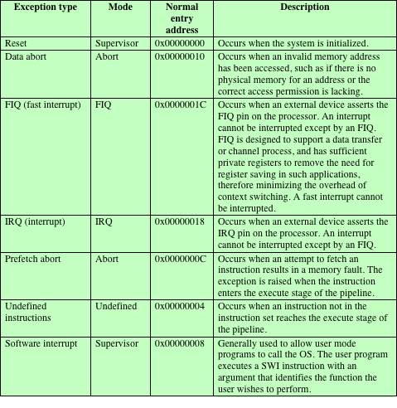
Table 14.4
ARM
Interrupt
Vector
Notes:
As with any processor, the ARM includes a facility that enables the processor to interrupt the currently executing program to deal with exception conditions. Exceptions are generated by internal and external sources to cause the processor to handle an event. The processor state just before handling the exception is normally preserved so that the original program can be resumed when the exception routine has completed. More than one exception can arise at the same time. The ARM architecture supports seven types of exception. Table 14.4 lists the types of exception and the processor mode that is used to process each type. When an exception occurs, execution is forced from a fixed memory address corresponding to the type of exception. These fixed addresses are called the exception vectors.
If more than one interrupt is outstanding, they are handled in priority order. Table 14.4 lists the exceptions in priority order, highest to lowest.
When an exception occurs, the processor halts execution after the current instruction. The state of the processor is preserved in the SPSR that corresponds to the type of exception, so that the original program can be resumed when the exception routine has completed. The address of the instruction the processor was just about to execute is placed in the link register of the appropriate processor mode. To return after handling the exception, the SPSR is moved into the CPSR and R14 is moved into the PC.

Slide 55
Summary
Processor Structure and Function
Chapter 14
Instruction pipelining
  Pipelining strategy
  Pipeline performance
  Pipeline hazards
  Dealing with branches
  Intel 80486 pipelining
The Arm processor
  Processor organization
  Processor modes
  Register organization
  Interrupt processing
Processor organization
Register organization
  User-visible registers
  Control and status registers
Instruction cycle
  The indirect cycle
  Data flow
The x86 processor family
  Register organization
  Interrupt processing
Notes:
Chapter 14 summary.

