Slide 1

William Stallings
Computer Organization and Architecture
9th Edition
Notes:
Lecture slides prepared for “Computer Organization and Architecture”, 9/e, by William Stallings, Chapter 4 “Cache Memory”.

Slide 2
Chapter 4
Cache Memory
Notes:
Although seemingly simple in concept, computer memory exhibits perhaps the widest
range of type, technology, organization, performance, and cost of any feature
of a computer system. No single technology is optimal in satisfying the memory
requirements for a computer system. As a consequence, the typical computer
system is equipped with a hierarchy of memory subsystems, some internal to the
system (directly accessible by the processor) and some external (accessible by the
processor via an I/O module).
This chapter and the next focus on internal memory elements, while Chapter 6
is devoted to external memory. To begin, the first section examines key characteristics
of computer memories. The remainder of the chapter examines an essential element
of all modern computer systems: cache memory.

Slide 3
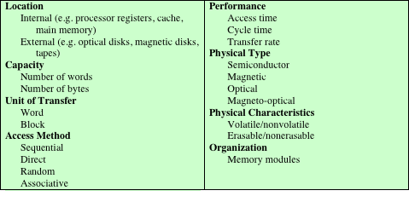
Key Characteristics of Computer Memory Systems
Table 4.1 Key Characteristics of Computer Memory Systems
Notes:
The complex subject of computer memory is made more manageable if we classify
memory systems according to their key characteristics. The most important of these
are listed in Table 4.1.

Slide 4
Characteristics of Memory Systems
Location
  Refers to whether memory is internal and external to the computer
  Internal memory is often equated with main memory
  Processor requires its own local memory, in the form of registers
  Cache is another form of internal memory
  External memory consists of peripheral storage devices that are accessible to the processor via I/O controllers
Capacity
  Memory is typically expressed in terms of bytes
Unit of transfer
  For internal memory the unit of transfer is equal to the number of electrical lines into and out of the memory module
Notes:
The term location in Table 4.1 refers to whether memory is internal and external
to the computer. Internal memory is often equated with main memory. But there
are other forms of internal memory. The processor requires its own local memory, in
the form of registers (e.g., see Figure 2.3). Further, as we shall see, the control unit
portion of the processor may also require its own internal memory. We will defer
discussion of these latter two types of internal memory to later chapters. Cache is
another form of internal memory. External memory consists of peripheral storage
devices, such as disk and tape, that are accessible to the processor via I/O controllers.
An obvious characteristic of memory is its capacity. For internal memory, this is
typically expressed in terms of bytes (1 byte = 8 bits) or words. Common word lengths
are 8, 16, and 32 bits. External memory capacity is typically expressed in terms of bytes.
A related concept is the unit of transfer. For internal memory, the unit
of transfer is equal to the number of electrical lines into and out of the memory
module. This may be equal to the word length, but is often larger, such as 64, 128, or
256 bits. To clarify this point, consider three related concepts for internal memory:
• Word: The “natural” unit of organization of memory. The size of a word is typically
equal to the number of bits used to represent an integer and to the instruction
length. Unfortunately, there are many exceptions. For example, the CRAY
C90 (an older model CRAY supercomputer) has a 64-bit word length but uses
a 46-bit integer representation. The Intel x86 architecture has a wide variety of
instruction lengths, expressed as multiples of bytes, and a word size of 32 bits.
• Addressable units: In some systems, the addressable unit is the word. However,
many systems allow addressing at the byte level. In any case, the relationship
between the length in bits A of an address and the number N of addressable
units is 2A = N.
• Unit of transfer: For main memory, this is the number of bits read out of or
written into memory at a time. The unit of transfer need not equal a word or
an addressable unit. For external memory, data are often transferred in much
larger units than a word, and these are referred to as blocks

Slide 5
Method of Accessing Units of Data
Notes:
Another distinction among memory types is the method of accessing units of
data. These include the following:
• Sequential access: Memory is organized into units of data, called records.
Access must be made in a specific linear sequence. Stored addressing information
is used to separate records and assist in the retrieval process. A shared
read–write mechanism is used, and this must be moved from its current location
to the desired location, passing and rejecting each intermediate record.
Thus, the time to access an arbitrary record is highly variable. Tape units, discussed
in Chapter 6, are sequential access.
Direct access: As with sequential access, direct access involves a shared
read–write mechanism. However, individual blocks or records have a unique
address based on physical location. Access is accomplished by direct access
to reach a general vicinity plus sequential searching, counting, or waiting to
reach the final location. Again, access time is variable. Disk units, discussed in
Chapter 6, are direct access.
• Random access: Each addressable location in memory has a unique, physically
wired-in addressing mechanism. The time to access a given location is independent
of the sequence of prior accesses and is constant. Thus, any location
can be selected at random and directly addressed and accessed. Main memory
and some cache systems are random access.
• Associative: This is a random access type of memory that enables one to make
a comparison of desired bit locations within a word for a specified match, and
to do this for all words simultaneously. Thus, a word is retrieved based on a
portion of its contents rather than its address. As with ordinary random-access
memory, each location has its own addressing mechanism, and retrieval time
is constant independent of location or prior access patterns. Cache memories
may employ associative access.

Slide 6
Capacity and Performance:
Notes:
From a user’s point of view, the two most important characteristics of memory
are capacity and performance. Three performance parameters are used:
• Access time (latency): For random-access memory, this is the time it takes to
perform a read or write operation, that is, the time from the instant that an
address is presented to the memory to the instant that data have been stored
or made available for use. For non-random-access memory, access time is the
time it takes to position the read–write mechanism at the desired location.
• Memory cycle time: This concept is primarily applied to random-access memory
and consists of the access time plus any additional time required before a second
access can commence. This additional time may be required for transients to die
out on signal lines or to regenerate data if they are read destructively. Note that
memory cycle time is concerned with the system bus, not the processor.
• Transfer rate: This is the rate at which data can be transferred into or out of a
memory unit. For random-access memory, it is equal to 1/(cycle time).

Slide 7
Memory
  The most common forms are:
  Semiconductor memory
  Magnetic surface memory
  Optical
  Magneto-optical
  Several physical characteristics of data storage are important:
  Volatile memory
    Information decays naturally or is lost when electrical power is switched off
  Nonvolatile memory
    Once recorded, information remains without deterioration until deliberately changed
    No electrical power is needed to retain information
  Magnetic-surface memories
    Are nonvolatile
  Semiconductor memory
    May be either volatile or nonvolatile
  Nonerasable memory
    Cannot be altered, except by destroying the storage unit
    Semiconductor memory of this type is known as read-only memory (ROM)
  For random-access memory the organization is a key design issue
  Organization refers to the physical arrangement of bits to form words
Notes:
A variety of physical types of memory have been employed. The most common
today are semiconductor memory, magnetic surface memory, used for disk and
tape, and optical and magneto-optical.
Several physical characteristics of data storage are important. In a volatile
memory, information decays naturally or is lost when electrical power is switched
off. In a nonvolatile memory, information once recorded remains without deterioration
until deliberately changed; no electrical power is needed to retain information.
Magnetic-surface memories are nonvolatile. Semiconductor memory (memory
on integrated circuits) may be either volatile or nonvolatile. Nonerasable memory
cannot be altered, except by destroying the storage unit. Semiconductor memory of
this type is known as read-only memory (ROM). Of necessity, a practical nonerasable
memory must also be nonvolatile.
For random-access memory, the organization is a key design issue. In this context,
organization refers to the physical arrangement of bits to form words. The
obvious arrangement is not always used, as is explained in Chapter 5.

Slide 8
Memory Hierarchy
Design constraints on a computer’s memory can be summed up by three questions:
  How much, how fast, how expensive
There is a trade-off among capacity, access time, and cost
  Faster access time, greater cost per bit
  Greater capacity, smaller cost per bit
  Greater capacity, slower access time
The way out of the memory dilemma is not to rely on a single memory component or technology, but to employ a memory hierarchy
Notes:
The design constraints on a computer’s memory can be summed up by three questions:
How much? How fast? How expensive?
The question of how much is somewhat open ended. If the capacity is there,
applications will likely be developed to use it. The question of how fast is, in a sense,
easier to answer. To achieve greatest performance, the memory must be able to
keep up with the processor. That is, as the processor is executing instructions, we
would not want it to have to pause waiting for instructions or operands. The final
question must also be considered. For a practical system, the cost of memory must
be reasonable in relationship to other components.
As might be expected, there is a trade-off among the three key characteristics
of memory: capacity, access time, and cost. A variety of technologies are used to
implement memory systems, and across this spectrum of technologies, the following
relationships hold:
• Faster access time, greater cost per bit
• Greater capacity, smaller cost per bit
• Greater capacity, slower access time
The dilemma facing the designer is clear. The designer would like to use memory
technologies that provide for large-capacity memory, both because the capacity
is needed and because the cost per bit is low. However, to meet performance
requirements, the designer needs to use expensive, relatively lower-capacity memories
with short access times.
The way out of this dilemma is not to rely on a single memory component or
technology, but to employ a memory hierarchy.

Slide 9
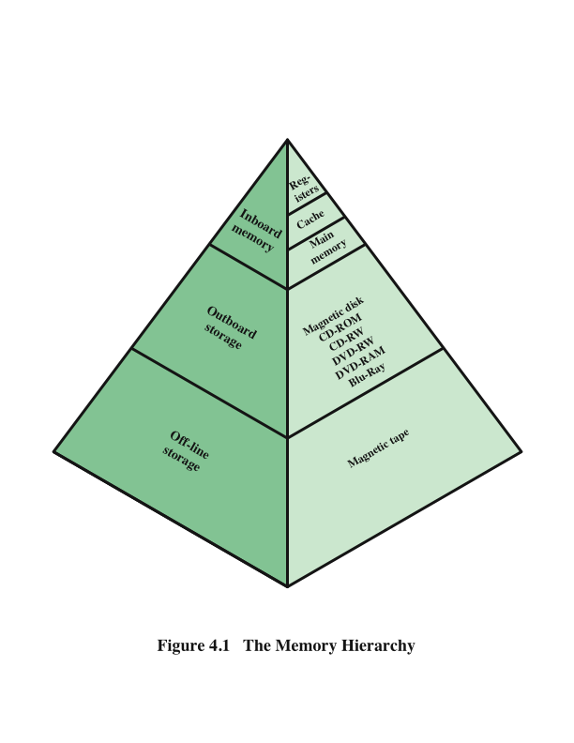
Memory Hierarchy - Diagram
Notes:
A typical hierarchy is illustrated in
Figure 4.1. As one goes down the hierarchy, the following occur:
a. Decreasing cost per bit
b. Increasing capacity
c. Increasing access time
d. Decreasing frequency of access of the memory by the processor
Thus, smaller, more expensive, faster memories are supplemented by larger,
cheaper, slower memories. The key to the success of this organization is item (d)
:decreasing frequency of access. We examine this concept in greater detail when we
discuss the cache, later in this chapter, and virtual memory in Chapter 8. A brief
explanation is provided at this point.
The use of two levels of memory to reduce average access time works in principle,
but only if conditions (a) through (d) apply. By employing a variety of technologies,
a spectrum of memory systems exists that satisfies conditions (a) through
(c). Fortunately, condition (d) is also generally valid.
The basis for the validity of condition (d) is a principle known as locality of
reference [DENN68]. During the course of execution of a program, memory references
by the processor, for both instructions and data, tend to cluster. Programs
typically contain a number of iterative loops and subroutines. Once a loop or subroutine
is entered, there are repeated references to a small set of instructions.
Similarly, operations on tables and arrays involve access to a clustered set of data
words. Over a long period of time, the clusters in use change, but over a short period
of time, the processor is primarily working with fixed clusters of memory references.
Accordingly, it is possible to organize data across the hierarchy such that the
percentage of accesses to each successively lower level is substantially less than that
of the level above. Consider the two-level example already presented. Let level 2
memory contains all program instructions and data. The current clusters can be
temporarily placed in level 1. From time to time, one of the clusters in level 1 will
have to be swapped back to level 2 to make room for a new cluster coming in to
level 1. On average, however, most references will be to instructions and data contained
in level 1.
This principle can be applied across more than two levels of memory, as suggested
by the hierarchy shown in Figure 4.1. The fastest, smallest, and most expensive
type of memory consists of the registers internal to the processor. Typically, a
processor will contain a few dozen such registers, although some machines contain
hundreds of registers. Main memory is the principal internal memory system of
the computer. Each location in main memory has a unique address. Main memory
is usually extended with a higher-speed, smaller cache. The cache is not usually
visible to the programmer or, indeed, to the processor. It is a device for staging
the movement of data between main memory and processor registers to improve
performance.

Slide 10
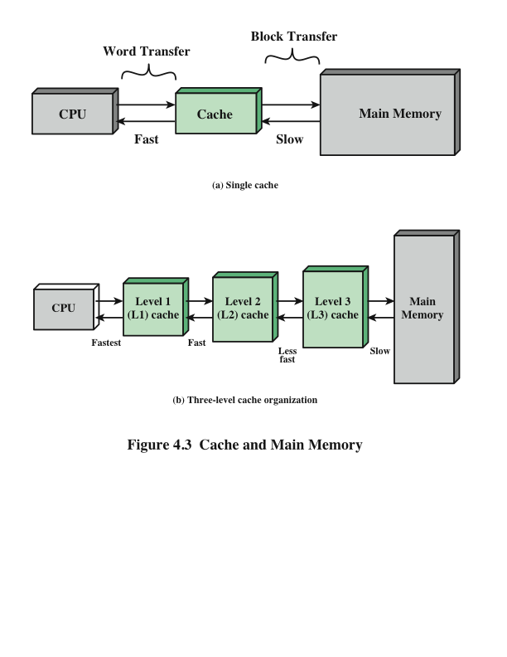
Cache and Main Memory
Notes:
Cache memory is designed to combine the memory access time of expensive, high-speed
memory combined with the large memory size of less expensive, lower-speed
memory.
The concept is illustrated in Figure 4.3a. There is a relatively large and slow
main memory together with a smaller, faster cache memory. The cache contains a
copy of portions of main memory. When the processor attempts to read a word of
memory, a check is made to determine if the word is in the cache. If so, the word is
delivered to the processor. If not, a block of main memory, consisting of some fixed
number of words, is read into the cache and then the word is delivered to the processor.
Because of the phenomenon of locality of reference, when a block of data is
fetched into the cache to satisfy a single memory reference, it is likely that there will
be future references to that same memory location or to other words in the block.
Figure 4.3b depicts the use of multiple levels of cache. The L2 cache is slower
and typically larger than the L1 cache, and the L3 cache is slower and typically
larger than the L2 cache.

Slide 11
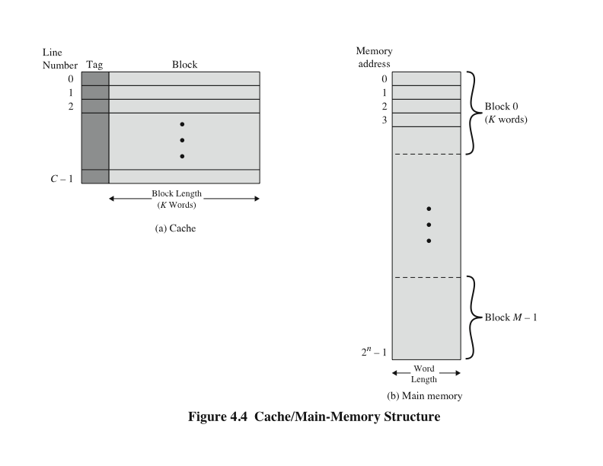
Cache/Main Memory Structure
Notes:
Figure 4.4 depicts the structure of a cache/main-memory system.

Slide 12
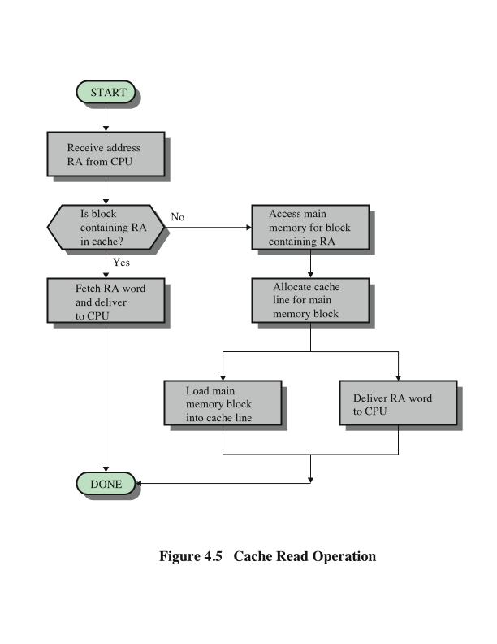
Cache Read Operation
Notes:
Figure 4.5 illustrates the read operation. The processor generates the read
address (RA) of a word to be read. If the word is contained in the cache, it is delivered
to the processor. Otherwise, the block containing that word is loaded into the
cache, and the word is delivered to the processor.

Slide 13
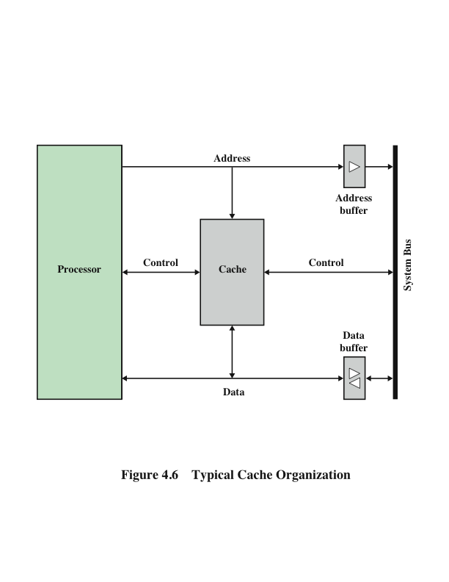
Typical Cache Organization
Notes:
Figure 4.5 shows these last two
operations occurring in parallel and reflects the organization shown in Figure 4.6,
which is typical of contemporary cache organizations. In this organization, the cache
connects to the processor via data, control, and address lines. The data and address
lines also attach to data and address buffers, which attach to a system bus from
which main memory is reached. When a cache hit occurs, the data and address buffers
are disabled and communication is only between processor and cache, with no
system bus traffic. When a cache miss occurs, the desired address is loaded onto the
system bus and the data are returned through the data buffer to both the cache and
the processor. In other organizations, the cache is physically interposed between
the processor and the main memory for all data, address, and control lines. In this
latter case, for a cache miss, the desired word is first read into the cache and then
transferred from cache to processor.

Slide 14
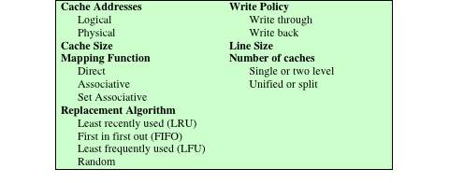
Elements of Cache Design
Table 4.2 Elements of Cache Design
Notes:
This section provides an overview of cache design parameters and reports some
typical results. We occasionally refer to the use of caches in high-performance computing
(HPC). HPC deals with supercomputers and their software, especially for
scientific applications that involve large amounts of data, vector and matrix computation,
and the use of parallel algorithms. Cache design for HPC is quite different
than for other hardware platforms and applications. Indeed, many researchers
have found that HPC applications perform poorly on computer architectures that
employ caches [BAIL93]. Other researchers have since shown that a cache hierarchy
can be useful in improving performance if the application software is tuned to
exploit the cache [WANG99, PRES01].
Although there are a large number of cache implementations, there are a few
basic design elements that serve to classify and differentiate cache architectures.
Table 4.2 lists key elements.

Slide 15
Cache Addresses
Virtual Memory
Virtual memory
  Facility that allows programs to address memory from a logical point of view, without regard to the amount of main memory physically available
  When used, the address fields of machine instructions contain virtual addresses
  For reads to and writes from main memory, a hardware memory management unit (MMU) translates each virtual address into a physical address in main memory
Notes:
Almost all non-embedded processors, and many embedded processors, support virtual
memory, a concept discussed in Chapter 8. In essence, virtual memory is a facility
that allows programs to address memory from a logical point of view, without
regard to the amount of main memory physically available. When virtual memory is
used, the address fields of machine instructions contain virtual addresses. For reads
to and writes from main memory, a hardware memory management unit (MMU)
translates each virtual address into a physical address in main memory.

Slide 16
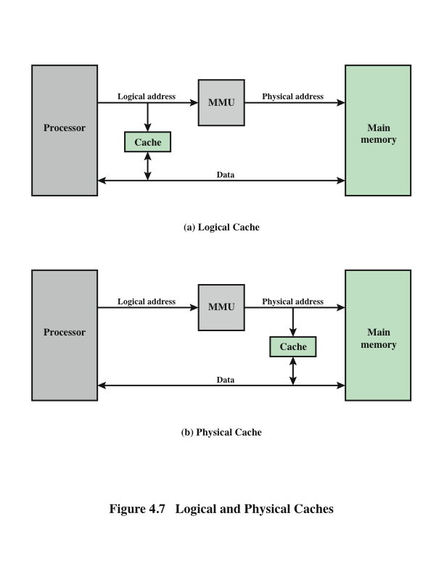
Logical and
Physical
Caches
Notes:
When virtual addresses are used, the system designer may choose to place the
cache between the processor and the MMU or between the MMU and main memory
(Figure 4.7). A logical cache, also known as a virtual cache, stores data using
virtual addresses. The processor accesses the cache directly, without going through
the MMU. A physical cache stores data using main memory physical addresses.
One obvious advantage of the logical cache is that cache access speed is faster
than for a physical cache, because the cache can respond before the MMU performs
an address translation. The disadvantage has to do with the fact that most virtual
memory systems supply each application with the same virtual memory address
space. That is, each application sees a virtual memory that starts at address 0. Thus,
the same virtual address in two different applications refers to two different physical
addresses. The cache memory must therefore be completely flushed with each
application context switch, or extra bits must be added to each line of the cache to
identify which virtual address space this address refers to.

Slide 17
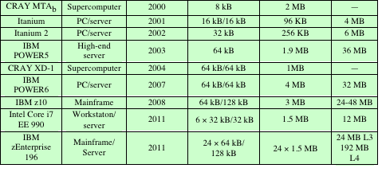
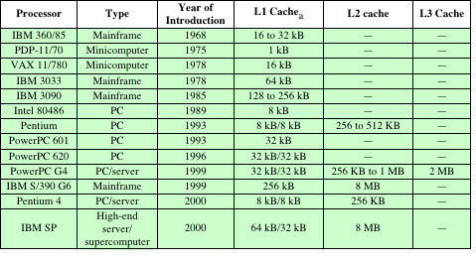
Table 4.3
Cache Sizes of Some Processors
ª Two values separated by a slash refer to instruction and data caches.
^{b} Both caches are instruction only; no data caches.
Notes:
The first item in Table 4.2, cache size, has already been discussed. We would like the
size of the cache to be small enough so that the overall average cost per bit is close
to that of main memory alone and large enough so that the overall average access
time is close to that of the cache alone. There are several other motivations for
minimizing cache size. The larger the cache, the larger the number of gates involved
in addressing the cache. The result is that large caches tend to be slightly slower
than small ones—even when built with the same integrated circuit technology and
put in the same place on chip and circuit board. The available chip and board area
also limits cache size. Because the performance of the cache is very sensitive to the
nature of the workload, it is impossible to arrive at a single “optimum” cache size.
Table 4.3 lists the cache sizes of some current and past processors.

Slide 18
Mapping Function
Because there are fewer cache lines than main memory blocks, an algorithm is needed for mapping main memory blocks into cache lines
Three techniques can be used:
Notes:
Because there are fewer cache lines than main memory blocks, an algorithm is
needed for mapping main memory blocks into cache lines. Further, a means is
needed for determining which main memory block currently occupies a cache line.
The choice of the mapping function dictates how the cache is organized. Three
techniques can be used: direct, associative, and set associative.
Direct mapping: The simplest technique, known as direct mapping, maps each
block of main memory into only one possible cache line.
Associative mapping: Associative mapping overcomes the disadvantage of direct
mapping by permitting each main memory block to be loaded into any line of the
cache.
Set-associative mapping: Set-associative mapping is a compromise that
exhibits the strengths of both the direct and associative approaches while reducing
their disadvantages.

Slide 19
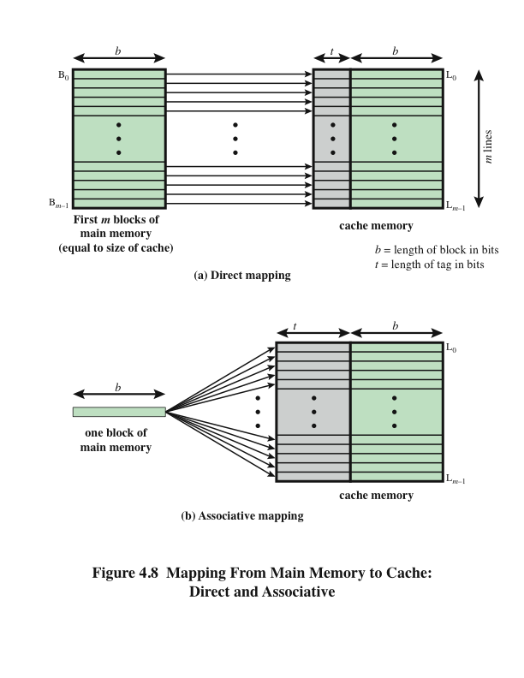
Direct
Mapping
Notes:
The mapping is expressed as
i = j modulo m
where
i = cache line number
j = main memory block number
m = number of lines in the cache
Figure 4.8a shows the mapping for the first m blocks of main memory. Each
block of main memory maps into one unique line of the cache. The next m blocks
of main memory map into the cache in the same fashion; that is, block B_{m} of main
memory maps into line L₀ of cache, block _{Bm+1} maps into line L₁, and so on.

Slide 20
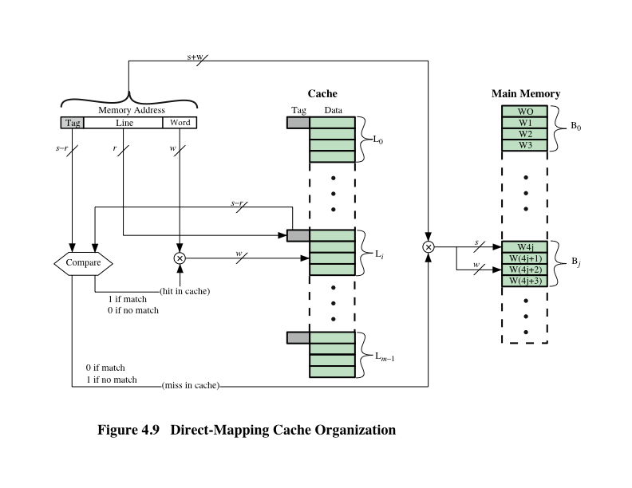
Direct Mapping Cache Organization
Notes:
The mapping function is easily implemented using the main memory address.
Figure 4.9 illustrates the general mechanism.

Slide 21
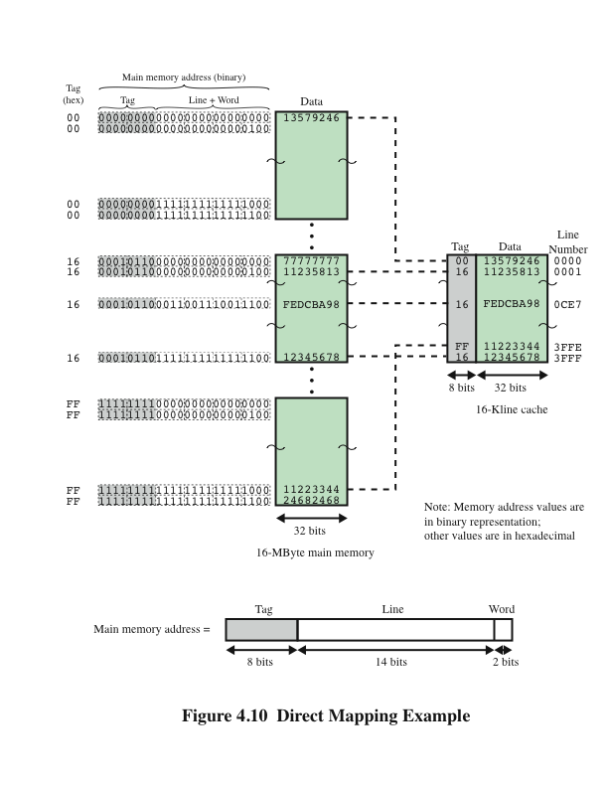
Direct
Mapping
Example
Notes:
Figure 4.10 Direct Mapping Example.

Slide 22

Direct Mapping Summary
Address length = (s + w) bits
Number of addressable units = 2^{s+w} words or bytes
Block size = line size = 2w words or bytes
Number of blocks in main memory = 2^{s+ w}/2^{w} = 2^{s}
Number of lines in cache = m = 2r
Size of tag = (s – r) bits
Notes:
The direct mapping technique is simple and inexpensive to implement. Its
main disadvantage is that there is a fixed cache location for any given block. Thus,
if a program happens to reference words repeatedly from two different blocks that
map into the same line, then the blocks will be continually swapped in the cache,
and the hit ratio will be low (a phenomenon known as thrashing).

Slide 23

Victim Cache
  Originally proposed as an approach to reduce the conflict misses of direct mapped caches without affecting its fast access time
Fully associative cache
Typical size is 4 to 16 cache lines
Residing between direct mapped L1 cache and the next level of memory
Notes:
One approach to lower the miss penalty is to remember what was discarded
in case it is needed again. Since the discarded data has already been fetched, it can
be used again at a small cost. Such recycling is possible using a victim cache. Victim
cache was originally proposed as an approach to reduce the conflict misses of direct
mapped caches without affecting its fast access time. Victim cache is a fully associative
cache, whose size is typically 4 to 16 cache lines, residing between a direct mapped L1
cache and the next level of memory. This concept is explored in Appendix D.

Slide 24
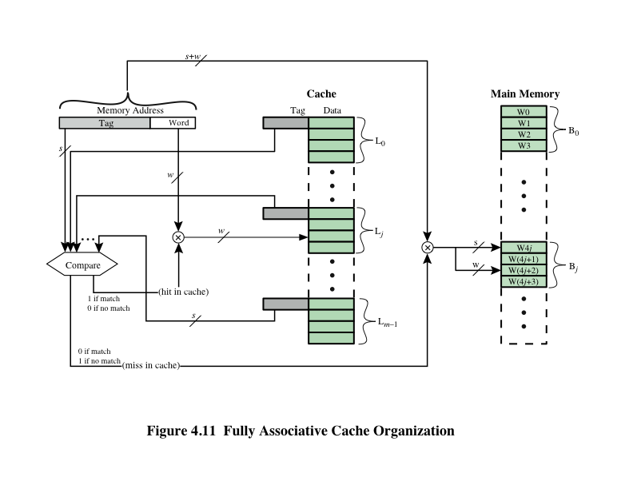
Fully Associative Cache Organization
Notes:
Associative mapping overcomes the disadvantage of direct
mapping by permitting each main memory block to be loaded into any line of the
cache (Figure 4.8b). In this case, the cache control logic interprets a memory address
simply as a Tag and a Word field. The Tag field uniquely identifies a block of main
memory. To determine whether a block is in the cache, the cache control logic must
simultaneously examine every line’s tag for a match. Figure 4.11 illustrates the logic.

Slide 25
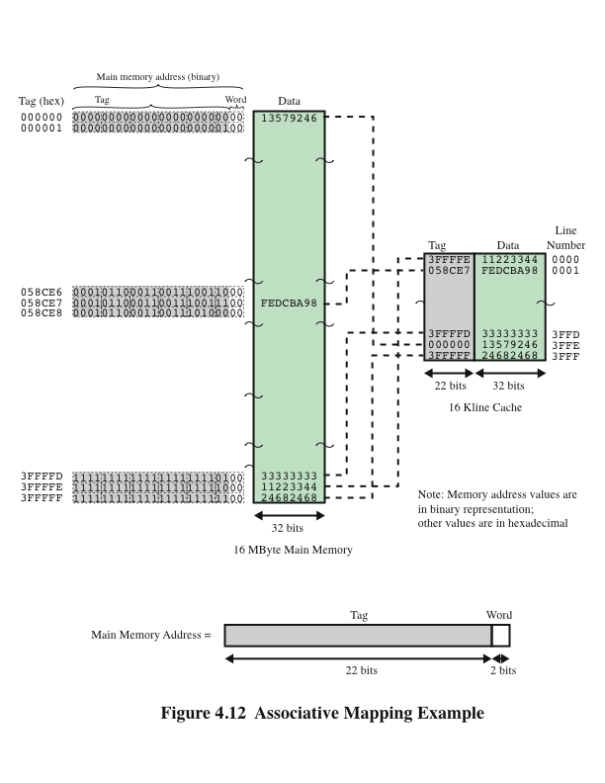
Associative
Mapping
Example
Notes:
Figure 4.12 Associative Mapping Example.

Slide 26
Associative Mapping Summary
Address length = (s + w) bits
Number of addressable units = 2^{s+w} words or bytes
Block size = line size = 2w words or bytes
Number of blocks in main memory = 2^{s+ w}/2^{w} = 2^{s}
Number of lines in cache = undetermined
Size of tag = s bits
Notes:
With associative mapping, there is flexibility as to which block to replace when
a new block is read into the cache. Replacement algorithms, discussed later in this
section, are designed to maximize the hit ratio. The principal disadvantage of associative
mapping is the complex circuitry required to examine the tags of all cache
lines in parallel.

Slide 27
Set Associative Mapping
Compromise that exhibits the strengths of both the direct and associative approaches while reducing their disadvantages
Cache consists of a number of sets
Each set contains a number of lines
A given block maps to any line in a given set
e.g. 2 lines per set
  2 way associative mapping
  A given block can be in one of 2 lines in only one set
Notes:
Set-associative mapping is a compromise that
exhibits the strengths of both the direct and associative approaches while reducing
their disadvantages.
In this case, the cache consists of a number sets, each of which consists of a
number of lines. The relationships are
m = v* k
i = j modulo v
where
i = cache set number
j = main memory block number
m = number of lines in the cache
v = number of sets
k = number of lines in each set
This is referred to as k-way set-associative mapping.

Slide 28
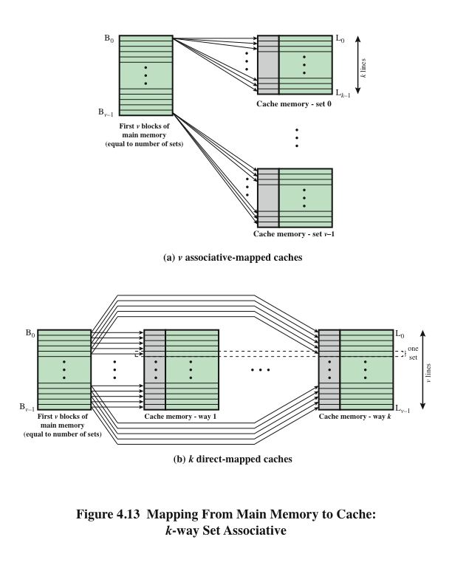
Mapping From Main Memory to Cache: k-Way
Set Associative
Notes:
Figure 4.13a illustrates
this mapping for the first v blocks of main memory. As with associative mapping,
each word maps into multiple cache lines. For set-associative mapping, each word
maps into all the cache lines in a specific set, so that main memory block B₀ maps
into set 0, and so on. Thus, the set-associative cache can be physically implemented
as n associative caches. It is also possible to implement the set-associative cache as
k direct mapping caches, as shown in Figure 4.13b. Each direct-mapped cache is
referred to as a way, consisting of v lines. The first v lines of main memory are direct
mapped into the v lines of each way; the next group of v lines of main memory are
similarly mapped, and so on. The direct-mapped implementation is typically used
for small degrees of associativity (small values of k) while the associative-mapped
implementation is typically used for higher degrees of associativity [JACO08].

Slide 29
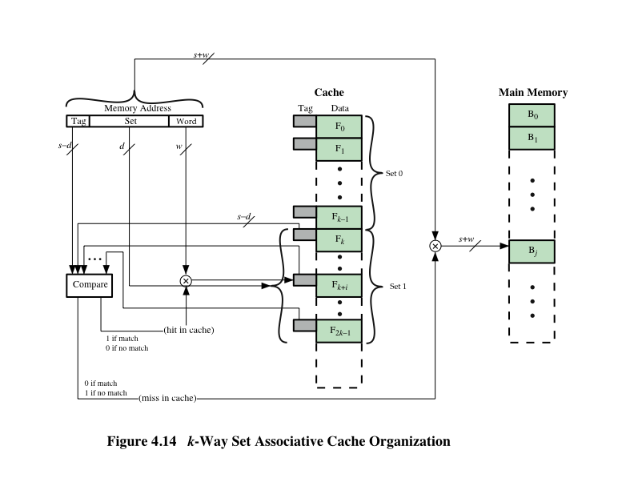
k-Way
Set Associative Cache Organization
Notes:
For set-associative mapping, the cache control logic interprets a memory
address as three fields: Tag, Set, and Word. The d set bits specify one of v = 2^{d} sets.
The s bits of the Tag and Set fields specify one of the 2^{s} blocks of main memory.
Figure 4.14 illustrates the cache control logic. With fully associative mapping, the
tag in a memory address is quite large and must be compared to the tag of every line
in the cache. With k-way set-associative mapping, the tag in a memory address is
much smaller and is only compared to the k tags within a single set.

Slide 30
Set Associative Mapping Summary
Address length = (s + w) bits
Number of addressable units = 2^{s+w} words or bytes
Block size = line size = 2^{w} words or bytes
Number of blocks in main memory = 2^{s+w/}2^{w=}2^{s}
Number of lines in set = k
Number of sets = v = 2^{d}
Number of lines in cache = m=kv = k * 2^{d}
Size of cache = k * 2^{d+w} words or bytes
Size of tag = (s – d) bits
Notes:
Set Associative Mapping Summary.

Slide 31
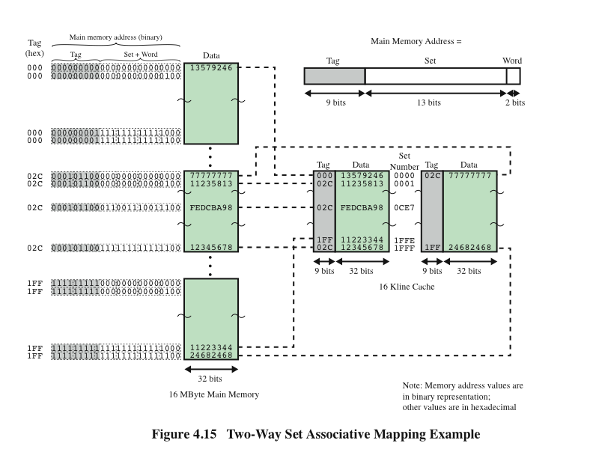
Notes:
Figure 4.15 shows an example using set-associative mapping with two
lines in each set, referred to as two-way set-associative.

Slide 32
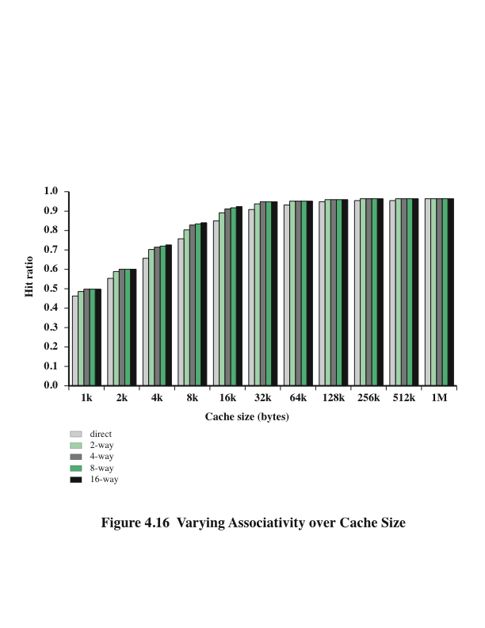
Varying Associativity Over Cache Size
Notes:
Figure 4.16 shows the results of one simulation study of set-associative cache
performance as a function of cache size [GENU04]. The difference in performance
between direct and two-way set associative is significant up to at least a cache size of
64 kB. Note also that the difference between two-way and four-way at 4 kB is much
less than the difference in going from for 4 kB to 8 kB in cache size. The complexity
of the cache increases in proportion to the associativity, and in this case would not
be justifiable against increasing cache size to 8 or even 16 Kbytes. A final point to
note is that beyond about 32 kB, increase in cache size brings no significant increase
in performance.
The results of Figure 4.16 are based on simulating the execution of a GCC
compiler. Different applications may yield different results. For example, [CANT01]
reports on the results for cache performance using many of the CPU2000 SPEC
benchmarks. The results of [CANT01] in comparing hit ratio to cache size follow
the same pattern as Figure 4.16, but the specific values are somewhat different.

Slide 33
Replacement Algorithms
Once the cache has been filled, when a new block is brought into the cache, one of the existing blocks must be replaced
For direct mapping there is only one possible line for any particular block and no choice is possible
For the associative and set-associative techniques a replacement algorithm is needed
To achieve high speed, an algorithm must be implemented in hardware
Notes:
Once the cache has been filled, when a new block is brought into the cache, one
of the existing blocks must be replaced. For direct mapping, there is only one possible
line for any particular block, and no choice is possible. For the associative
and set-associative techniques, a replacement algorithm is needed. To achieve high
speed, such an algorithm must be implemented in hardware.

Slide 34
The four most common replacement algorithms are:
Least recently used (LRU)
  Most effective
  Replace that block in the set that has been in the cache longest with no reference to it
  Because of its simplicity of implementation, LRU is the most popular replacement algorithm
First-in-first-out (FIFO)
  Replace that block in the set that has been in the cache longest
  Easily implemented as a round-robin or circular buffer technique
Least frequently used (LFU)
  Replace that block in the set that has experienced the fewest references
  Could be implemented by associating a counter with each line
Notes:
A number of algorithms
have been tried. We mention four of the most common. Probably the most
effective is least recently used (LRU): Replace that block in the set that has been in
the cache longest with no reference to it. For two-way set associative, this is easily
implemented. Each line includes a USE bit. When a line is referenced, its USE bit
is set to 1 and the USE bit of the other line in that set is set to 0. When a block is to
be read into the set, the line whose USE bit is 0 is used. Because we are assuming
that more recently used memory locations are more likely to be referenced, LRU
should give the best hit ratio. LRU is also relatively easy to implement for a fully
associative cache. The cache mechanism maintains a separate list of indexes to all
the lines in the cache. When a line is referenced, it moves to the front of the list.
For replacement, the line at the back of the list is used. Because of its simplicity of
implementation, LRU is the most popular replacement algorithm.
Another possibility is first-in-first-out (FIFO): Replace that block in the set
that has been in the cache longest. FIFO is easily implemented as a round-robin
or circular buffer technique. Still another possibility is least frequently used (LFU):
Replace that block in the set that has experienced the fewest references. LFU could
be implemented by associating a counter with each line. A technique not based on
usage (i.e., not LRU, LFU, FIFO, or some variant) is to pick a line at random from
among the candidate lines. Simulation studies have shown that random replacement
provides only slightly inferior performance to an algorithm based on usage [SMIT82].

Slide 35
Write Policy
Notes:
When a block that is resident in the cache is to be replaced, there are two cases to
consider. If the old block in the cache has not been altered, then it may be overwritten
with a new block without first writing out the old block. If at least one write
operation has been performed on a word in that line of the cache, then main memory
must be updated by writing the line of cache out to the block of memory before
bringing in the new block. A variety of write policies, with performance and economic
trade-offs, is possible. There are two problems to contend with. First, more
than one device may have access to main memory. For example, an I/O module
may be able to read-write directly to memory. If a word has been altered only in the
cache, then the corresponding memory word is invalid. Further, if the I/O device
has altered main memory, then the cache word is invalid. A more complex problem
occurs when multiple processors are attached to the same bus and each processor
has its own local cache. Then, if a word is altered in one cache, it could conceivably
invalidate a word in other caches.

Slide 36
Write Through and Write Back
Write through
  Simplest technique
  All write operations are made to main memory as well as to the cache
  The main disadvantage of this technique is that it generates substantial memory traffic and may create a bottleneck
Write back
  Minimizes memory writes
  Updates are made only in the cache
  Portions of main memory are invalid and hence accesses by I/O modules can be allowed only through the cache
  This makes for complex circuitry and a potential bottleneck
Notes:
The simplest technique is called write through. Using this technique, all write
operations are made to main memory as well as to the cache, ensuring that main
memory is always valid. Any other processor–cache module can monitor traffic to
main memory to maintain consistency within its own cache. The main disadvantage
of this technique is that it generates substantial memory traffic and may create a bottleneck.
An alternative technique, known as write back, minimizes memory writes.
With write back, updates are made only in the cache. When an update occurs, a
dirty bit, or use bit, associated with the line is set. Then, when a block is replaced, it
is written back to main memory if and only if the dirty bit is set. The problem with
write back is that portions of main memory are invalid, and hence accesses by I/O
modules can be allowed only through the cache. This makes for complex circuitry
and a potential bottleneck. Experience has shown that the percentage of memory
references that are writes is on the order of 15% [SMIT82]. However, for HPC
applications, this number may approach 33% (vector-vector multiplication) and can
go as high as 50% (matrix transposition).
In a bus organization in which more than one device (typically a processor)
has a cache and main memory is shared, a new problem is introduced. If data in one
cache are altered, this invalidates not only the corresponding word in main memory,
but also that same word in other caches (if any other cache happens to have that
same word). Even if a write-through policy is used, the other caches may contain
invalid data. A system that prevents this problem is said to maintain cache coherency.
Possible approaches to cache coherency include the following:
• Bus watching with write through: Each cache controller monitors the address
lines to detect write operations to memory by other bus masters. If another
master writes to a location in shared memory that also resides in the cache
memory, the cache controller invalidates that cache entry. This strategy depends
on the use of a write-through policy by all cache controllers.
• Hardware transparency: Additional hardware is used to ensure that all updates
to main memory via cache are reflected in all caches. Thus, if one processor
modifies a word in its cache, this update is written to main memory. In addition,
any matching words in other caches are similarly updated.
• Non-cacheable memory: Only a portion of main memory is shared by more
than one processor, and this is designated as non-cacheable. In such a system,
all accesses to shared memory are cache misses, because the shared memory
is never copied into the cache. The non-cacheable memory can be identified
using chip-select logic or high-address bits.

Slide 37
Line Size
Notes:
Another design element is the line size. When a block of data is retrieved and placed
in the cache, not only the desired word but also some number of adjacent words are
retrieved. As the block size increases from very small to larger sizes, the hit ratio
will at first increase because of the principle of locality, which states that data in the
vicinity of a referenced word are likely to be referenced in the near future. As the
block size increases, more useful data are brought into the cache. The hit ratio will
begin to decrease, however, as the block becomes even bigger and the probability
of using the newly fetched information becomes less than the probability of reusing
the information that has to be replaced. Two specific effects come into play:
• Larger blocks reduce the number of blocks that fit into a cache. Because each
block fetch overwrites older cache contents, a small number of blocks results
in data being overwritten shortly after they are fetched.
• As a block becomes larger, each additional word is farther from the requested
word and therefore less likely to be needed in the near future.
The relationship between block size and hit ratio is complex, depending on
the locality characteristics of a particular program, and no definitive optimum value
has been found. A size of from 8 to 64 bytes seems reasonably close to optimum
[SMIT87, PRZY88, PRZY90, HAND98]. For HPC systems, 64- and 128-byte cache
line sizes are most frequently used.

Slide 38
Multilevel Caches
As logic density has increased it has become possible to have a cache on the same chip as the processor
The on-chip cache reduces the processor’s external bus activity and speeds up execution time and increases overall system performance
  When the requested instruction or data is found in the on-chip cache, the bus access is eliminated
  On-chip cache accesses will complete appreciably faster than would even zero-wait state bus cycles
  During this period the bus is free to support other transfers
Two-level cache:
  Internal cache designated as level 1 (L1)
  External cache designated as level 2 (L2)
Potential savings due to the use of an L2 cache depends on the hit rates in both the L1 and L2 caches
The use of multilevel caches complicates all of the design issues related to caches, including size, replacement algorithm, and write policy
Notes:
As logic density has increased, it has become possible to
have a cache on the same chip as the processor: the on-chip cache. Compared with
a cache reachable via an external bus, the on-chip cache reduces the processor’s
external bus activity and therefore speeds up execution times and increases overall
system performance. When the requested instruction or data is found in the on-chip
cache, the bus access is eliminated. Because of the short data paths internal to
the processor, compared with bus lengths, on-chip cache accesses will complete
appreciably faster than would even zero-wait state bus cycles. Furthermore, during
this period the bus is free to support other transfers.
The inclusion of an on-chip cache leaves open the question of whether an
off-chip, or external, cache is still desirable. Typically, the answer is yes, and most contemporary
designs include both on-chip and external caches. The simplest such organization
is known as a two-level cache, with the internal cache designated as level 1 (L1)
and the external cache designated as level 2 (L2). The reason for including an L2 cache
is the following: If there is no L2 cache and the processor makes an access request
for a memory location not in the L1 cache, then the processor must access DRAM or
ROM memory across the bus. Due to the typically slow bus speed and slow memory
access time, this results in poor performance. On the other hand, if an L2 SRAM (static
RAM) cache is used, then frequently the missing information can be quickly retrieved.
If the SRAM is fast enough to match the bus speed, then the data can be accessed
using a zero-wait state transaction, the fastest type of bus transfer.
Two features of contemporary cache design for multilevel caches are noteworthy.
First, for an off-chip L2 cache, many designs do not use the system bus as
the path for transfer between the L2 cache and the processor, but use a separate
data path, so as to reduce the burden on the system bus. Second, with the continued
shrinkage of processor components, a number of processors now incorporate the L2
cache on the processor chip, improving performance.
The potential savings due to the use of an L2 cache depends on the hit rates
in both the L1 and L2 caches. Several studies have shown that, in general, the use
of a second-level cache does improve performance (e.g., see [AZIM92], [NOVI93],
[HAND98]). However, the use of multilevel caches does complicate all of the design
issues related to caches, including size, replacement algorithm, and write policy; see
[HAND98] and [PEIR99] for discussions.

Slide 39
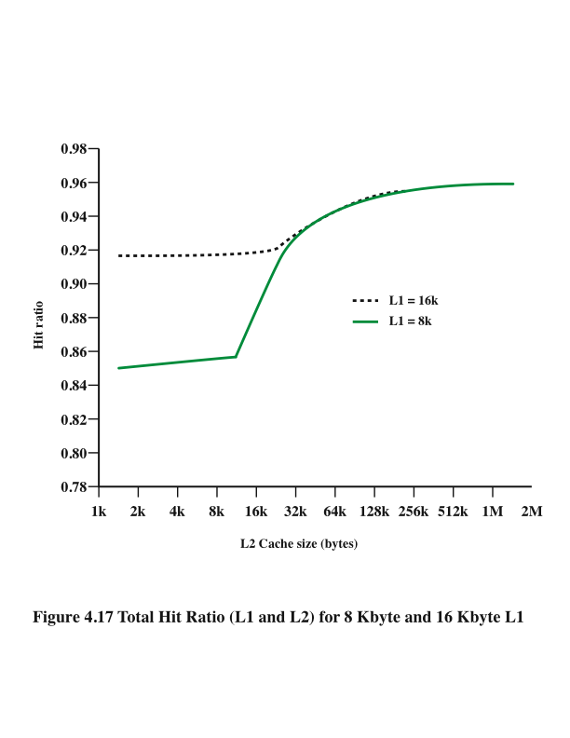
Hit Ratio (L1 & L2)
For 8 Kbyte and 16 Kbyte L1
Notes:
Figure 4.17 shows the results of one simulation study of two-level cache performance
as a function of cache size [GENU04]. The figure assumes that both
caches have the same line size and shows the total hit ratio. That is, a hit is counted
if the desired data appears in either the L1 or the L2 cache. The figure shows the
impact of L2 on total hits with respect to L1 size. L2 has little effect on the total
number of cache hits until it is at least double the L1 cache size. Note that the steepest
part of the slope for an L1 cache of 8 Kbytes is for an L2 cache of 16 Kbytes.
Again for an L1 cache of 16 Kbytes, the steepest part of the curve is for an L2 cache
size of 32 Kbytes. Prior to that point, the L2 cache has little, if any, impact on total
cache performance. The need for the L2 cache to be larger than the L1 cache to
affect performance makes sense. If the L2 cache has the same line size and capacity
as the L1 cache, its contents will more or less mirror those of the L1 cache.
With the increasing availability of on-chip area available for cache, most contemporary
microprocessors have moved the L2 cache onto the processor chip and
added an L3 cache. Originally, the L3 cache was accessible over the external bus.
More recently, most microprocessors have incorporated an on-chip L3 cache. In
either case, there appears to be a performance advantage to adding the third level
(e.g., see [GHAI98]). Further, large systems, such as the IBM mainframe zEnterprise
systems, now incorporate 3 on-chip cache levels and a fourth level of cache
shared across multiple chips [CURR11].

Slide 40
Unified Versus Split Caches
Has become common to split cache:
  One dedicated to instructions
  One dedicated to data
  Both exist at the same level, typically as two L1 caches
Advantages of unified cache:
  Higher hit rate
    Balances load of instruction and data fetches automatically
    Only one cache needs to be designed and implemented
Trend is toward split caches at the L1 and unified caches for higher levels
Advantages of split cache:
  Eliminates cache contention between instruction fetch/decode unit and execution unit
    Important in pipelining
Notes:
When the on-chip cache first made an appearance,
many of the designs consisted of a single cache used to store references to both data
and instructions. More recently, it has become common to split the cache into two:
one dedicated to instructions and one dedicated to data. These two caches both exist
at the same level, typically as two L1 caches. When the processor attempts to fetch an
instruction from main memory, it first consults the instruction L1 cache, and when the
processor attempts to fetch data from main memory, it first consults the data L1 cache.
There are two potential advantages of a unified cache:
• For a given cache size, a unified cache has a higher hit rate than split caches
because it balances the load between instruction and data fetches automatically.
That is, if an execution pattern involves many more instruction fetches
than data fetches, then the cache will tend to fill up with instructions, and if an
execution pattern involves relatively more data fetches, the opposite will occur.
• Only one cache needs to be designed and implemented.
The trend is toward split caches at the L1 and unified caches for higher levels,
particularly for superscalar machines, which emphasize parallel instruction execution
and the prefetching of predicted future instructions. The key advantage of the
split cache design is that it eliminates contention for the cache between the instruction
fetch/decode unit and the execution unit. This is important in any design that
relies on the pipelining of instructions. Typically, the processor will fetch instructions
ahead of time and fill a buffer, or pipeline, with instructions to be executed. Suppose
now that we have a unified instruction/data cache. When the execution unit performs
a memory access to load and store data, the request is submitted to the unified cache.
If, at the same time, the instruction prefetcher issues a read request to the cache for
an instruction, that request will be temporarily blocked so that the cache can service
the execution unit first, enabling it to complete the currently executing instruction.
This cache contention can degrade performance by interfering with efficient use of
the instruction pipeline. The split cache structure overcomes this difficulty.

Slide 41
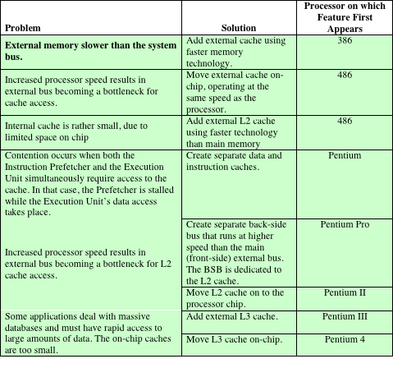
Pentium 4
Cache
Table 4.4 Intel Cache Evolution
Notes:
The evolution of cache organization is seen clearly in the evolution of Intel microprocessors
(Table 4.4). The 80386 does not include an on-chip cache. The 80486
includes a single on-chip cache of 8 Kbytes, using a line size of 16 bytes and a
four-way set-associative organization. All of the Pentium processors include two
on-chip L1 caches, one for data and one for instructions. For the Pentium 4, the
L1 data cache is 16 Kbytes, using a line size of 64 bytes and a four-way set-associative
organization. The Pentium 4 instruction cache is described subsequently. The
Pentium II also includes an L2 cache that feeds both of the L1 caches. The L2 cache
is eight-way set associative with a size of 512 kB and a line size of 128 bytes. An L3
cache was added for the Pentium III and became on-chip with high-end versions of
the Pentium 4.

Slide 42
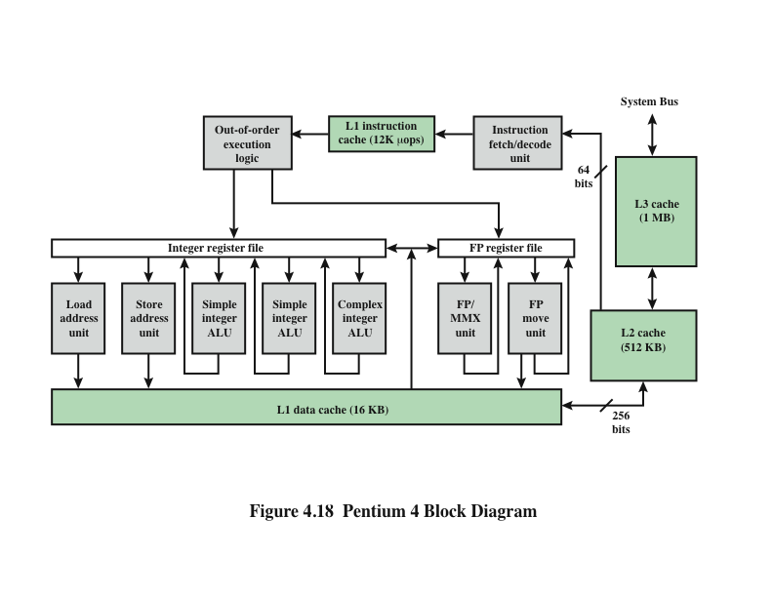
Pentium 4 Block Diagram
Notes:
Figure 4.18 provides a simplified view of the Pentium 4 organization, highlighting
the placement of the three caches. The processor core consists of four major
components:
• Fetch/decode unit: Fetches program instructions in order from the L2 cache,
decodes these into a series of micro-operations, and stores the results in the L1
instruction cache.
• Out-of-order execution logic: Schedules execution of the micro-operations
subject to data dependencies and resource availability; thus, micro-operations
may be scheduled for execution in a different order than they were fetched
from the instruction stream. As time permits, this unit schedules speculative
execution of micro-operations that may be required in the future.
Execution units: These units executes micro-operations, fetching the required
data from the L1 data cache and temporarily storing results in registers.
• Memory subsystem: This unit includes the L2 and L3 caches and the system
bus, which is used to access main memory when the L1 and L2 caches have a
cache miss and to access the system I/O resources.
Unlike the organization used in all previous Pentium models, and in most
other processors, the Pentium 4 instruction cache sits between the instruction
decode logic and the execution core. The reasoning behind this design decision is
as follows: As discussed more fully in Chapter 16, the Pentium process decodes, or
translates, Pentium machine instructions into simple RISC-like instructions called
micro-operations. The use of simple, fixed-length micro-operations enables the use
of superscalar pipelining and scheduling techniques that enhance performance.
However, the Pentium machine instructions are cumbersome to decode; they have a
variable number of bytes and many different options. It turns out that performance
is enhanced if this decoding is done independently of the scheduling and pipelining
logic. We return to this topic in Chapter 16.
The data cache employs a write-back policy: Data are written to main memory
only when they are removed from the cache and there has been an update. The
Pentium 4 processor can be dynamically configured to support write-through caching.

Slide 43
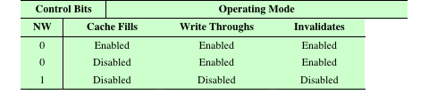
Pentium 4 Cache Operating Modes
Note: CD = 0; NW = 1 is an invalid combination.
Table 4.5 Pentium 4 Cache Operating Modes
Notes:
The L1 data cache is controlled by two bits in one of the control registers,
labeled the CD (cache disable) and NW (not write-through) bits (Table 4.5). There
are also two Pentium 4 instructions that can be used to control the data cache: INVD
invalidates (flushes) the internal cache memory and signals the external cache (if
any) to invalidate. WBINVD writes back and invalidates internal cache and then
writes back and invalidates external cache.
Both the L2 and L3 caches are eight-way set-associative with a line size of
128 bytes.

Slide 44
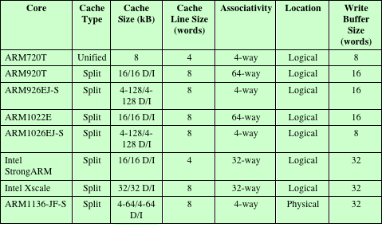
ARM Cache Features
Table 4.6 ARM Cache Features
Notes:
The ARM cache organization has evolved with the overall architecture of the ARM
family, reflecting the relentless pursuit of performance that is the driving force for
all microprocessor designers.
Table 4.6 shows this evolution. The ARM7 models used a unified L1 cache,
while all subsequent models use a split instruction/data cache. All of the ARM
designs use a set-associative cache, with the degree of associativity and the line size
varying. ARM cached cores with an MMU use a logical cache for processor families
ARM7 through ARM10, including the Intel StongARM and Intel Xscale processors.
The ARM11 family uses a physical cache. The distinction between logical and
physical cache is discussed earlier in this chapter (Figure 4.7).

Slide 45
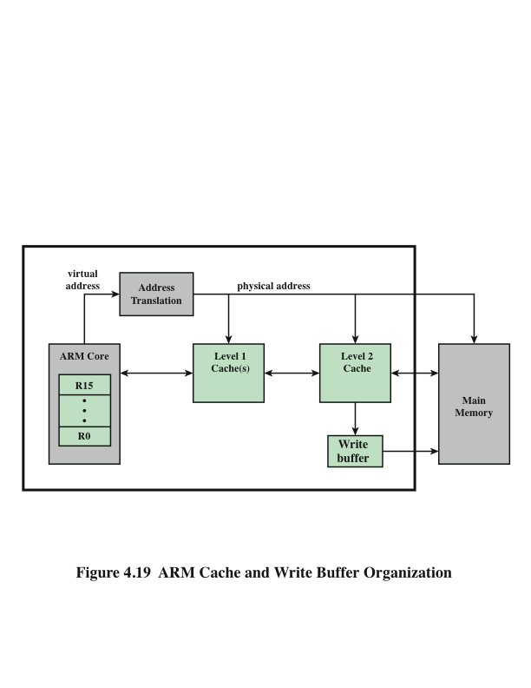
ARM Cache and Write Buffer Organization
Notes:
An interesting feature of the ARM architecture is the use of a small first-in-first-
out (FIFO) write buffer to enhance memory write performance. The write
buffer is interposed between the cache and main memory and consists of a set of
addresses and a set of data words. The write buffer is small compared to the cache,
and may hold up to four independent addresses. Typically, the write buffer is enabled
for all of main memory, although it may be selectively disabled at the page
level. Figure 4.19, taken from [SLOS04], shows the relationship among the write
buffer, cache, and main memory.
The write buffer operates as follows: When the processor performs a write to
a bufferable area, the data are placed in the write buffer at processor clock speed
and the processor continues execution. A write occurs when data in the cache are
written back to main memory. Thus, the data to be written are transferred from the
cache to the write buffer. The write buffer then performs the external write in parallel.
If, however, the write buffer is full (either because there are already the maximum
number of words of data in the buffer or because there is no slot for the new
address) then the processor is stalled until there is sufficient space in the buffer. As
non-write operations proceed, the write buffer continues to write to main memory
until the buffer is completely empty.
Data written to the write buffer are not available for reading back into the
cache until the data have transferred from the write buffer to main memory. This
is the principal reason that the write buffer is quite small. Even so, unless there
is a high proportion of writes in an executing program, the write buffer improves
performance.

Slide 46
Summary
Cache
Memory
Chapter 4
  Elements of cache design
    Cache addresses
    Cache size
    Mapping function
    Replacement algorithms
    Write policy
    Line size
    Number of caches
  Pentium 4 cache organization
  ARM cache organization
Characteristics of Memory Systems
    Location
    Capacity
    Unit of transfer
Memory Hierarchy
  How much?
  How fast?
  How expensive?
Cache memory principles
Notes:
Chapter 4 summary.

