Slide 1
Chapter 7 Input/Output
Group 7
Jhonathan Briceño
Reginal Etienne
Christian Kruger
Felix Martinez
Dane Minott
Immer S Rivera
Ander Sahonero

Slide 2
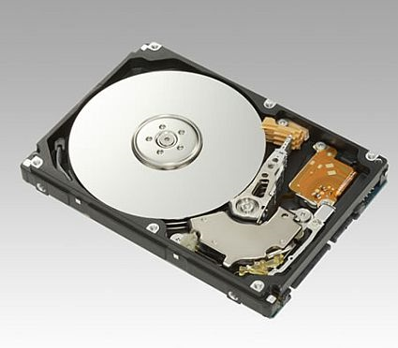
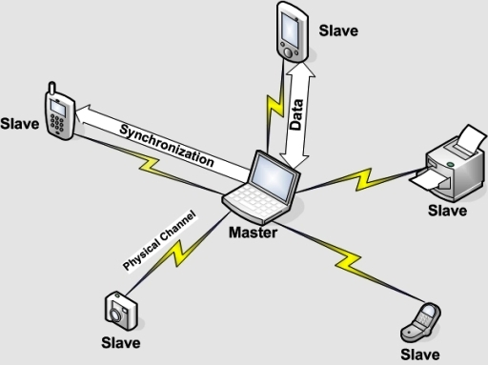
External Devices
What are external devices?
Three categories:
Human readable
Machine readable
Communication

Slide 3
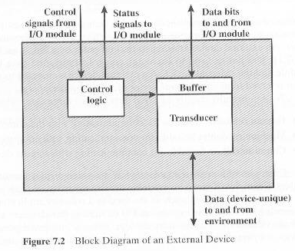
Keyboard/Monitor
The International Reference Alphabet (IRA)
IRA Control Characters
Disk Drive

Slide 4
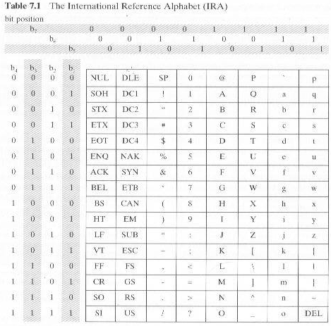

Slide 5
I/O Module Function
Control & Timing
CPU Communication
Device Communication
Data Buffering
Error Detection

Slide 6
I/O Steps
CPU checks I/O module device status
I/O module returns status
If ready, CPU requests data transfer
I/O module gets data from device
I/O module transfers data to CPU
Variations for output, DMA, etc.

Slide 7
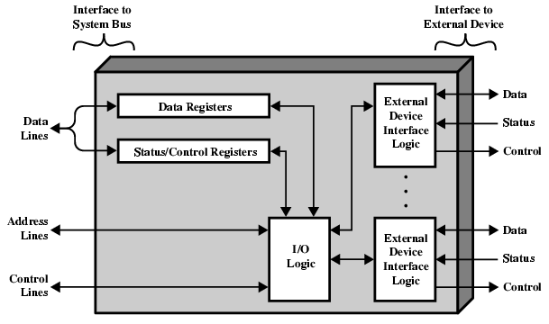
I/O Module Diagram

Slide 8
I/O Module Decisions
Hide or reveal device properties to CPU
Support multiple or single device
Control device functions or leave for CPU
Also O/S decisions
e.g. Unix treats everything it can as a file

Slide 9
Input Output Techniques
Programmed
Interrupt driven
Direct Memory Access (DMA)

Slide 10
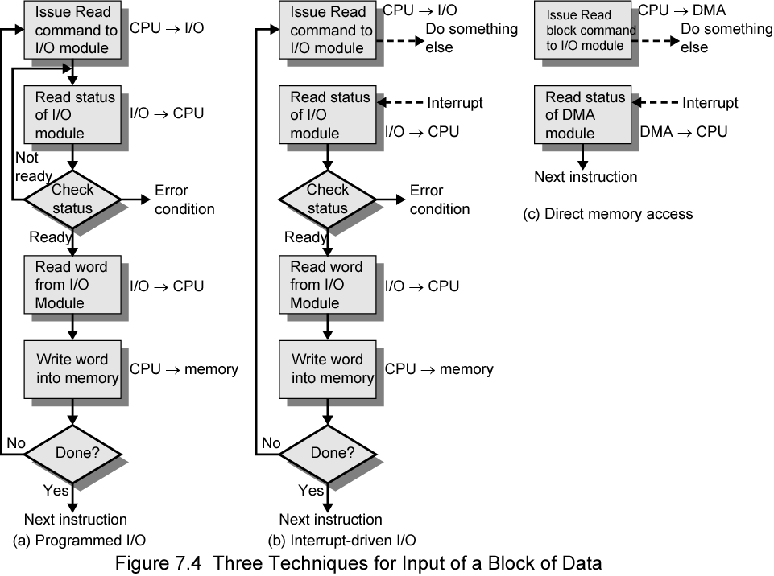
Three Techniques for Input of a Block of Data

Slide 11
I/O Commands
CPU issues address
Identifies module
CPU issues command
Control - telling module what to do
e.g. spin up disk
Test - check status
e.g. power? Error?
Read/Write
Module transfers data via buffer from/to device

Slide 12
I/O Commands
CPU issues address
Identifies module (& device if >1 per module)
CPU issues command
Control - telling module what to do
e.g. spin up disk
Test - check status
e.g. power? Error?
Read/Write
Module transfers data via buffer from/to device

Slide 13
Addressing I/O Devices
Under programmed I/O data transfer is very like memory access (CPU viewpoint)
Each device given unique identifier
CPU commands contain identifier (address)

Slide 14
I/O Mapping
Memory mapped I/O
Devices and memory share an address space
I/O looks just like memory read/write
No special commands for I/O
Large selection of memory access commands available
Isolated I/O
Separate address spaces
Need I/O or memory select lines
Special commands for I/O
Limited set

Slide 15
Memory Mapped and Isolated I/O

Slide 16
Interrupt Driven I/O
Overcomes CPU waiting
No repeated CPU checking of device
I/O module interrupts when ready

Slide 17
Interrupt Driven I/O Basic Operation
CPU issues read command
I/O module gets data from peripheral whilst CPU does other work
I/O module interrupts CPU
CPU requests data
I/O module transfers data

Slide 18
Simple Interrupt Processing

Slide 19
Changes in Memory and Registers for an Interrupt

Slide 20
Design Issues
How do you identify the module issuing the interrupt?
How do you deal with multiple interrupts?
i.e. an interrupt handler being interrupted

Slide 21
82C59A Interrupt Controller

Slide 22
Intel 82C55A Programmable Peripheral Interface

Slide 23
INTEL 82C59A INTERRUPT CONTROLLER
To allow the 80386 to handle a variety of devices, it is usually configured with and external interrupt arbiter. The 82C59A
External devices are connected to the 82C59A which in turn is connected to the 80386
A single 82C59 A can handle up to eight modules, if control for more than eight modules is required a cascade arrangement can be used

Slide 24
The 82C59A is responsible for the management of the interrupts
The 82C59A is programmable
The 80836 determines the priority scheme to be used by setting a control word in the 82C59A
Interrupt modes:
Fully nested: the interrupt requests are ordered from 0 (IR0) through 7 (IR7)
Rotating: In some applications a number of interrupts devices are of equal priority. In this mode a device, after being serviced, receives the lowest priority in the group
Special mask: this allows the processor to inhibit interrupts from certain devices

Slide 25
ITNEL 82C55A PROGRAMMABLE PERIPHERAL INTERFACE
The 82C55A is a single-chip general-purpose I/O module designed for use with the Intel 80386 processor
The 24 I/O lines are programmable by the 80386 by means of the control register
The 24 lines are divided in three 8-bit groups (A, B, C)

Slide 26
Each group can function as an 8 bit port, in addition group C is subdivided into 4 bit groups.
THE 82C55A includes an 8 bits bidirectional data bus (D0 through D7) used to transfer data to and from the I/O ports
The reset line is used to initialized the module
The control register is loaded by the processor to control the mode of operation and to define signals
Control signals serve two principal purposes handshaking and interrupt request. Handshaking is a simple timing mechanism

Slide 27
Because the 82C55A is programmable via the control register, it can be used to control a variety of simple peripheral devices
The keyboard provides 8 bits of input
Two of these bits SHIFT and CONTROL have special meaning to the keyboard handing program executing in the processor
The display is also linked by an 8 bit data port and again two lines have special meanings to the display.

Slide 28
Direct Memory Access
Interrupt driven and programmed I/O require active CPU intervention
Transfer rate is limited
CPU is tied up
DMA is the answer

Slide 29
DMA Function
Additional Module (hardware) on bus
DMA controller takes over from CPU for I/O

Slide 30
Typical DMA Module Diagram

Slide 31
DMA Operation
CPU tells DMA controller:-
Read/Write
Device address
Starting address of memory block for data
Amount of data to be transferred
CPU carries on with other work
DMA controller deals with transfer
DMA controller sends interrupt when finished

Slide 32
DMA Transfer Cycle Stealing
DMA controller takes over bus for a cycle
Transfer of one word of data
Not an interrupt
CPU does not switch context
CPU suspended just before it accesses bus
i.e. before an operand or data fetch or a data write
Slows down CPU but not as much as CPU doing transfer

Slide 33
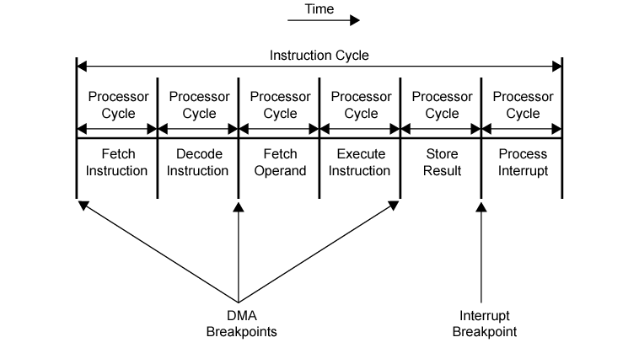
DMA and Interrupt Breakpoints During an Instruction Cycle

Slide 34
DMA Configurations (1)
Single Bus, Detached DMA controller
Each transfer uses bus twice
I/O to DMA then DMA to memory
CPU is suspended twice

Slide 35
DMA Configurations (2)
Single Bus, Integrated DMA controller
Controller may support >1 device
Each transfer uses bus once
DMA to memory
CPU is suspended once

Slide 36
DMA Configurations (3)
Separate I/O Bus
Bus supports all DMA enabled devices
Each transfer uses bus once
DMA to memory
CPU is suspended once

Slide 37
Intel 8237A DMA Controller
Interfaces to 80x86 family and DRAM
When DMA module needs buses it sends HOLD signal to processor
CPU responds HLDA (hold acknowledge)
DMA module can use buses
E.g. transfer data from memory to disk
Device requests service of DMA by pulling DREQ (DMA request) high
DMA puts high on HRQ (hold request),
CPU finishes present bus cycle (not necessarily present instruction) and puts high on HDLA (hold acknowledge). HOLD remains active for duration of DMA
DMA activates DACK (DMA acknowledge), telling device to start transfer
DMA starts transfer by putting address of first byte on address bus and activating MEMR; it then activates IOW to write to peripheral. DMA decrements counter and increments address pointer. Repeat until count reaches zero
DMA deactivates HRQ, giving bus back to CPU

Slide 38
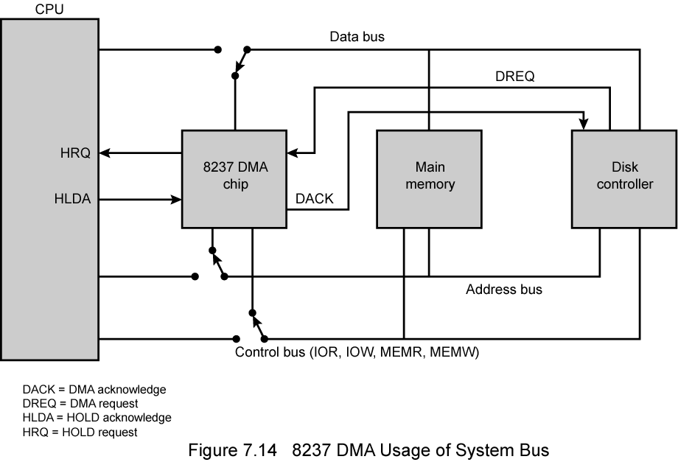
8237 DMA Usage of Systems Bus

Slide 39
Fly-By
While DMA using buses processor idle
Processor using bus, DMA idle
Known as fly-by DMA controller
Data does not pass through and is not stored in DMA chip
DMA only between I/O port and memory
Not between two I/O ports or two memory locations
Can do memory to memory via register
8237 contains four DMA channels
Programmed independently
Any one active
Numbered 0, 1, 2, and 3

Slide 40
Review Questions
What are the two main I/O addressing modes?
Memory Mapped and Isolated
What is one advantage of Memory Mapped I/O? Isolated I/O?
Memory Mapped I/O allows for a larger instruction set; no memory space used for I/O devices
Name and define the different categories of external devices.
Human Readable, Machine Readable, Communication Devices
What are the two main I/O addressing modes?
Memory Mapped and Isolated
What is one advantage of Memory Mapped I/O? Isolated I/O?
Memory Mapped I/O allows for a larger instruction set; no memory space used for I/O devices

Slide 41
Review Questions
What are 2 tasks the IO module performs?
Data buffering and Error detection
Status registers provide current status info and can also function as a _________?
Control register
How is the DMA able to use the same bus-lines as the CPU?
Steals the bus for a cycle
Where is the DMA located?
Additional hardware module located on bus
What are the 3 input/output techniques?
Programmed I/O, Interrupt Driven I/O, Direct Memory Access
How many types of I/O commands are there?
Four

