Slide 1
Glendale College Presentation
May 7, 2013

Slide 2
Some Personal History
Grew up in the San Fernando Valley
BS Degree in Engineering, 1978 (CSUN)
MS Degree in Engineering, 1985 (CSUN)
PhD in Mechanical Engineering, 1994 (UCLA)
Worked at Lockheed from 1979-1981
Faculty member at CSUN, 1981 – present
Currently an Associate Professor

Slide 3
Why Go to College?
There used to be a bumper sticker that said – “If you think education is expensive, try ignorance”
Consider unemployment rates for those with bachelor’s degrees and those without
Education is an investment in yourself that will pay dividends all through your life

Slide 4
Why Major in a STEM Field?
The world is rapidly changing as a result of technology – be a part of it
Your career will be less likely to move overseas
It’s interesting, fun, and rewarding

Slide 5
Why Major in Engineering?
Well, the physicists say that:
If you study engineering, you can do engineering
If you study physics, you can still do engineering, or
Explore the mysteries of the universe
Use lasers to develop new medical techniques
Become an international rap sensation
Help solve the world’s energy problems
They’re entitled to their opinions!

Slide 6
Components of an Engineering Program
Basic Math and Science (Physics and Chemistry)
Engineering Science (Dynamics, Thermodynamics, Electronics, Materials, etc.)
Design Methodology and Application to Projects (especially Capstone Project)
Use of Modern Computational Tools (CAD, FEA, Matlab, LabVIEW, CAM, etc.)
Engineering Economics
Engineering Application Courses

Slide 7
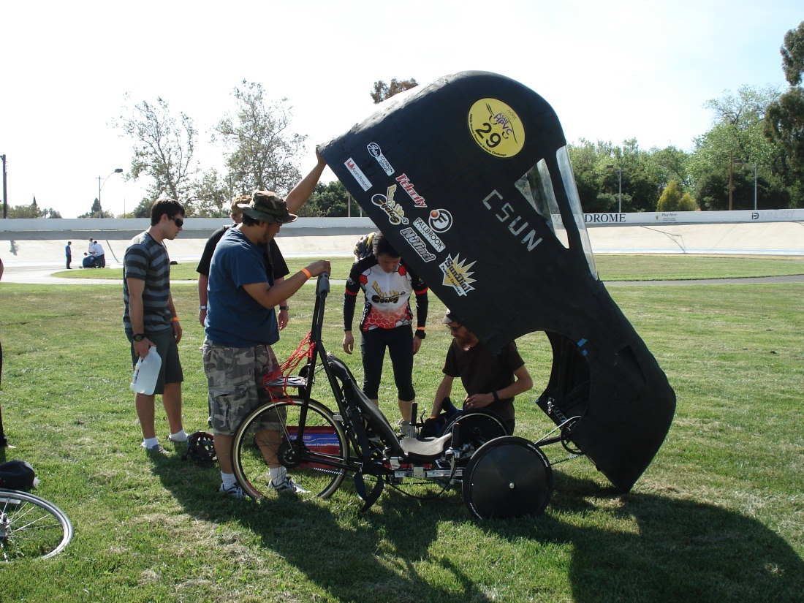
HPV – A Capstone ME Project
Design a Vehicle According to Competition Specifications, Using Appropriate Methodology
Implement the Design by Building It
Compete Against Other Universities

Slide 8
HPV – A Capstone ME Project
Design a Vehicle According to Competition Specifications, Using Appropriate Methodology
Implement the Design by Building It
Compete Against Other Universities

Slide 9
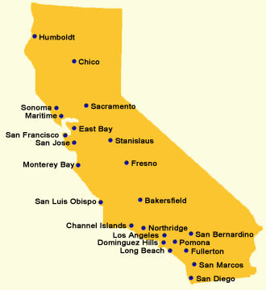
Human Powered Vehicle Challenge (HPVC)
ASME's international Human Powered Vehicle Challenge (HPVC) provides an opportunity for students to demonstrate the application of sound engineering design principles in the development of sustainable and practical transportation alternatives.
In the HPVC, the students worked collectively as a team to design and build an efficient, highly engineered vehicle for everyday use.

Slide 10
Human Powered Vehicle Challenge (HPVC)
Competition Event
Maximum Points
Design Event
30 points
Design Event
30
26.2 ft.
15.5 mph
Male
12.5
19.7 ft.
Speed Event
Female
12.5
Speed Event
Female/Male 12.5 points (each)
Innovation Event
20
Endurance Event
25
400-600 meters
100 meters
200 meters
TOTAL 100
Innovation Event
20 points
Capability, Usability, Safety, Innovation, Effectiveness
Endurance Event
25 points
Demonstrate the functionality, agility, and durability of the vehicle
1.5 km

Slide 11
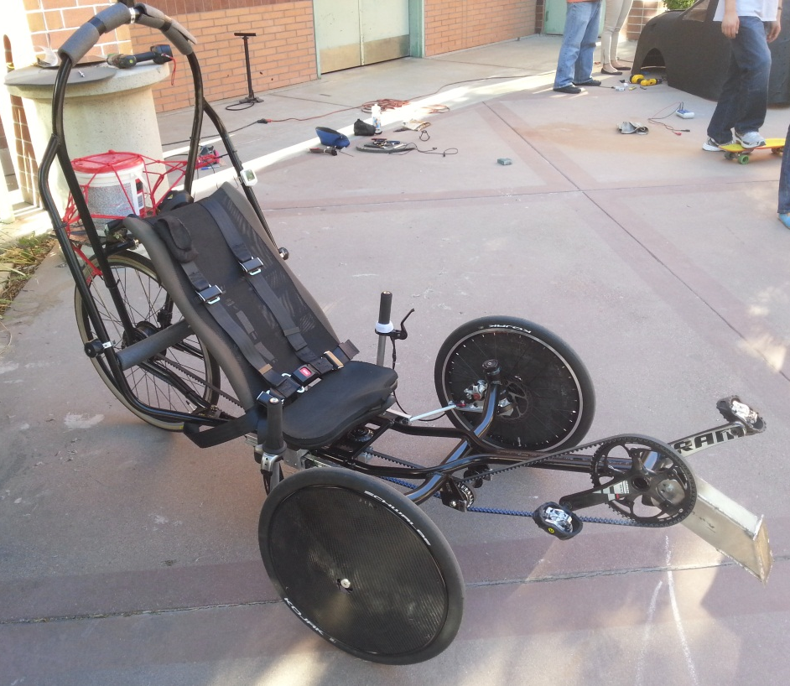
Design Objectives
CSUN HPVC Overall Ranking
2012: 14th Place
2013: 9th Place
Vehicle
Practical
Easy to drive
Comfortable
Well Ventilated
Good Visibility
Lightweight
Aerodynamic

Slide 12
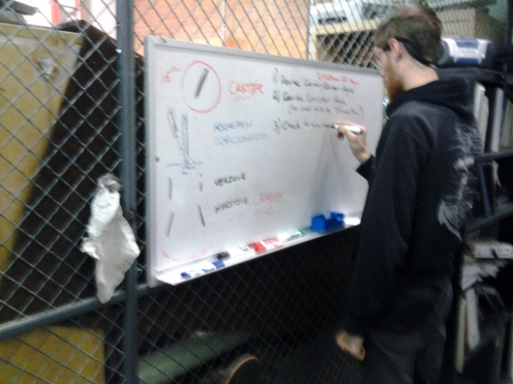
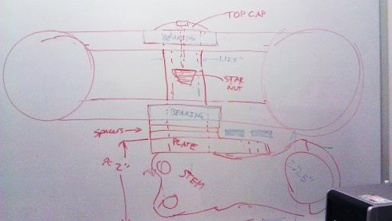
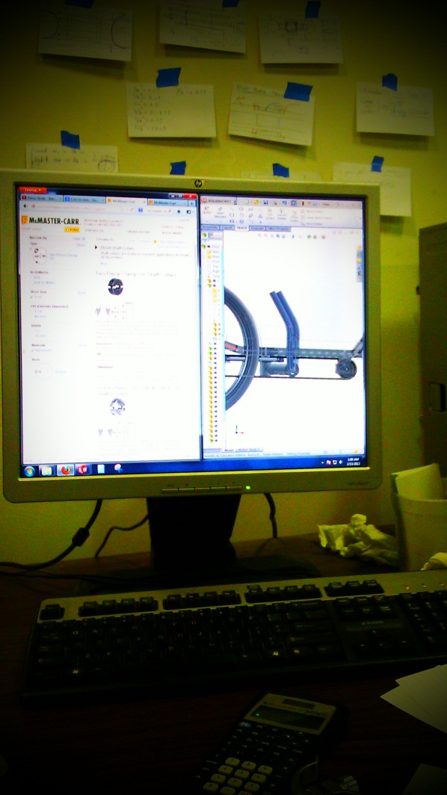
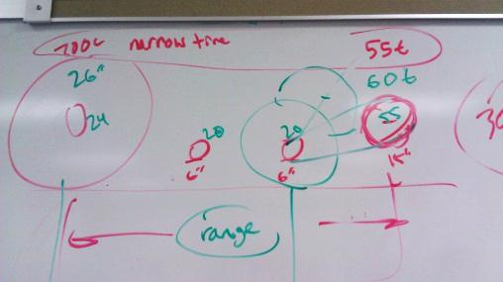
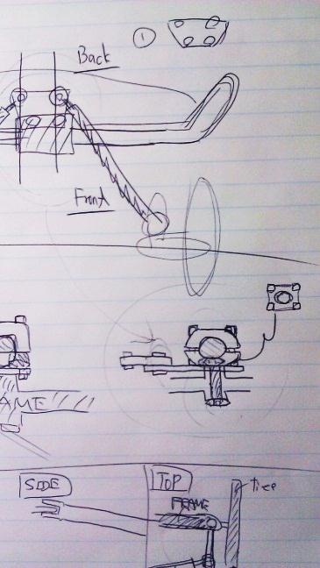
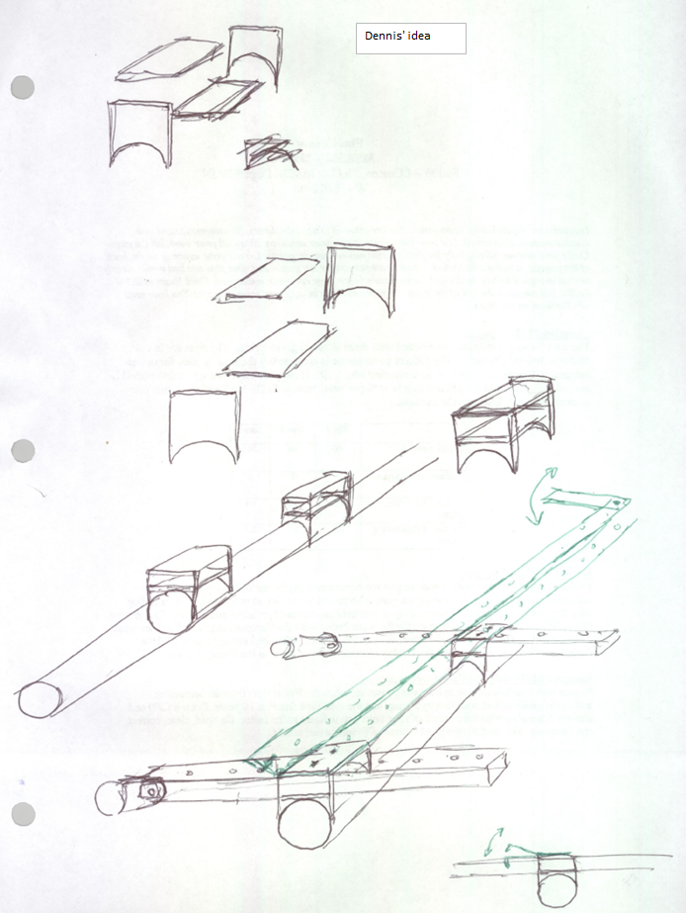
Designing

Slide 13
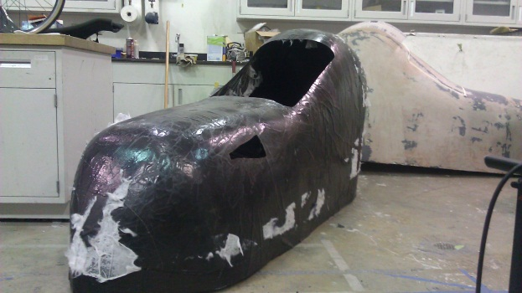
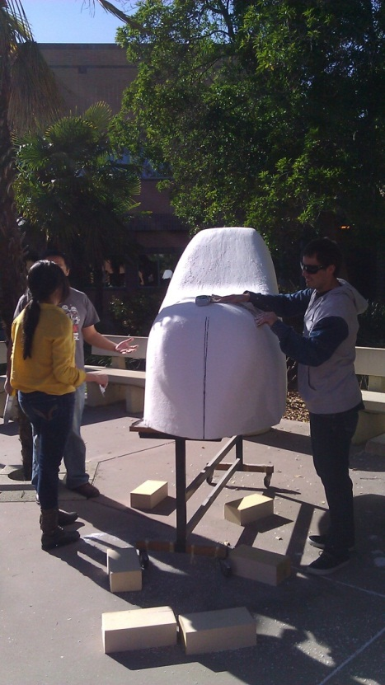
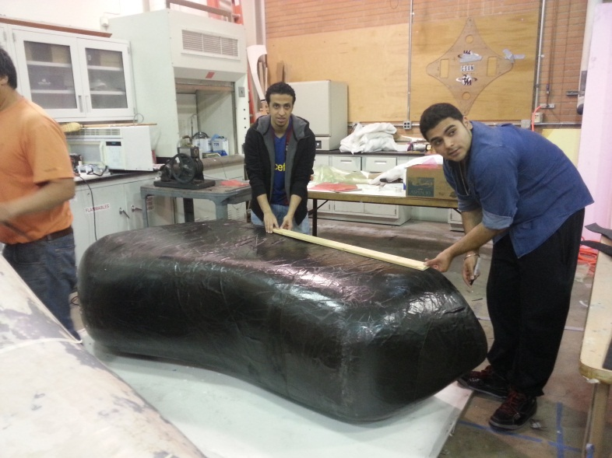
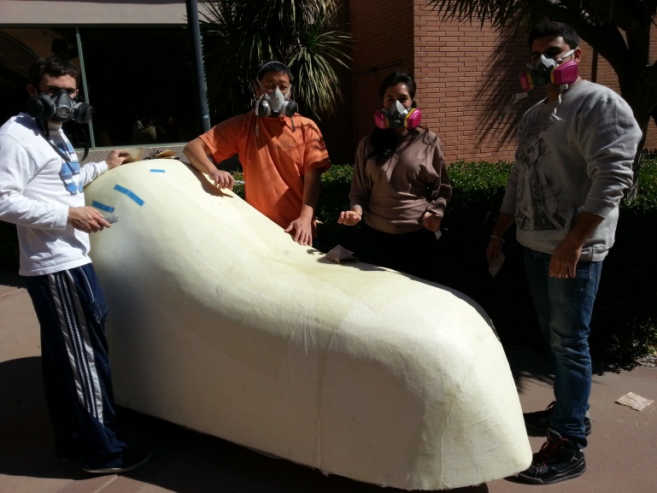
Fabrication
Styrofoam male mold
Fiberglass mold surface
5.4 oz, 2k weave carbon fiber (2 layers)
High density zotefoam
3D printed ABS plastic ducts
Lexan windows

Slide 14
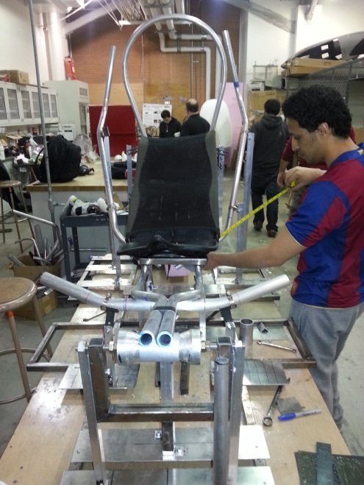
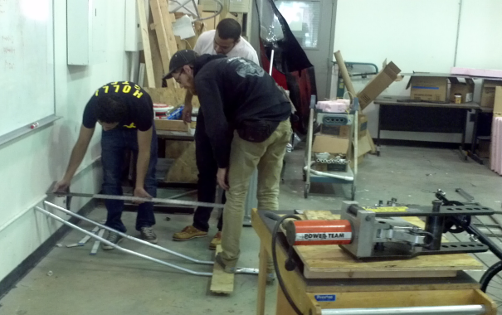
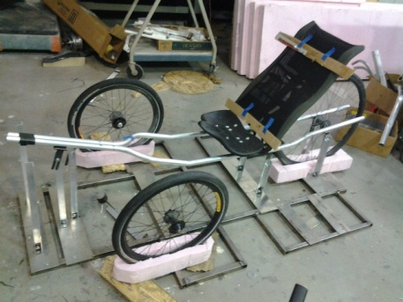
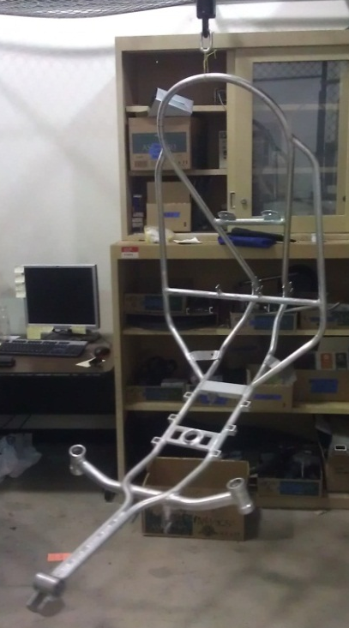
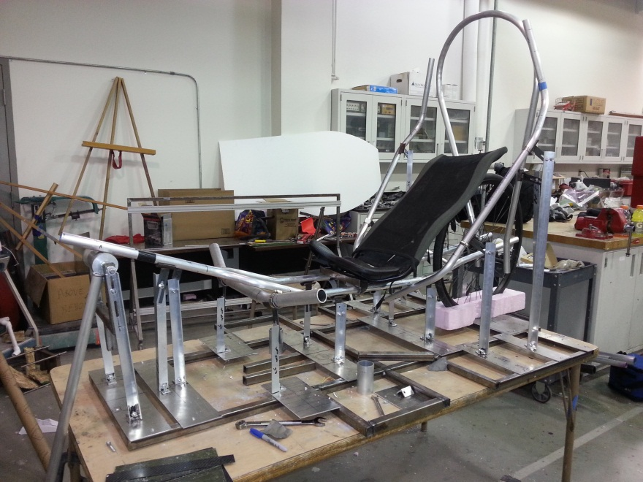
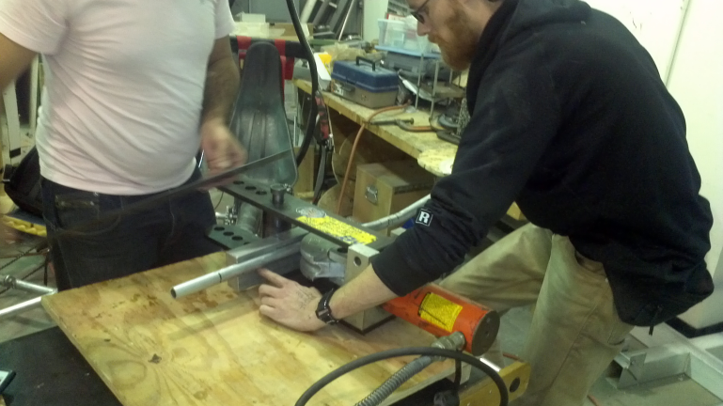
Fabrication
6061 Al tubing
Pneumatic tube bending
TIG Welded
Press-Fit Bearings
Powder Coated

Slide 15
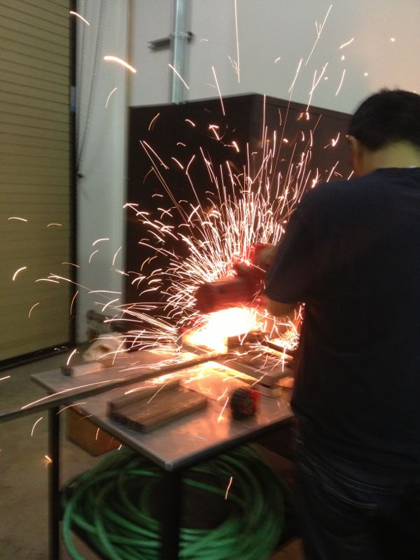
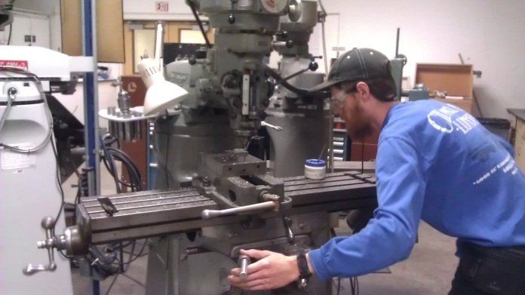
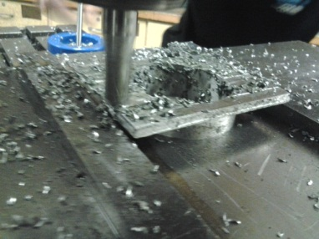
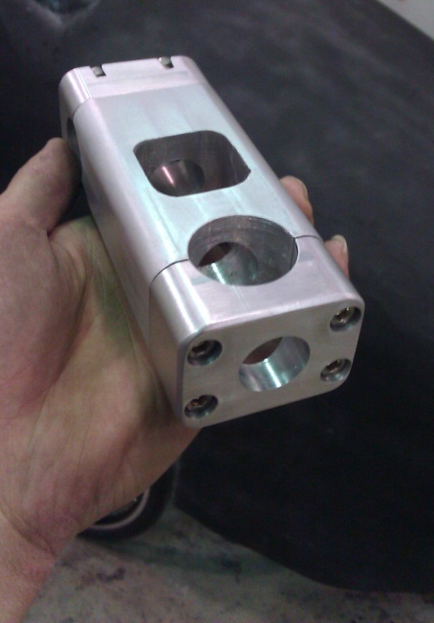
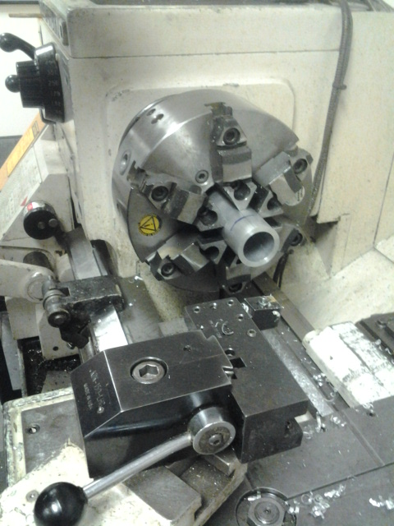
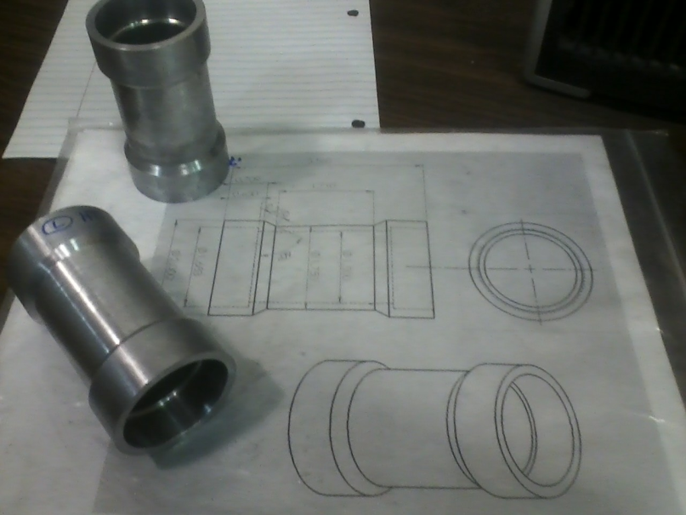
Fabrication
Vertical Mill
Lathe
Band Saw
Drill Press
CNC

Slide 16
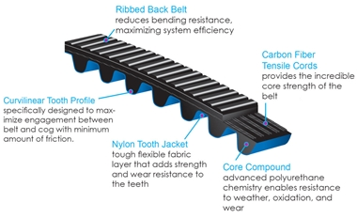
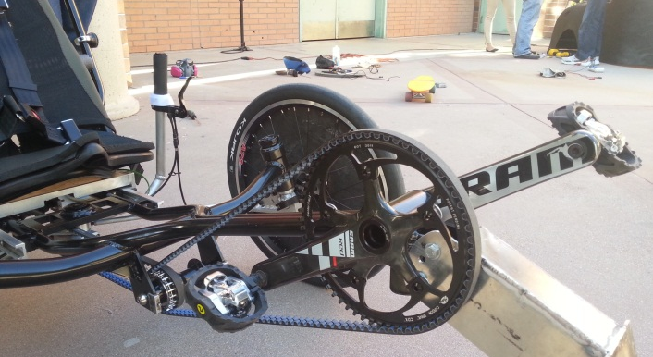
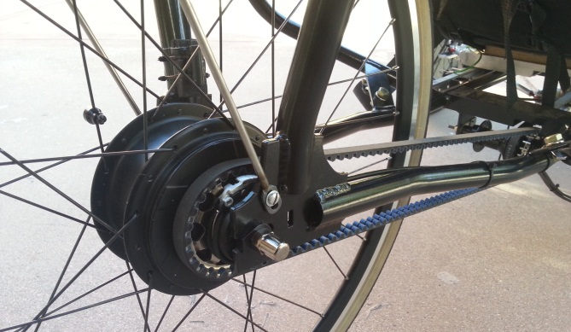
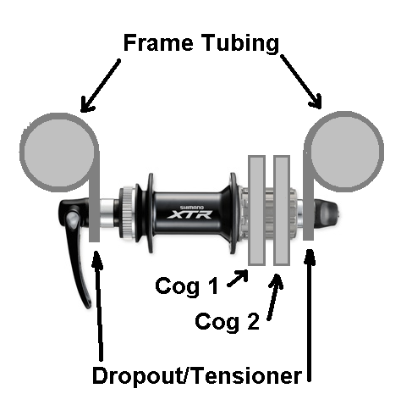
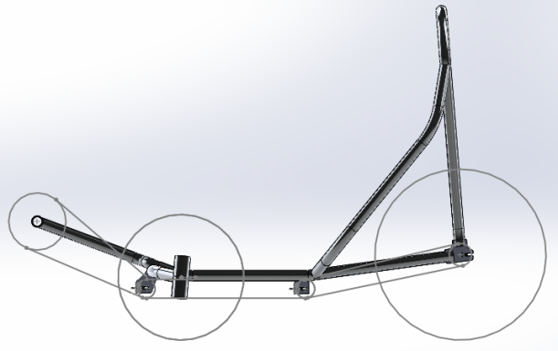
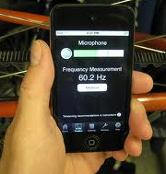
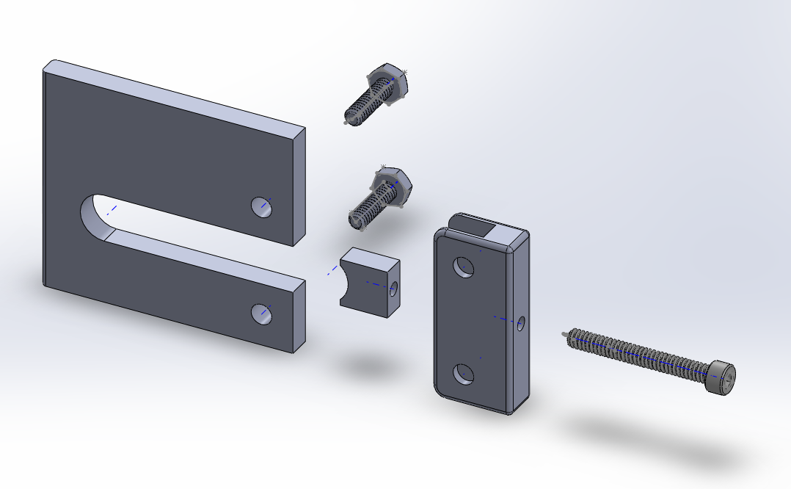
Drive System Gates Carbon Belt Drive
Belt versus chain
Innovative drive system
Belt tension
Frame compatibility
Requires Internal Gear Hub (IGH)

Slide 17
PROJECT RESULTS
Design objectives were met and overall project was a success!
Results
Speed | 10th/28
Design | 7th/28
Innovation | 8th/28
Endurance | 18th/28
Overall | 9th/28
Recommendations
Increase frame stiffness
Improve alignment of belt pulleys
Time management
Mold preparation

Slide 18
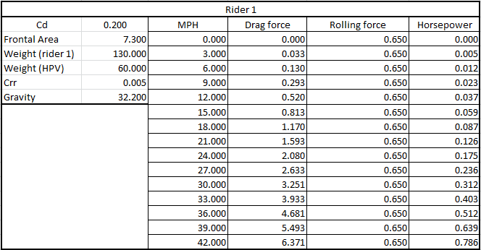
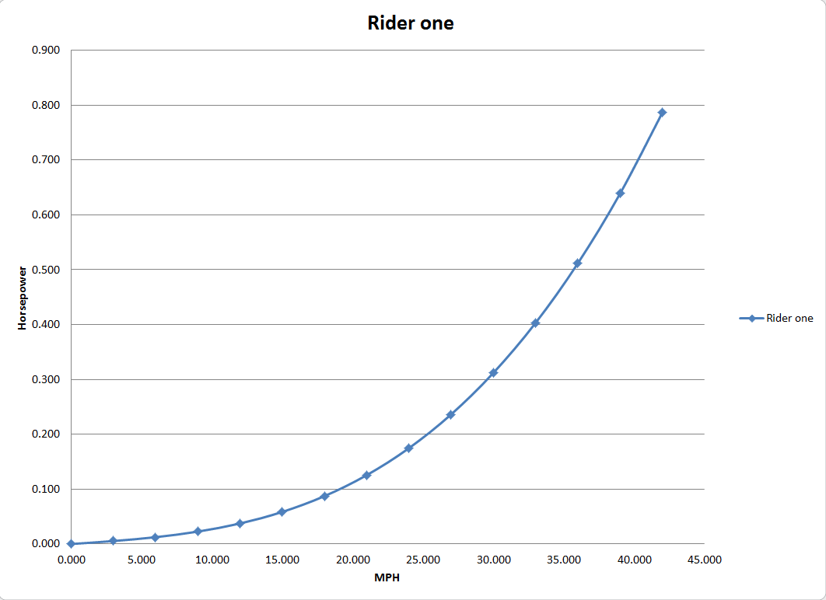
Power and Velocity (Rider 1)

Slide 19
How Do We Estimate Drag?
Use Numerical Simulation
Test Models in a Wind Tunnel
Measure Drag in Road Tests

Slide 20
Numerical Simulation
FULL
PARTIAL

Slide 21
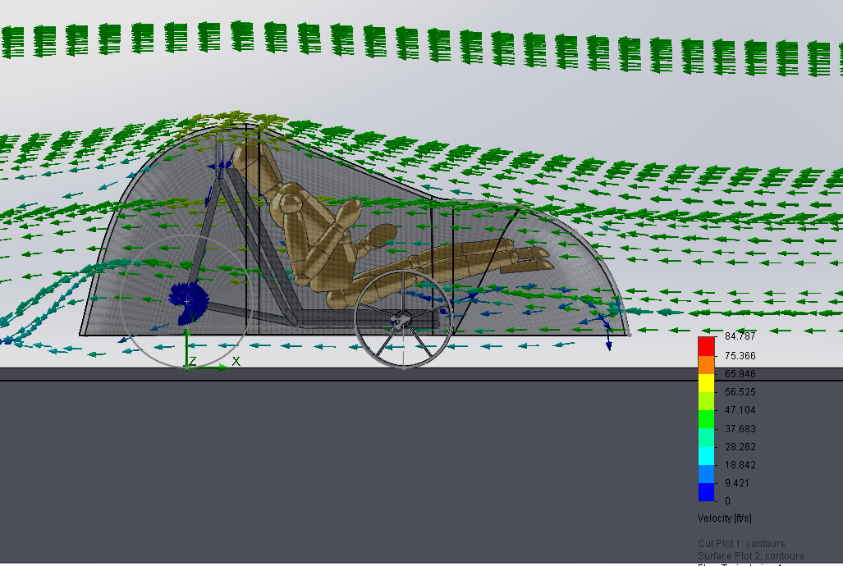
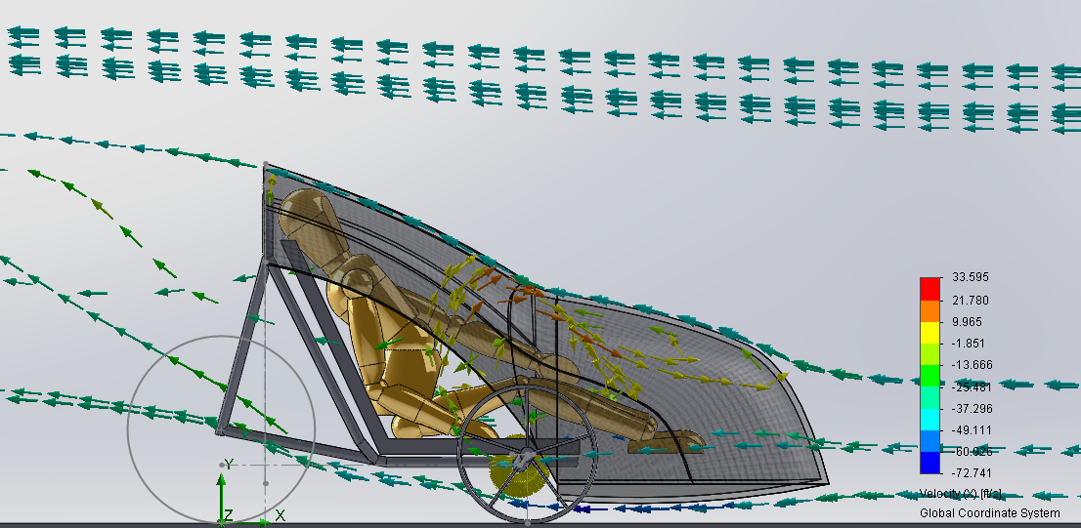
Simulation Results
FULL
PARTIAL

Slide 22
Numerical Simulation – Pros and Cons
Easy to change geometry and evaluate flow patterns and drag on different shapes
Accuracy depends on the “mesh” which the program creates in the computational domain
There are limitations in the mathematical model used to simulate the flow which also affect accuracy

Slide 23
Wind Tunnel Tests – Pros and Cons
Need to manufacture scale models which will fit in tunnel
Difficult to simulate “ground effect”
Need to consider “scaling effect”
The last two factors introduce error and uncertainty in result
We hope to perform some tests this summer

Slide 24
Road Tests – Pros and Cons
There are two types of tests – Coast Down and Steady State
Steady State requires more instrumentation (e.g. Power Tap hub)
Should be the most accurate, since the test is on the real vehicle in actual use
The vehicle must be completed well before the competition in order to have testing time
We hope to perform these tests this summer

Slide 25
Other Designs

Slide 26
Other Designs

Slide 27
Other Designs

Slide 28
Other Designs

Slide 29
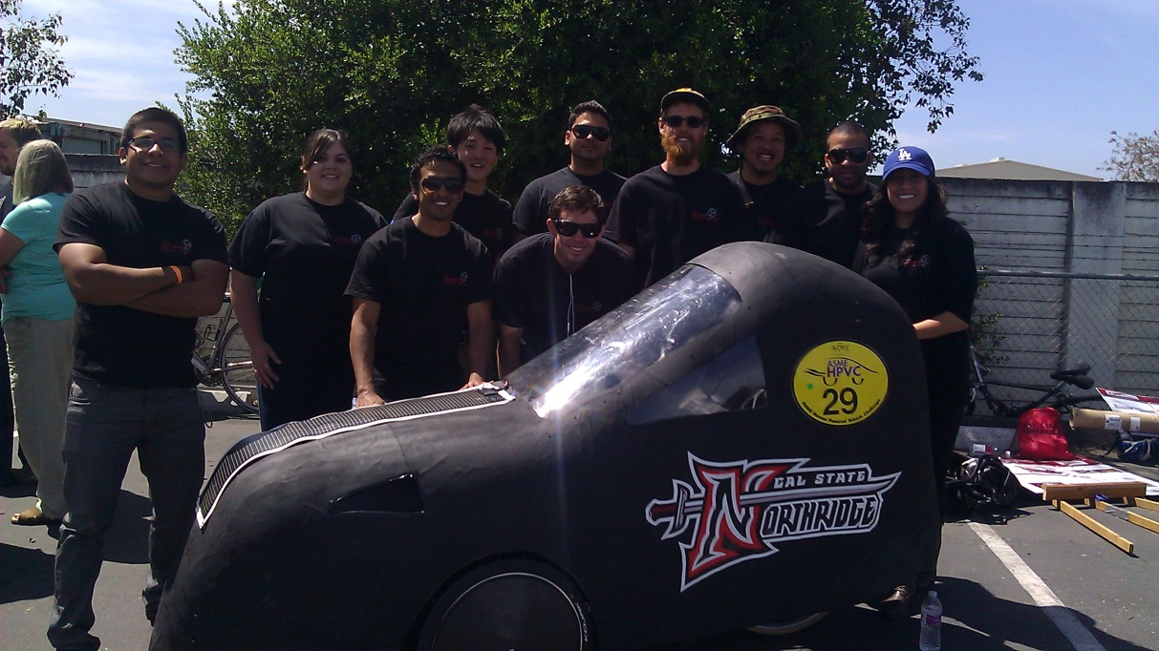
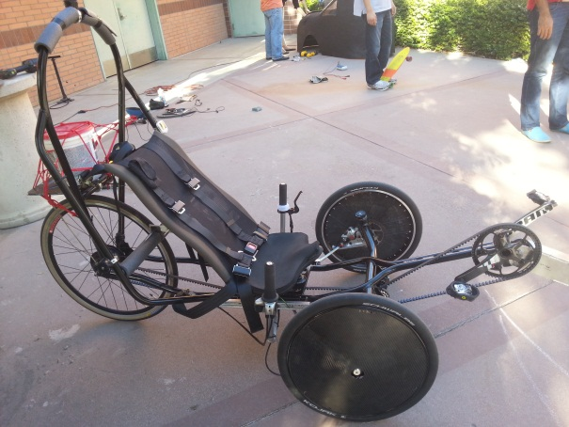
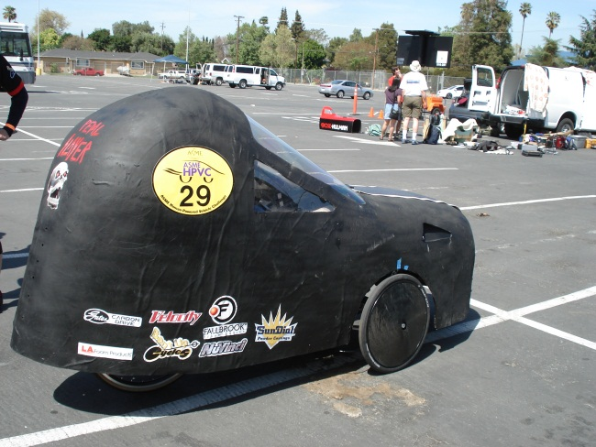
Questions?

